Slide 1
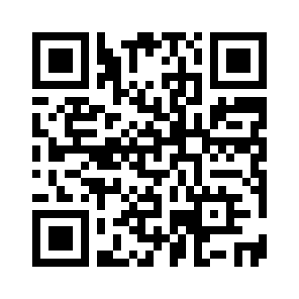
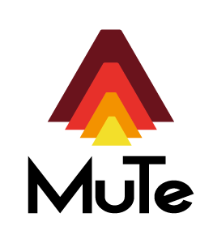
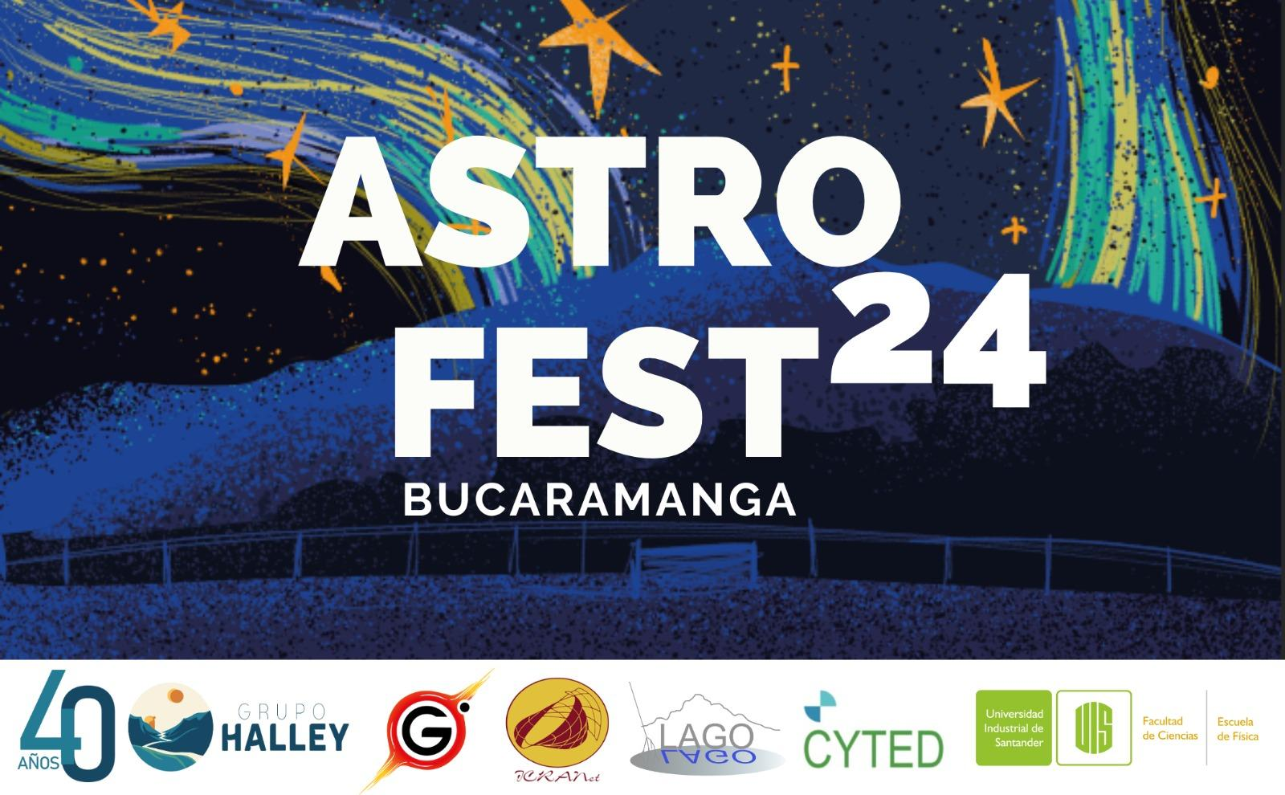
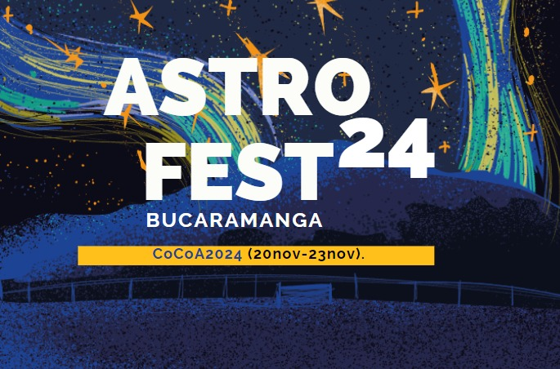
Astrogeophysics in Volcán Cerro Machín: a social experience
José D. Sanabria –Gómez for the MuTe Collaboration
Escuela de Física, Universidad Industrial de Santander
Bucaramanga Colombia
https://halley.uis.edu.co/fuego/en/

Slide 2
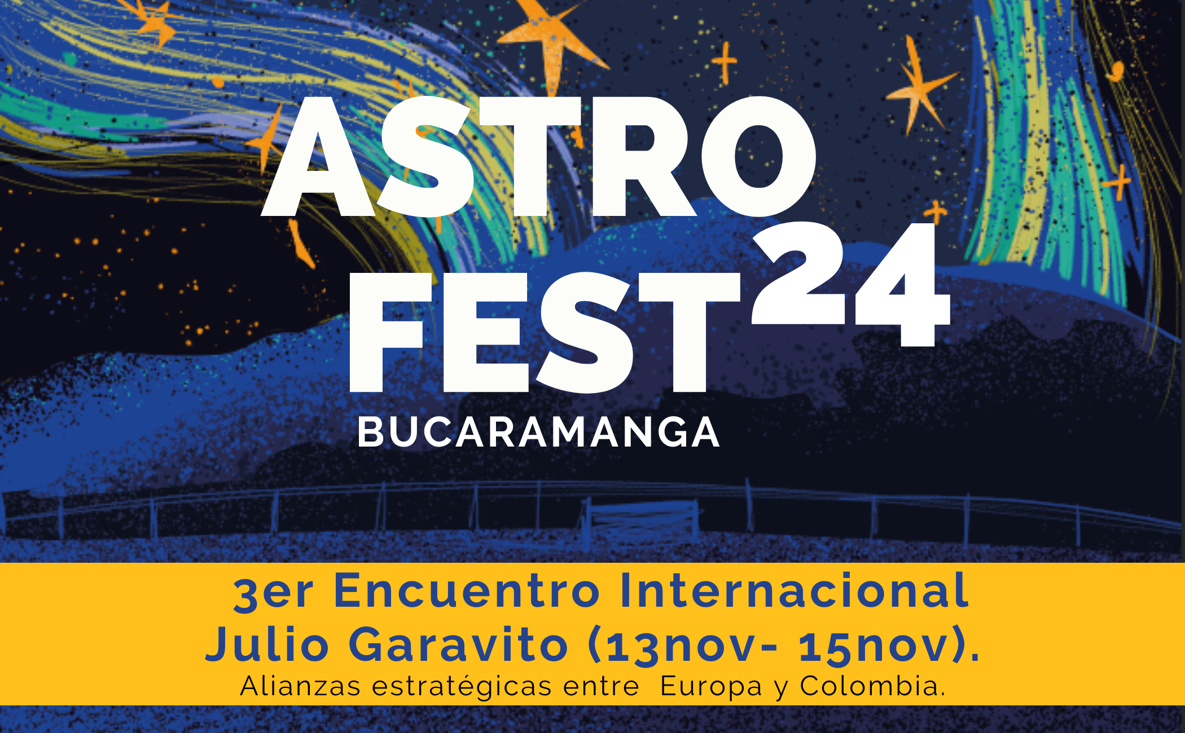
Astrogeophysics in Volcán Cerro Machín: a social experience
Research team
Physicists, Geophysicists, Geologists, Engineers,
Social workes, Education reasearchers.
Departments of Physics, Geology, Engineery, Social Work, Education.

Slide 3
Muon Telescope (MuTe) evolution from 1.0 to 2.0
Asorey, H., et al (2017). Astroparticle Techniques: Colombia active volcano candidates for Muon Telescope observation sites. Rev. Mex. Astron. Astrof. Ser. Conf. 49, 54, arXiv:1704.04967. Muon telescope (mute): A first study using geant4. In Revista Mexicana de Astronomia y Astrofisica Conference Series 49, 144
Moss, H., et al (2018). Muon tomography for the cerro machın volcano. Technical report, Department of Physics & Astronomy, University of Sheffield.
Asorey et al (2018). miniMuTe: A muon telescope prototype for studying volcanic structures with cosmic ray flux. Scientia et technica, 23, 386-391.
Asorey, H., et al (2018). Preliminary results from the latin american giant observatory space weather simulation chain. Space Weather, 16, 461-475.
2017 First Simulations Sites & Instrument
2018 HPC
MUSIC Site Simulations
2018 First hardware implementation
2018 First simulation chain implementation
Vesga-Ramírez, A., et al (2021). Simulated annealing for volcano muography. Journal of South American Earth Sciences, 109, 103248.
Vesga-Ramírez, A. et al (2020). Muon Tomography sites for Colombian volcanoes. ANNALS OF GEOPHYSICS, 63.
Peña-Rodríguez, J. et al (2020). Design and construction of MuTe: a hybrid muon telescope to study colombian volcanoes. J. Instrumentation, 15, P09006.
Vásquez-Ramírez, A.et al, (2020). Simulated response of MuTe, a hybrid Muon Telescope. J. Instrumentation, 15, P08004.
2021 optimization algorithm applied to Muography
2020 Full Colombia Muography site simulations
2020 Full Hardware implementation MuTE 1.0
2020 Full instrument simulation
Grisales-Casadiegos, et al. (2022). Impact of Global Data Assimilation System atmospheric models on astroparticle showers. Canadian Journal of Physics, 100, 152-157.
Sarmiento-Cano, C. et al (2022). The ARTI framework: cosmic rays atmospheric background simulations. The European Physical Journal C, 82, 1019.
Peña-Rodríguez, J. et al (2023). Characterization and On-Field Performance of the MuTe Silicon Photomultipliers. Instruments, 7, 7.
Peña-Rodríguez, J. et al (2024). MUYSC: an end-to-end muography simulation toolbox. Geophysical J. International, 237, 540.
2022 ARTI Full (first principle) simulation framework
2024 Full phenomenological simulation framework
MuTe 2.0
2022 modelling atmospheric
2023 Component on field performance

Slide 4
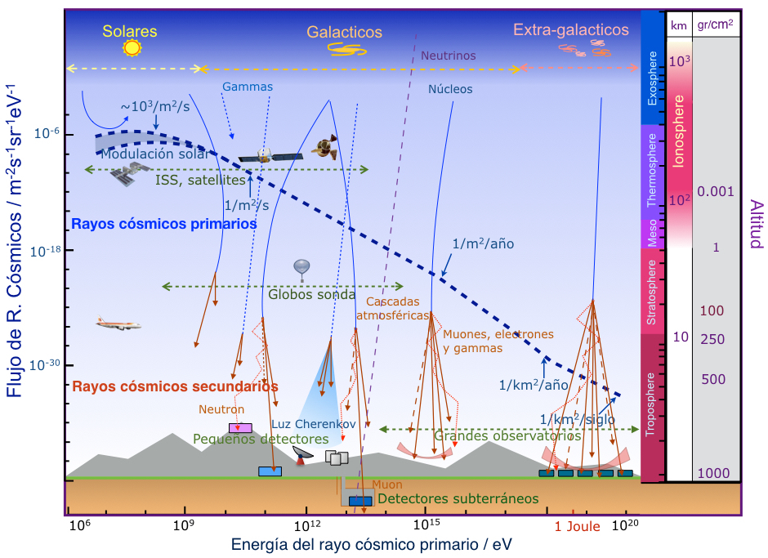
Los rayos cósmicos: una nueva ventana al universo
A. Ferriz Mas, Universidad de Vigo e IAA/CSIC y J. A. Garzón-Heydt, Universidad de Santiago de Compostela
http://revista.iaa.es/content/los-rayos-cósmicos-una-nueva-ventana-al-universo

Slide 5
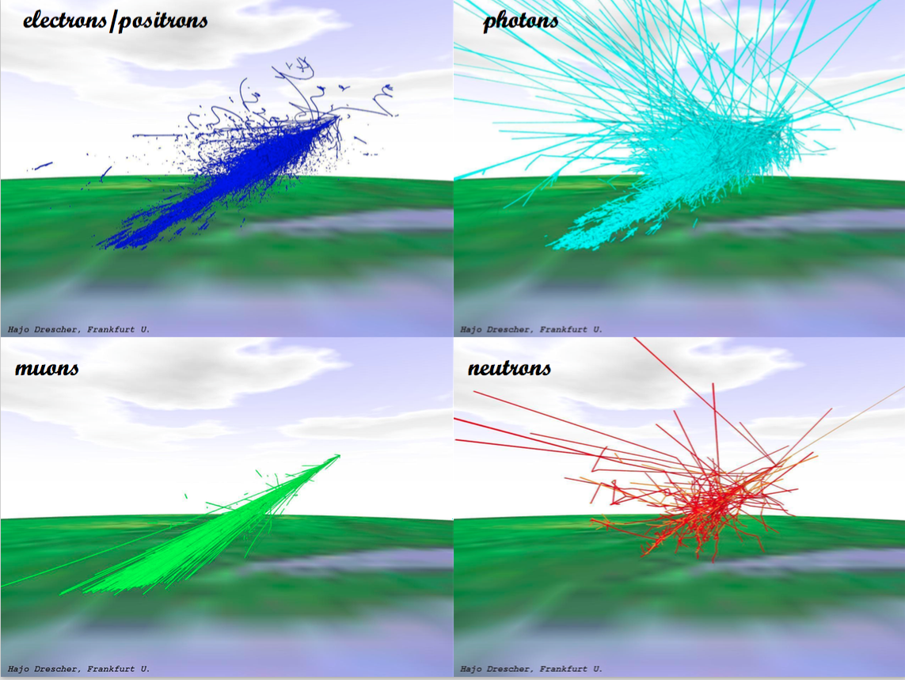

Slide 7
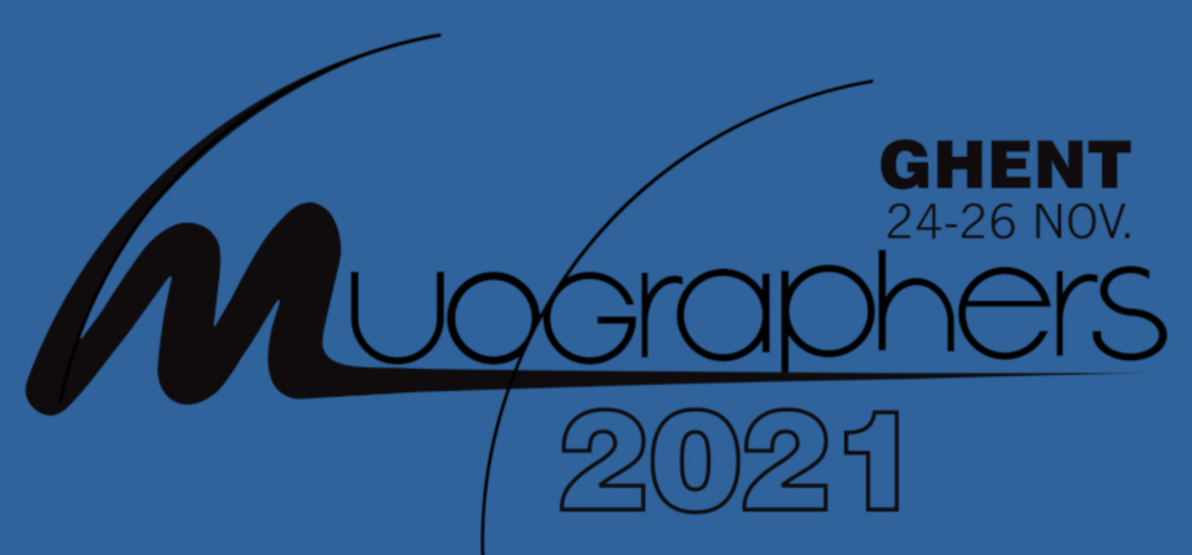
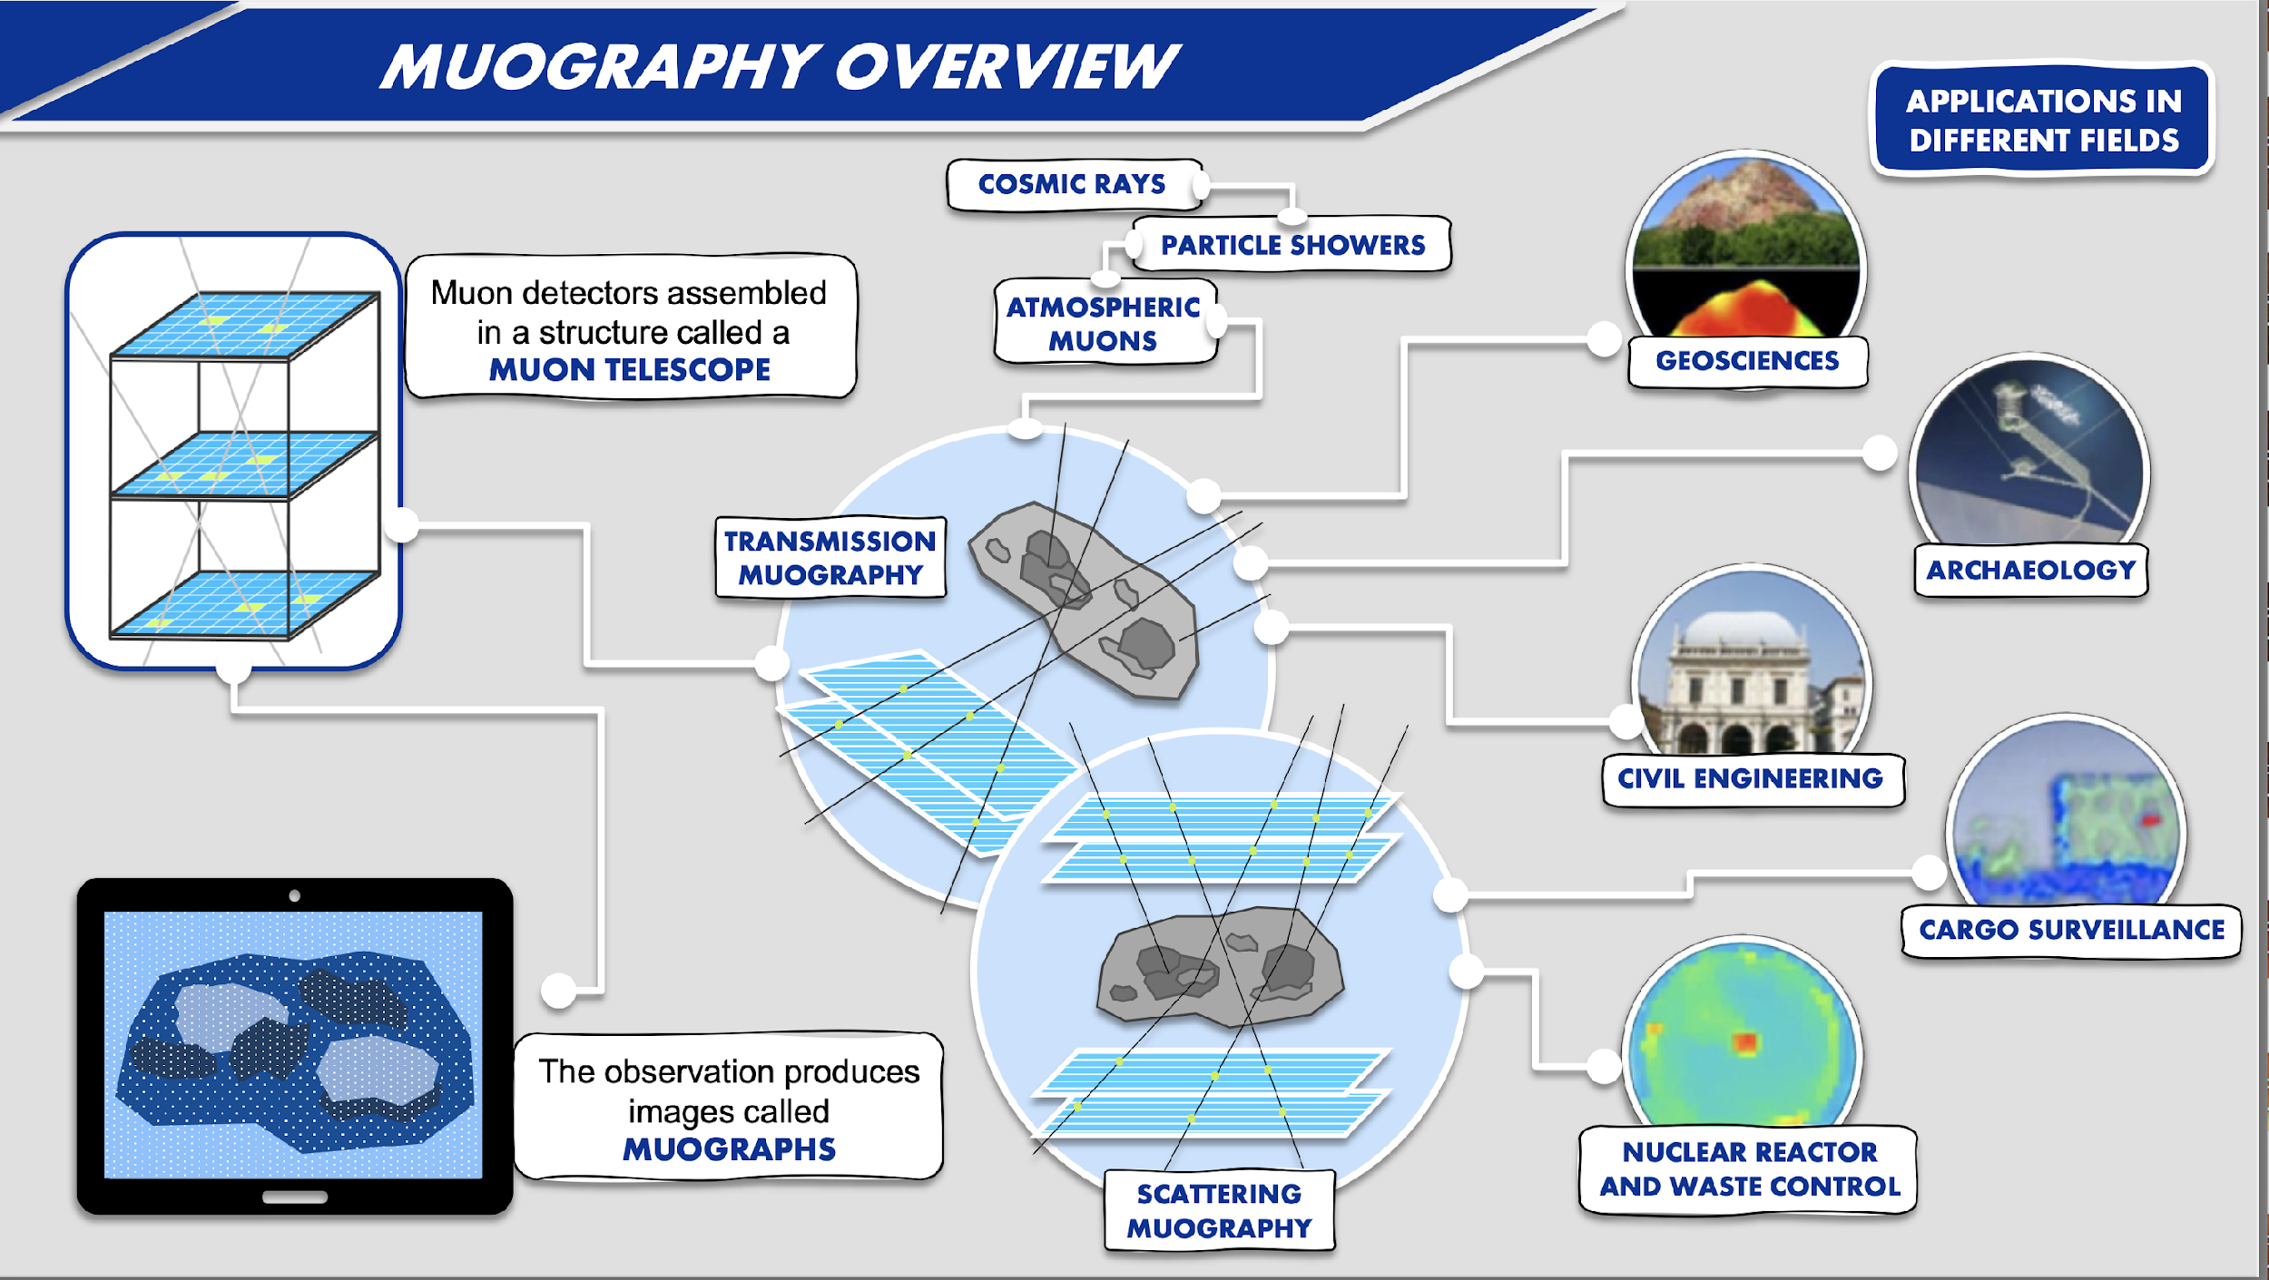
P. Teixeira et al International Workshop on Cosmic-Ray Muography (Muography2021)

Slide 8
Dezső Varga et al International Workshop on Cosmic-Ray Muography (Muography2021)

Slide 9
Dezső Varga et al International Workshop on Cosmic-Ray Muography (Muography2021)

Slide 10
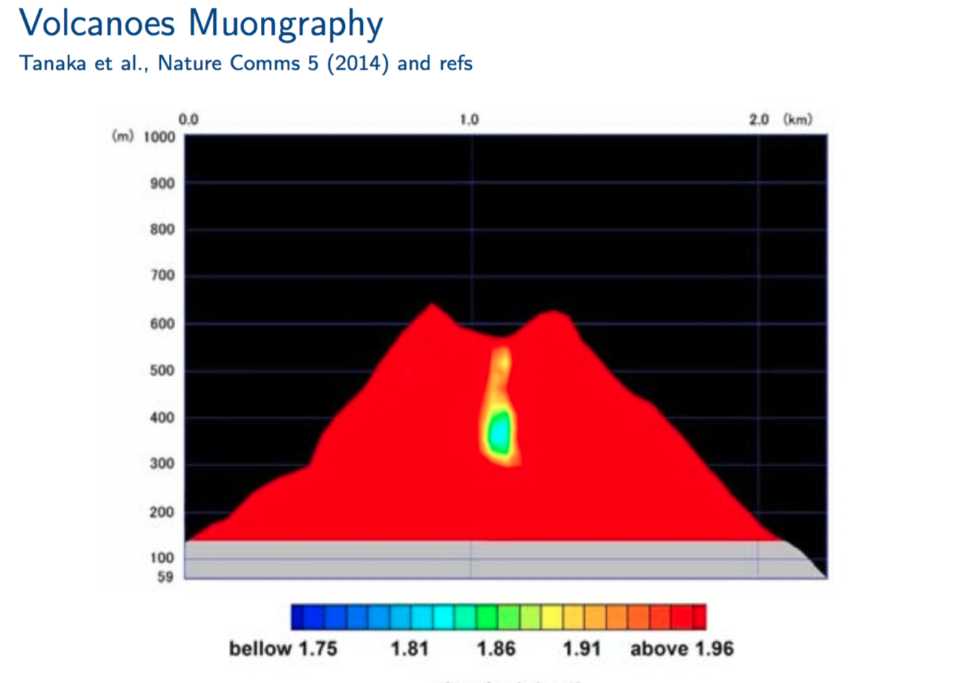

Slide 11
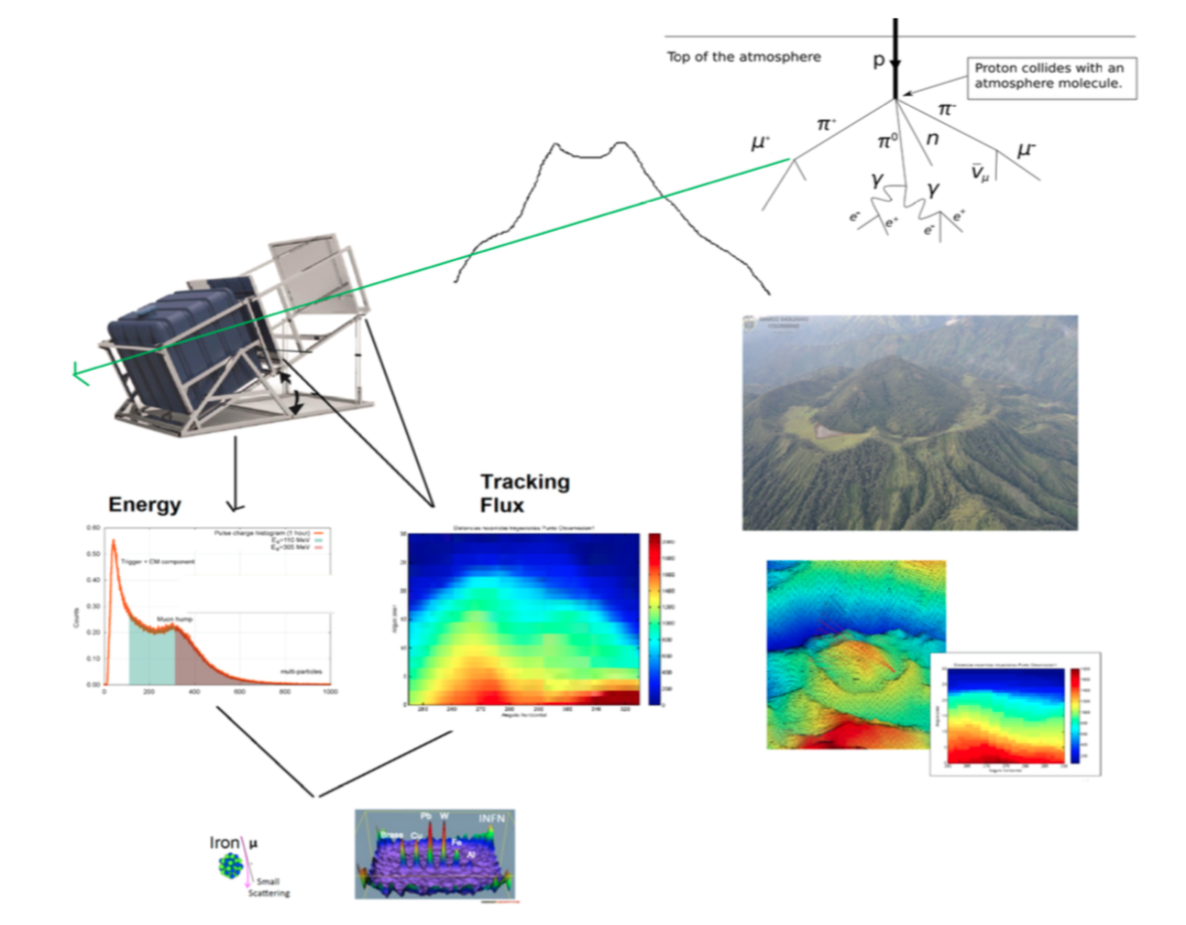

Slide 12
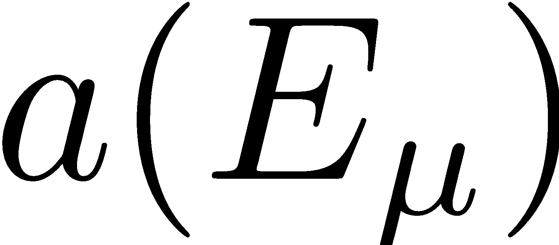
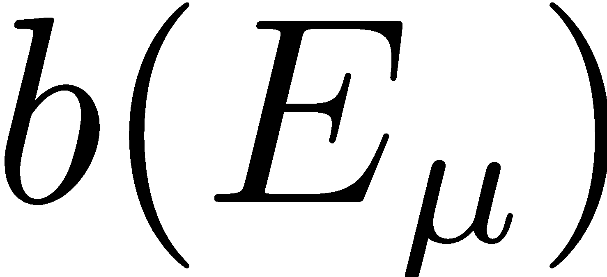
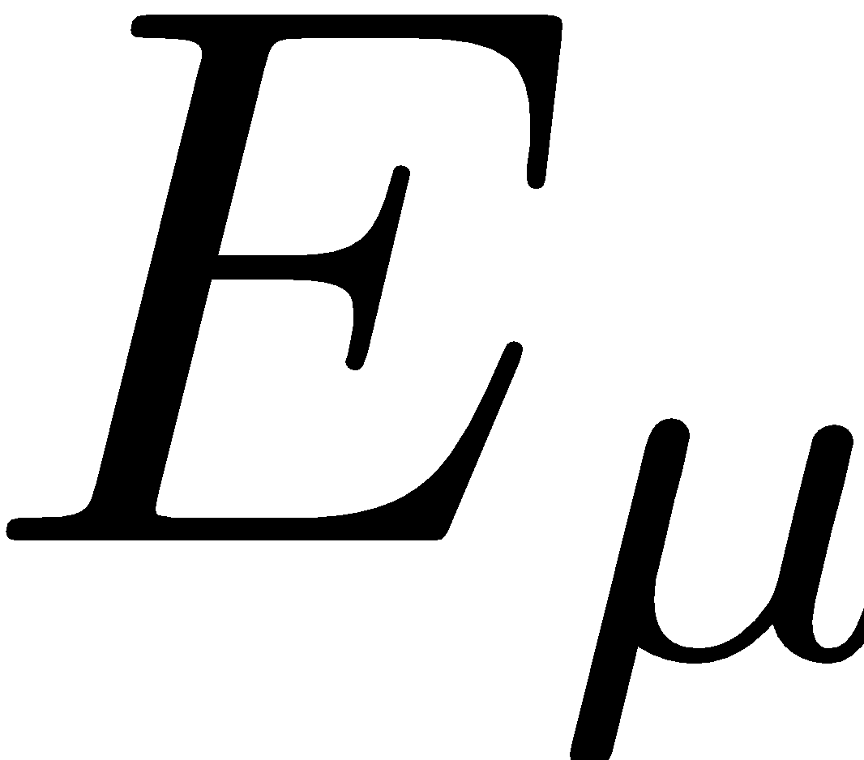
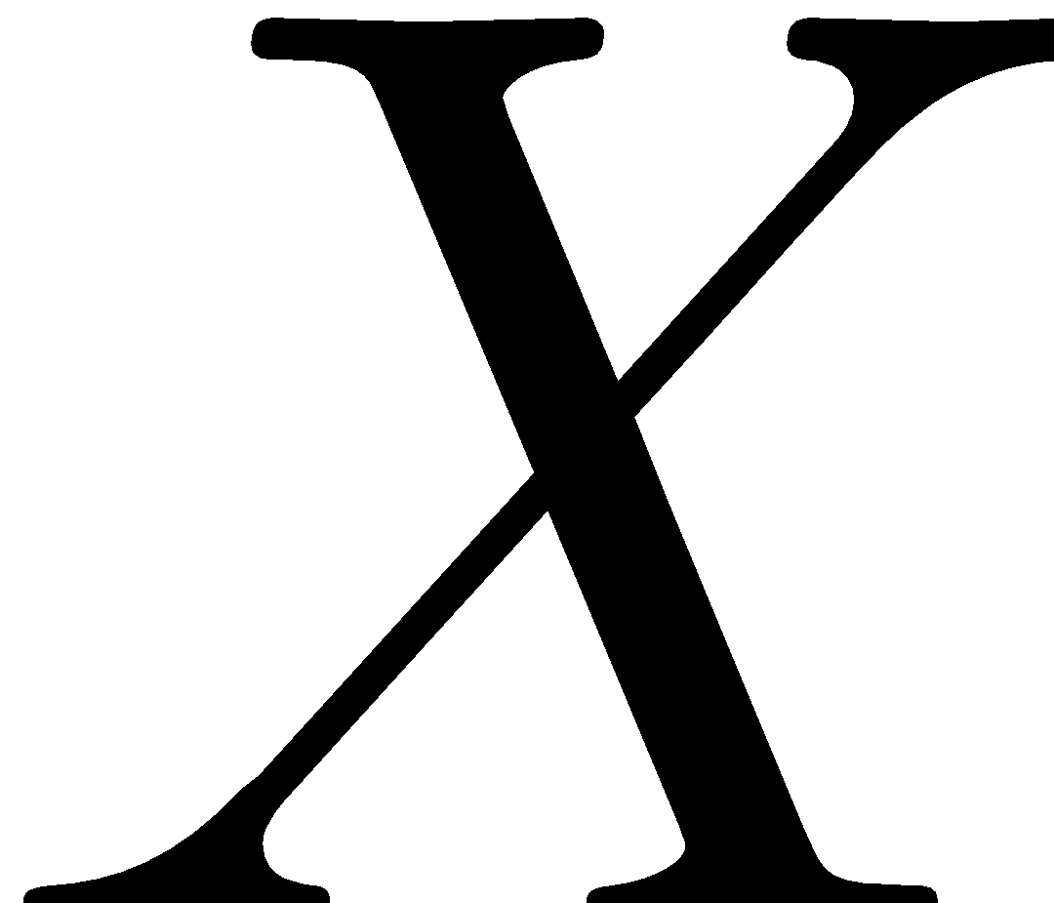
The math problem
Energy loss of muons crossing any material can be calculated as
Ionization loss
radiation loss
Muon energy
distance
The coefficients of the equation depend on the energy !
with
https://pdg.lbl.gov/2016/AtomicNuclearProperties/adndt.pdf

Slide 13
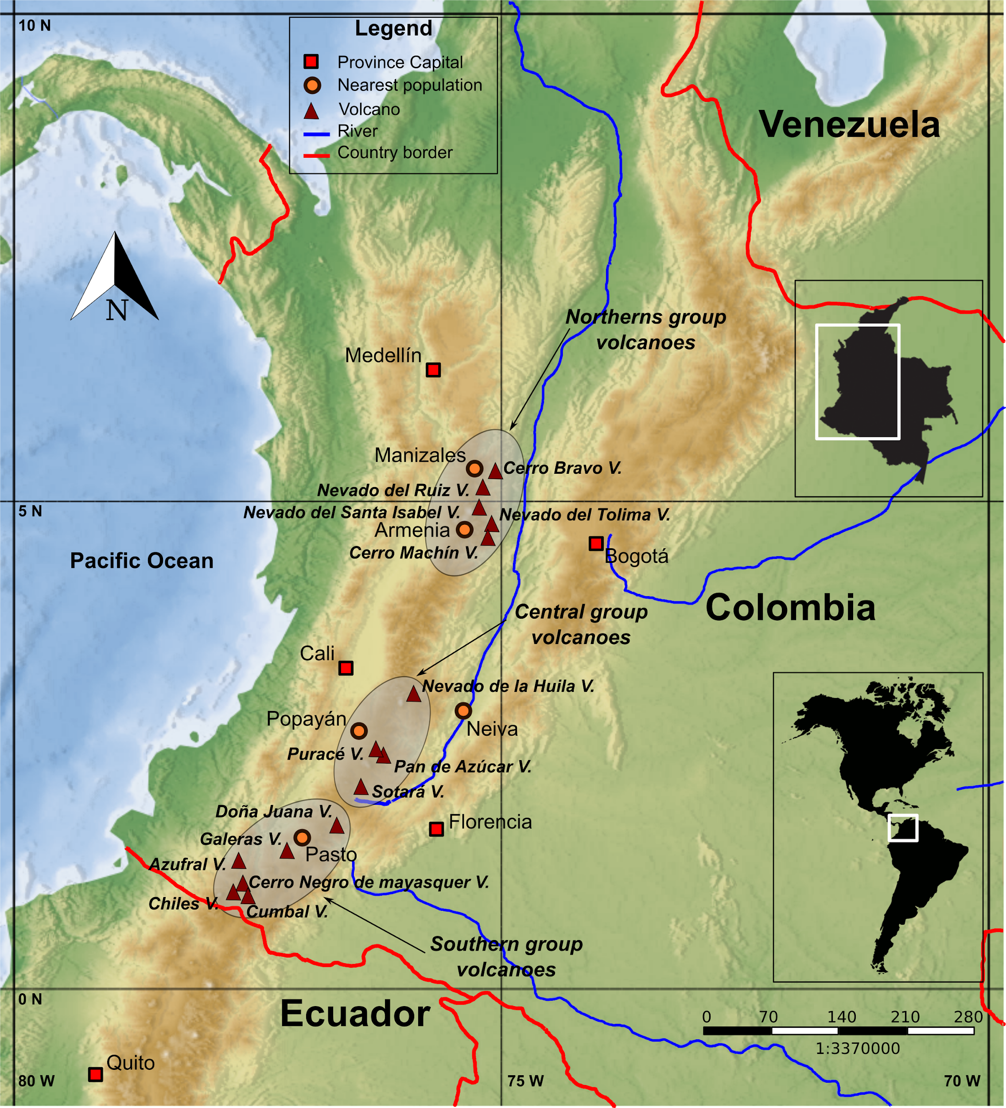
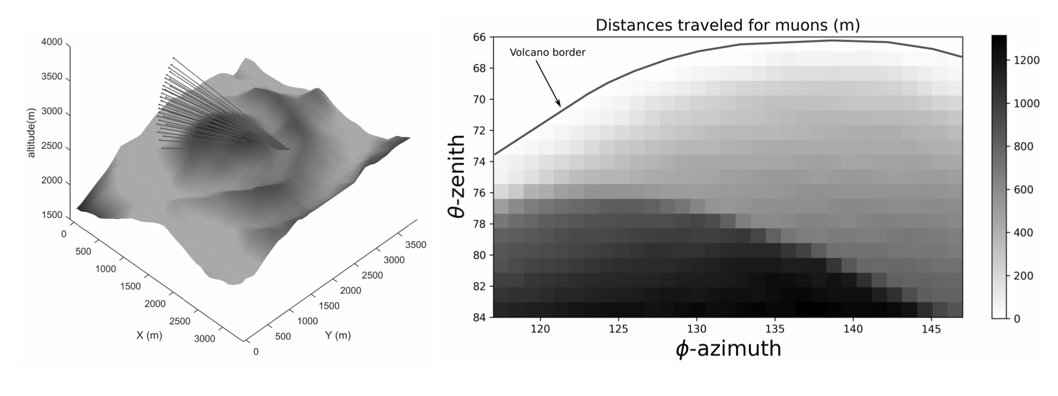
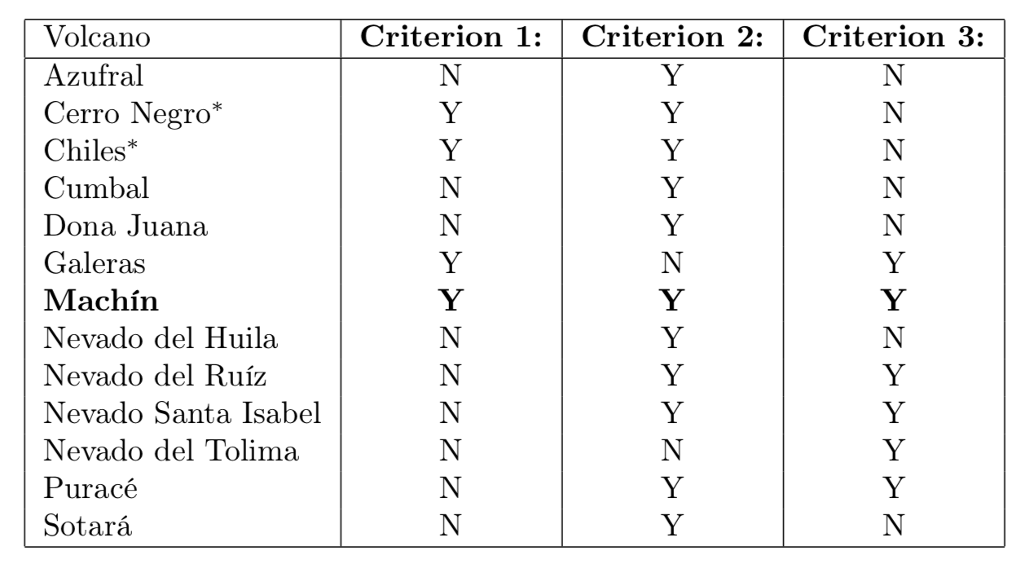
Vesga-Ramírez, A. et al (2020). Muon Tomography sites for Colombian volcanoes. ANNALS OF GEOPHYSICS, 63(6).
13 volcanoes analysed Complies: Cerro Machín
At the observational level, is the volcano base width less than 1,500 m?
Are there tentative observation points where the surrounding topography does not affect the target?
Are the sites accessible and secure?

Slide 14
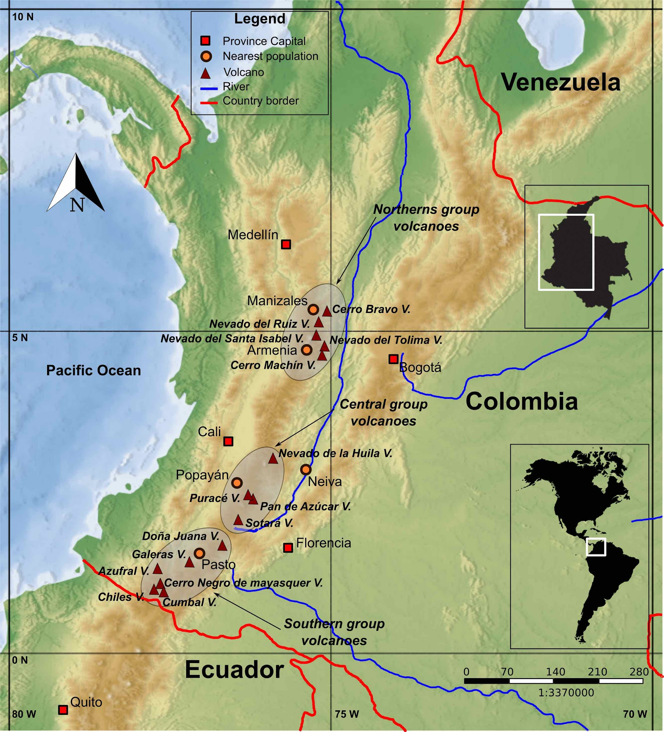
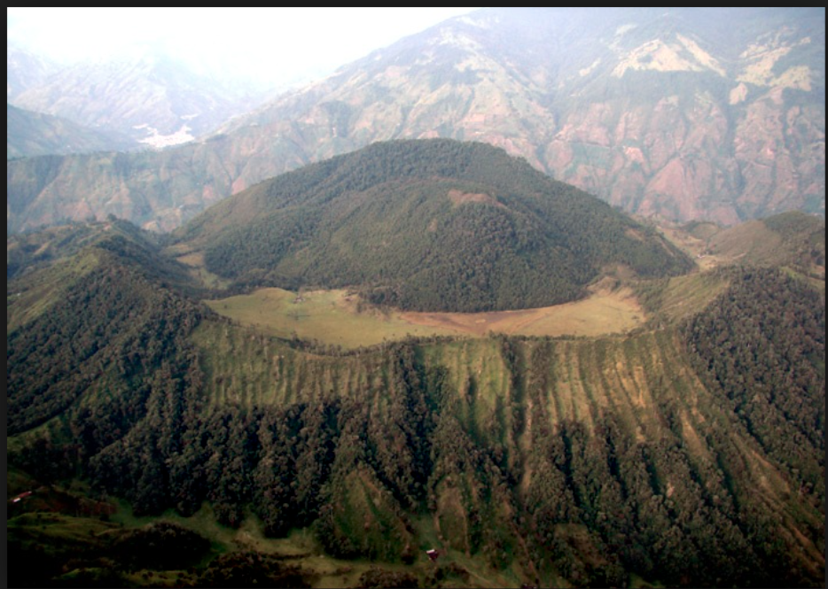
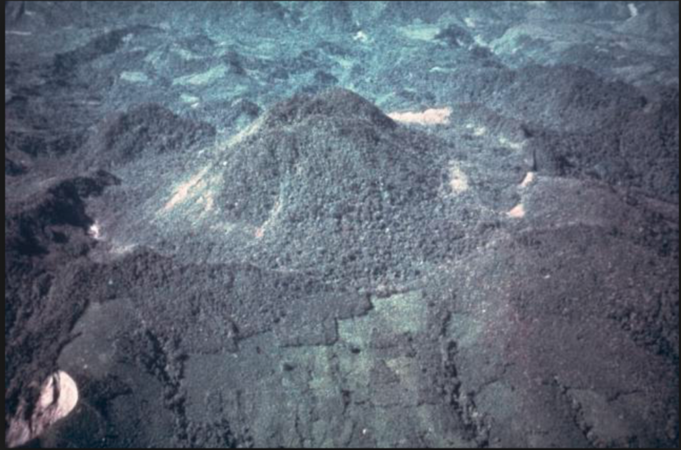
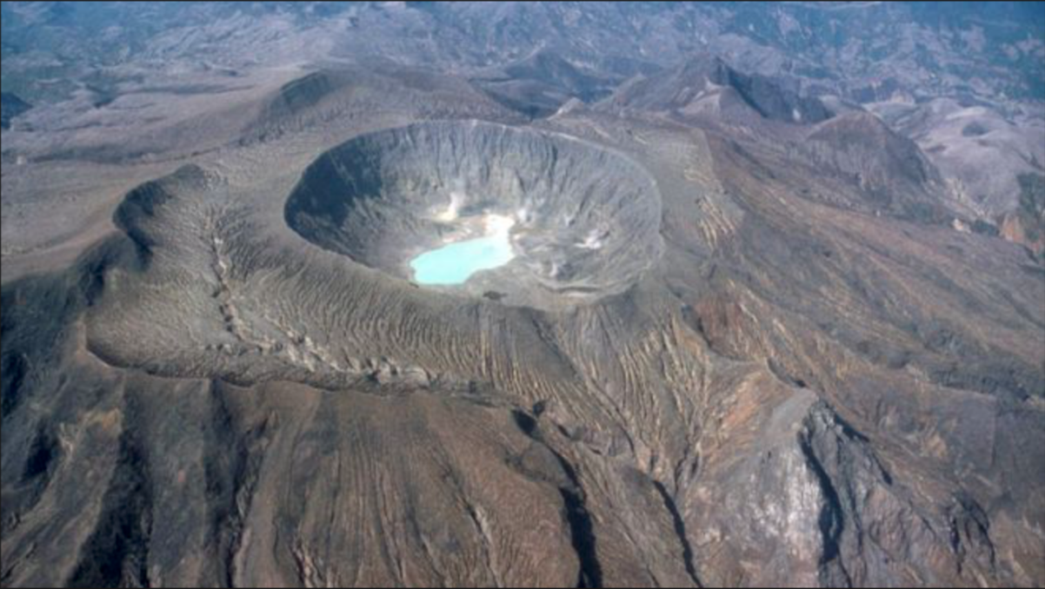
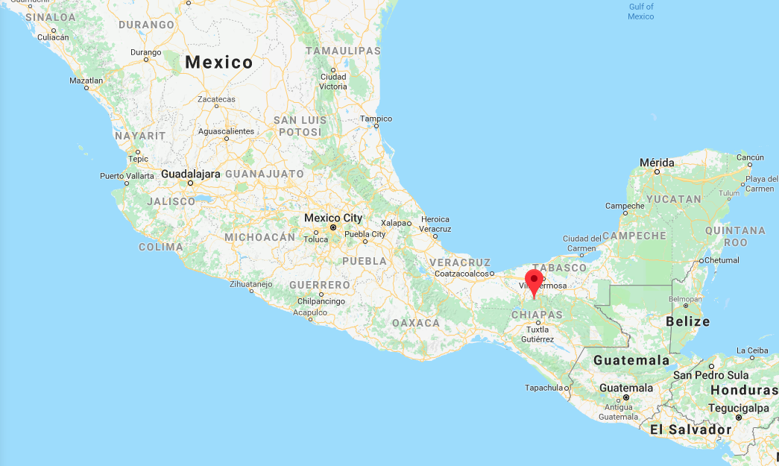
Colombian Volcanoes
Cerro Machin Volcano
Chichonal or Chichón (Mx) The most deadly
eruption of the century
(1982)
Vesga-Ramírez, A. et al (2020). Muon Tomography sites for Colombian volcanoes. ANNALS OF GEOPHYSICS, 63(6).

Slide 15
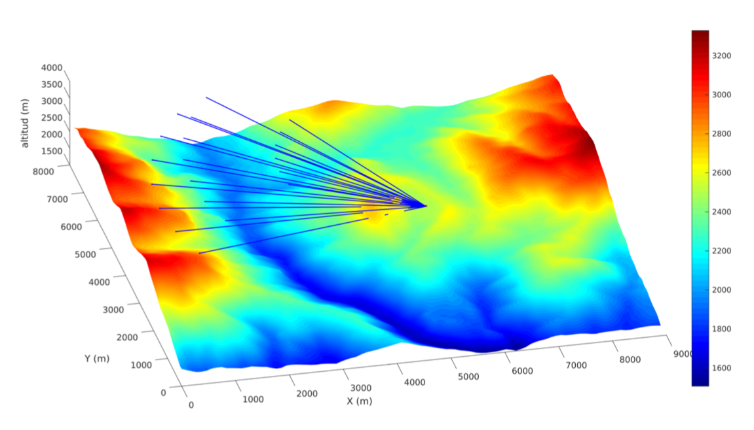
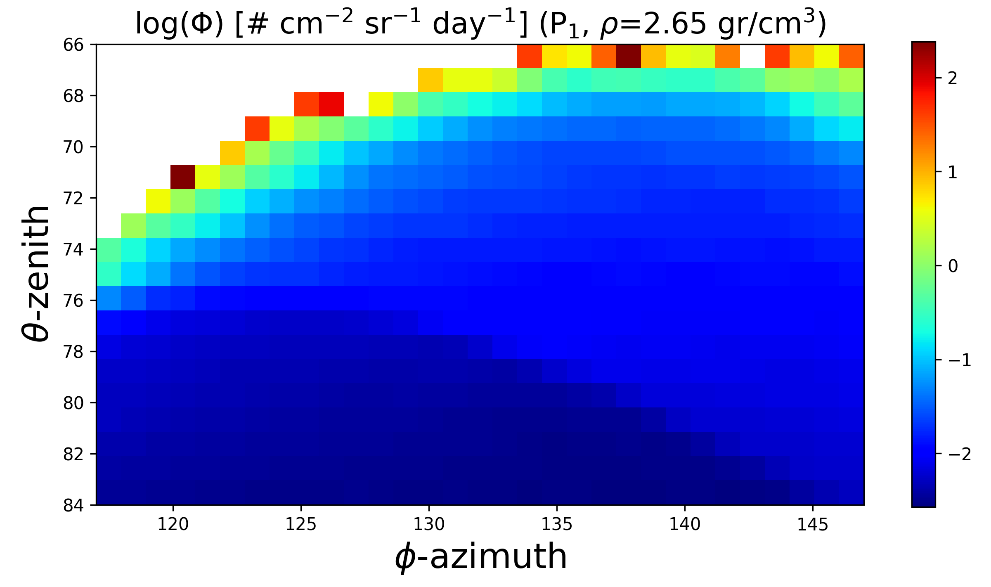
Observation points at Cerro Machín
Simulated flux at observation points
Vesga-Ramírez, A., et al (2021). Simulated annealing for volcano muography. Journal of South American Earth Sciences, 109, 103248.

Slide 16
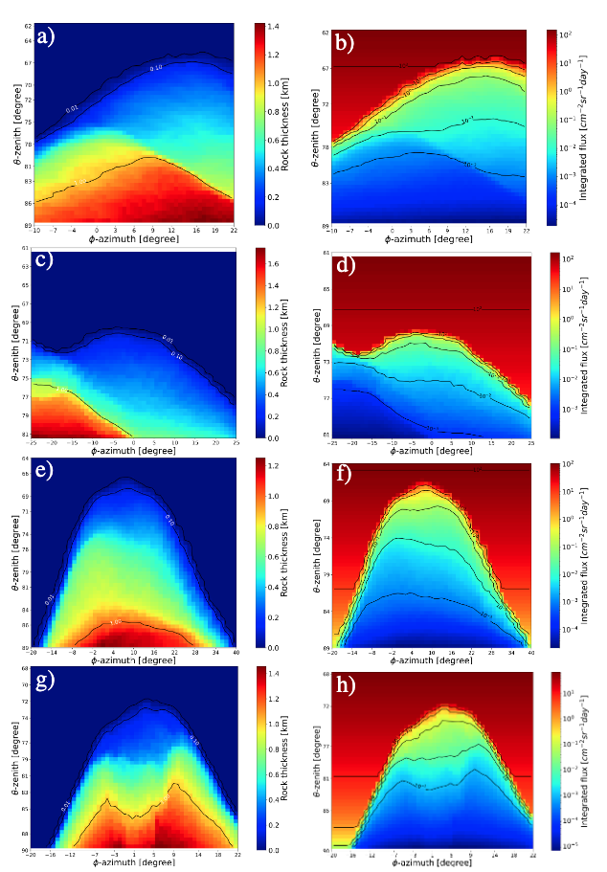
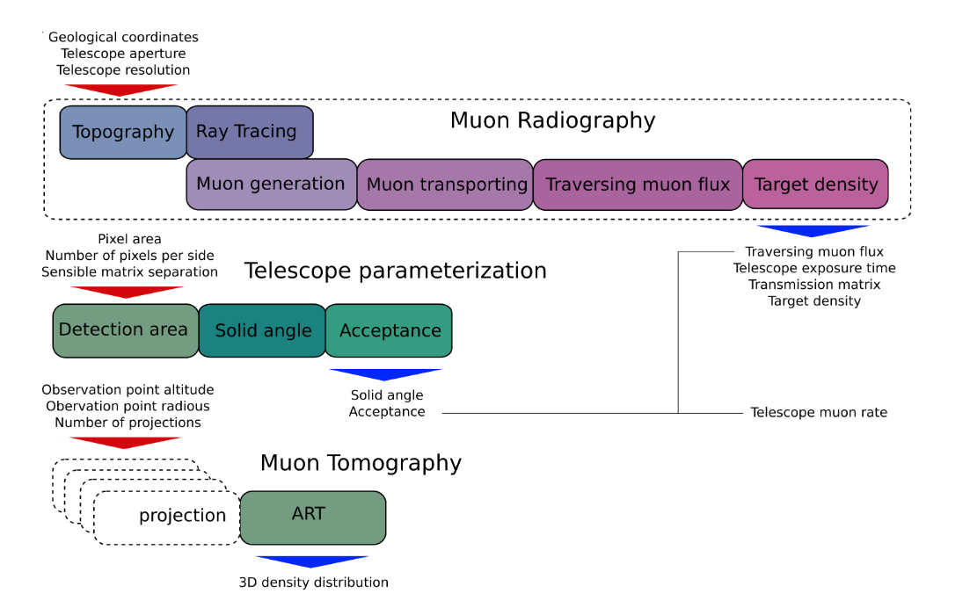
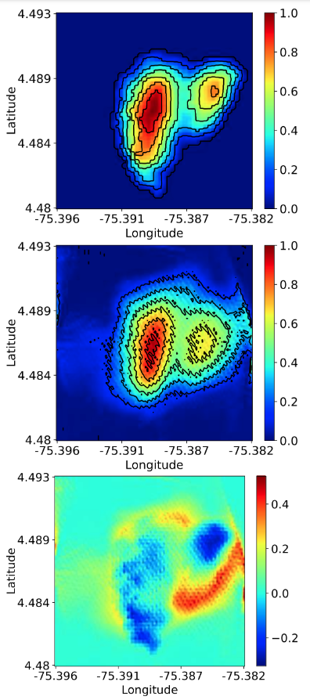
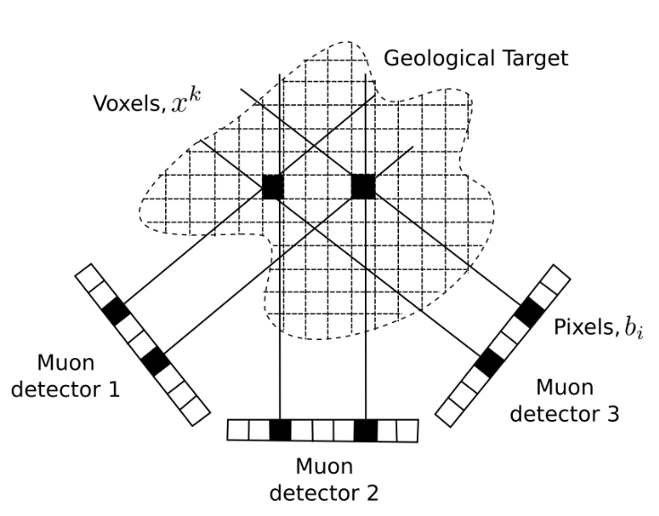
Parametric muon tomography
Machín
Etna
Puy Dome
Peña-Rodríguez, J. et al (2024). MUYSC: an end-to-end muography simulation toolbox. Geophysical J. International, 237(1), 540-556..
Vesuvius

Slide 17
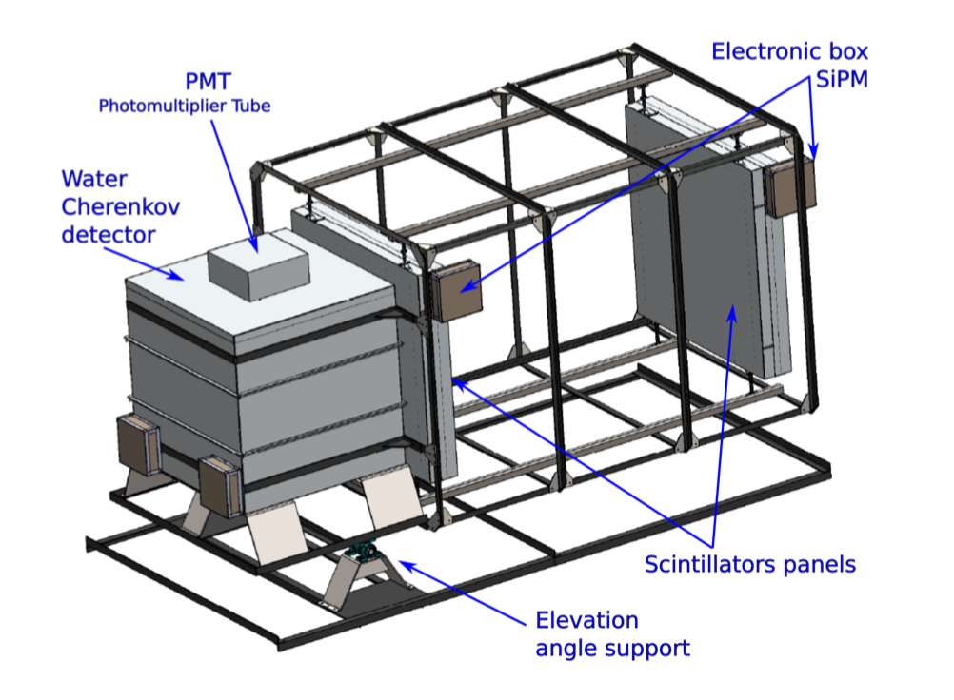
H. Asorey, R. Calderón-Ardila, C. R. Carvajal-Bohorquez, S. Hernández-Barajas, L. Martínez- Ramírez, A. Jaimes-Motta, F. León-Carreño, J. Peña-Rodríguez, J. Pisco-Guavabe, J.D. Sanabria- Gómez, M. Suárez-Durán, A. Vásquez-Ramírez, K. Forero-Gutiérrez, J. Salamanca-Coy, L. A. Núñez and D. Sierra-Porta (2018). Astroparticle projects at the Eastern Colombia region: facilities and instrumentation. Scientia et technica, 23(3), 392-397.
900 pixels 4cm x 4cm
30x30 bars:
120cm x 4cm x 2cm
MuTe 1.0: The first Muon Telescope

Slide 18
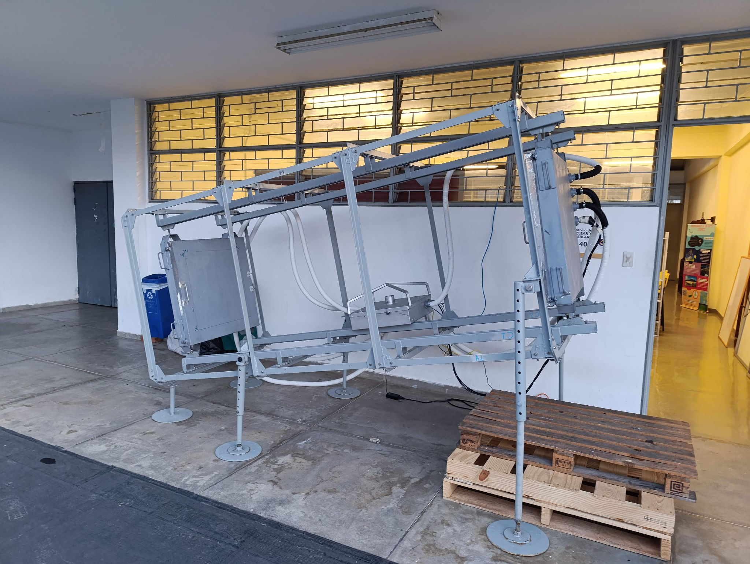
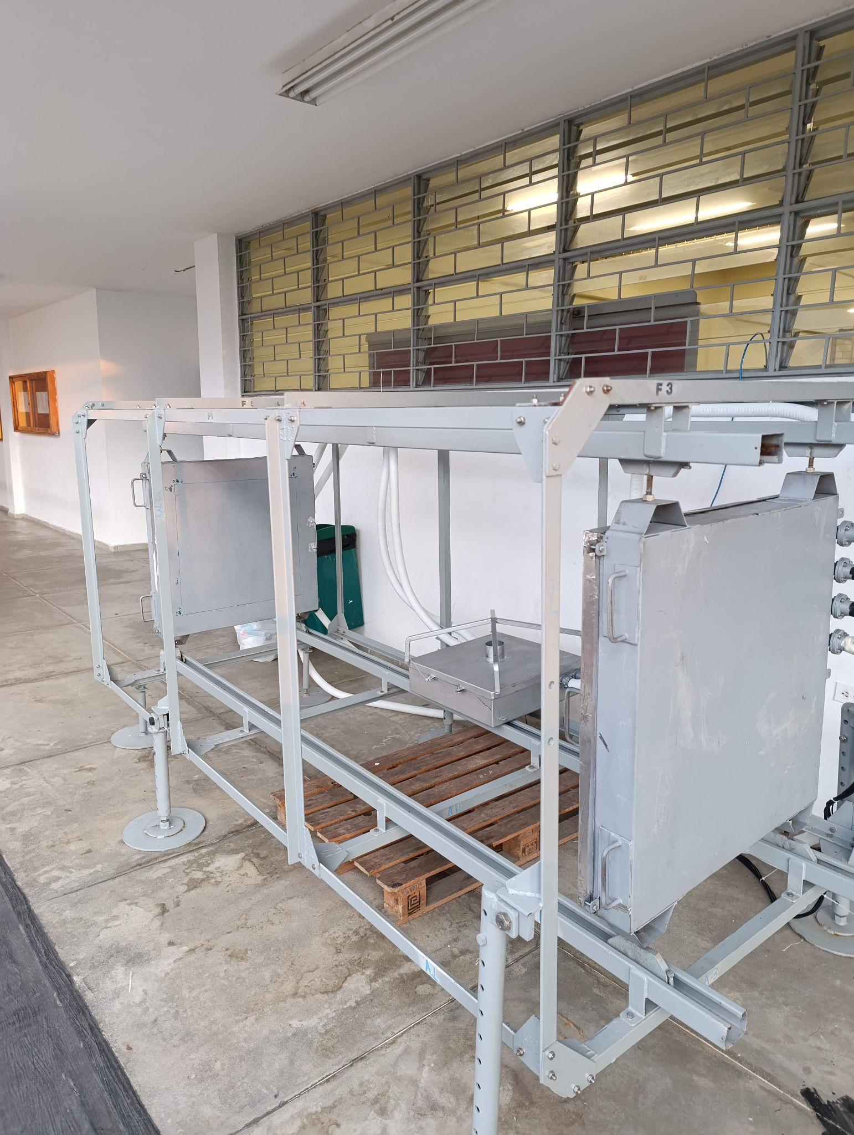
MuTe 2.0
Forthcoming
C. Sarmiento talk
tomorrow
15 x 15 scintillator array for a 225-pixel panel
84 possible angular trajectories.
32 mrad angular resolution

Slide 19
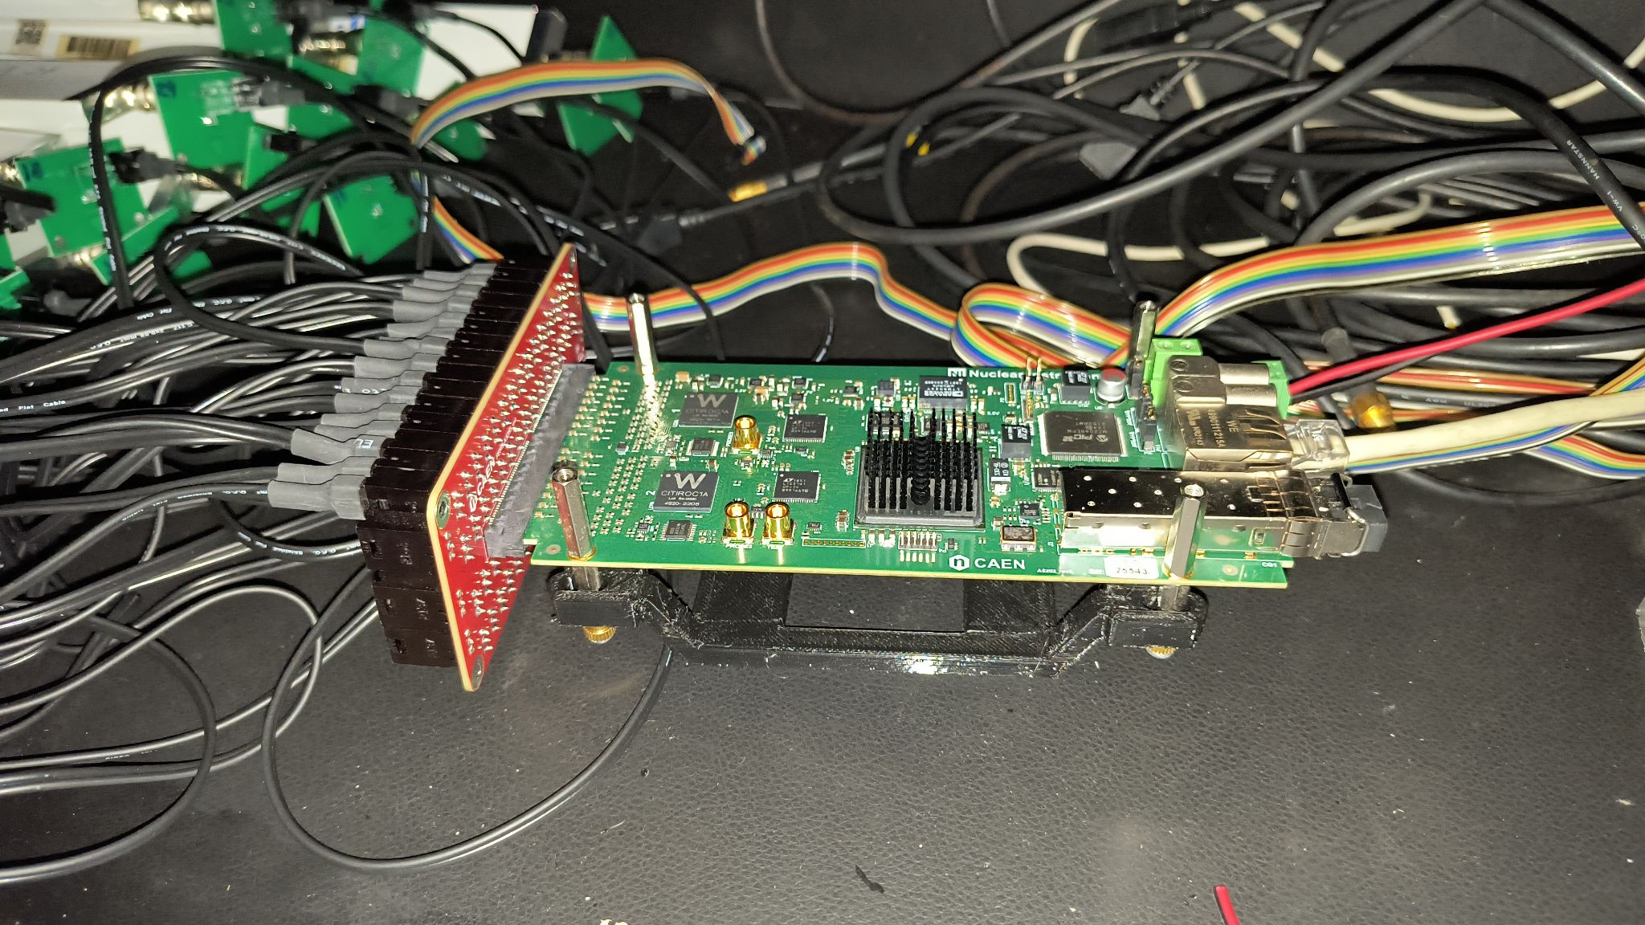
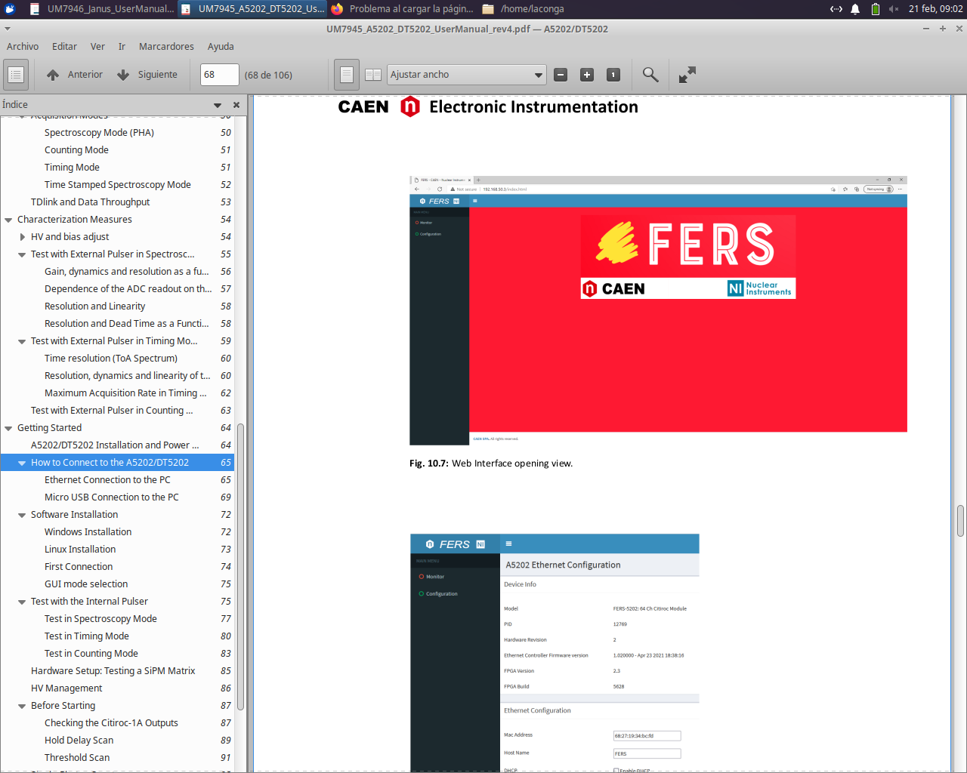
Commercial electronics to speed up the instrument
CAEN FERS-5202 64 channels Front-End Readout System for large arrays of detectors. Includes Front End electronics, A/D converters, trigger logic, synchronization, local memory and readout interface.

Slide 20
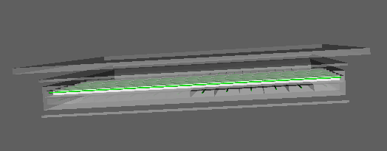
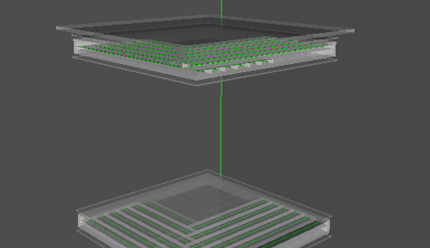
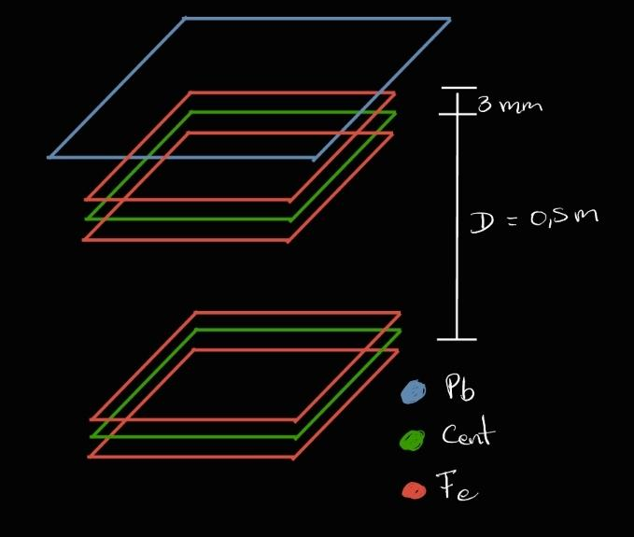
Lead shield design

Slide 21
Integration of muongraphy with standard geophysical methods for the construction of a 3D density model: application to the Cerro Machín Volcano.
Minciencias.
Provide detailed density information for the characterization of the internal structure of the VCM dome, with a focus on social appropriation of knowledge.
Determine the design and execute the geophysical acquisitions that will complement the muonography for the study of the VCM dome.
Incorporate information from standard geophysical methods with muonography information and geological information to construct a reliable 3D density image of the VCM dome
Participatively design and implement a process of social appropriation of knowledge through the dialogue of local and academic knowledge that qualifies the sustainable human development of the communities participating in the project.

Slide 22
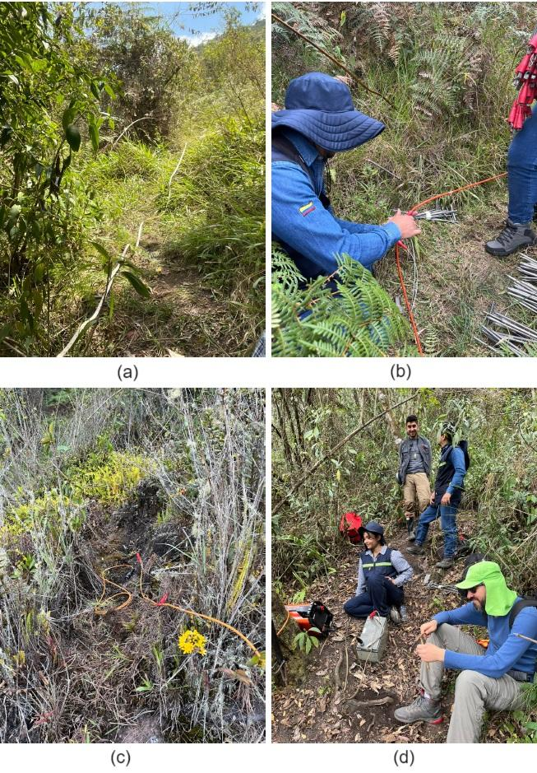
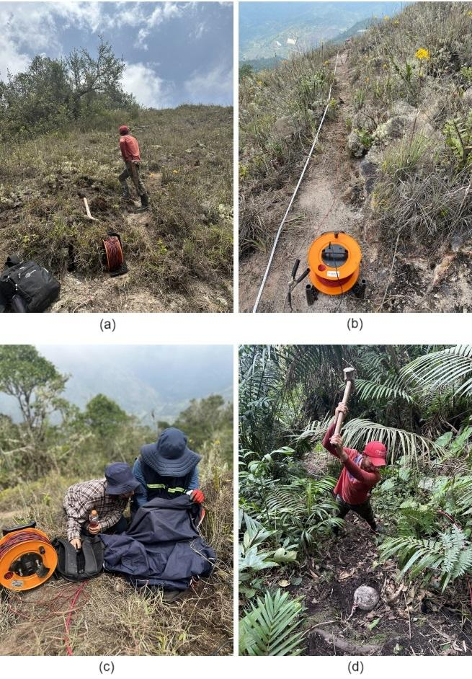
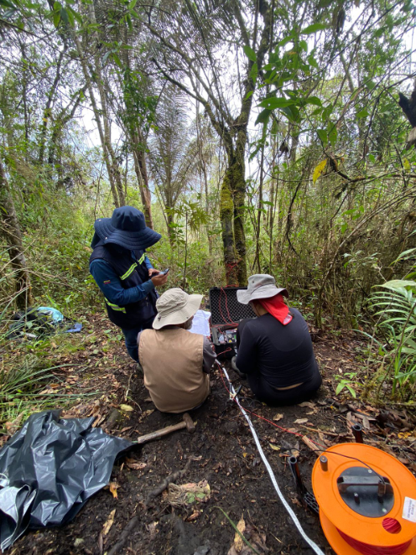
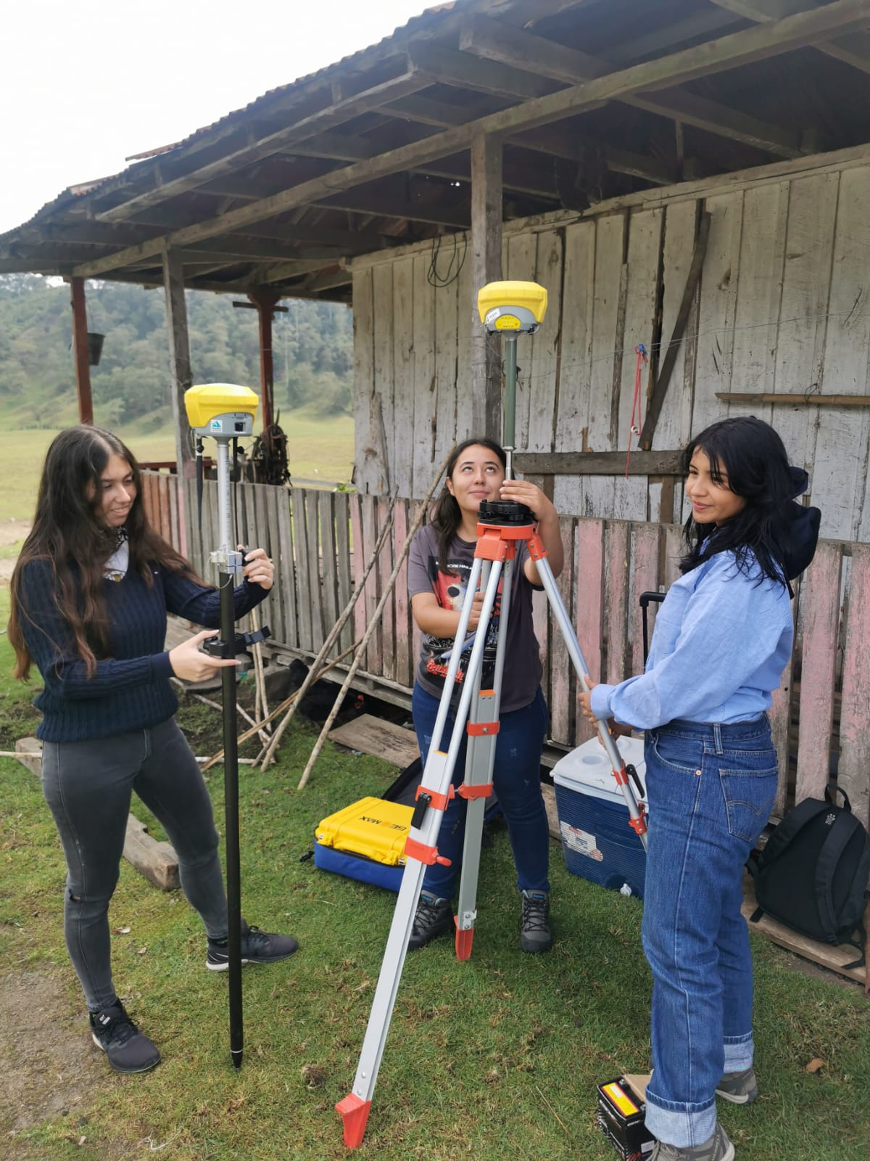
Geophysical methods: Gravimetry, magnetometry, refraction seismic, MASW, Ground Penetrating Radar GPR, vertical electrical sounding VES, electrical resistivity tomography ERT, induced polarization IP, spontaneous potential SP.

Slide 23
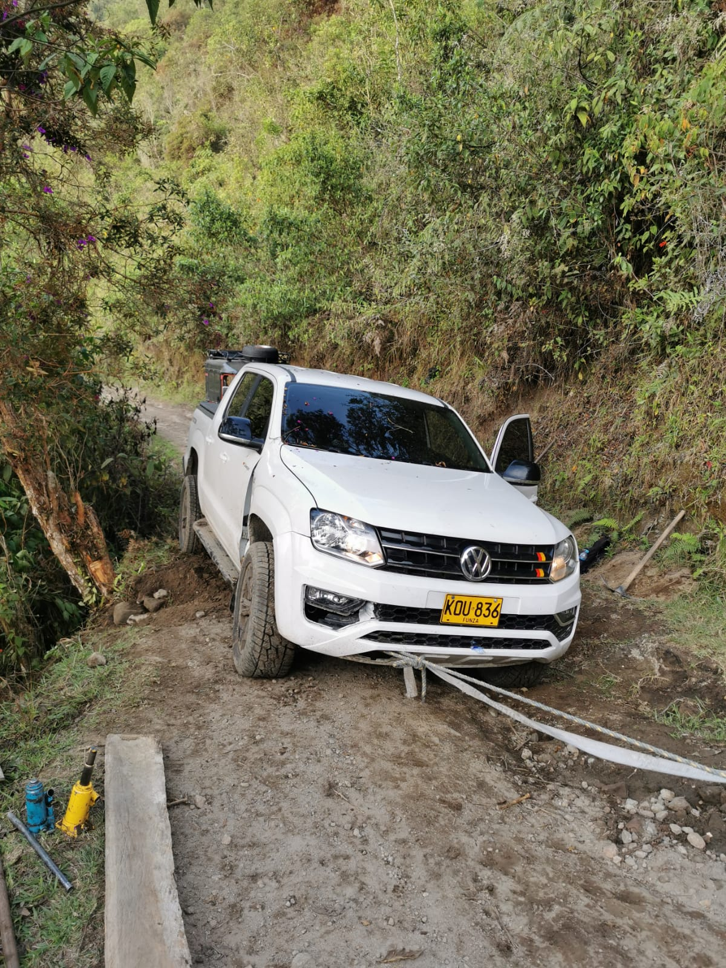
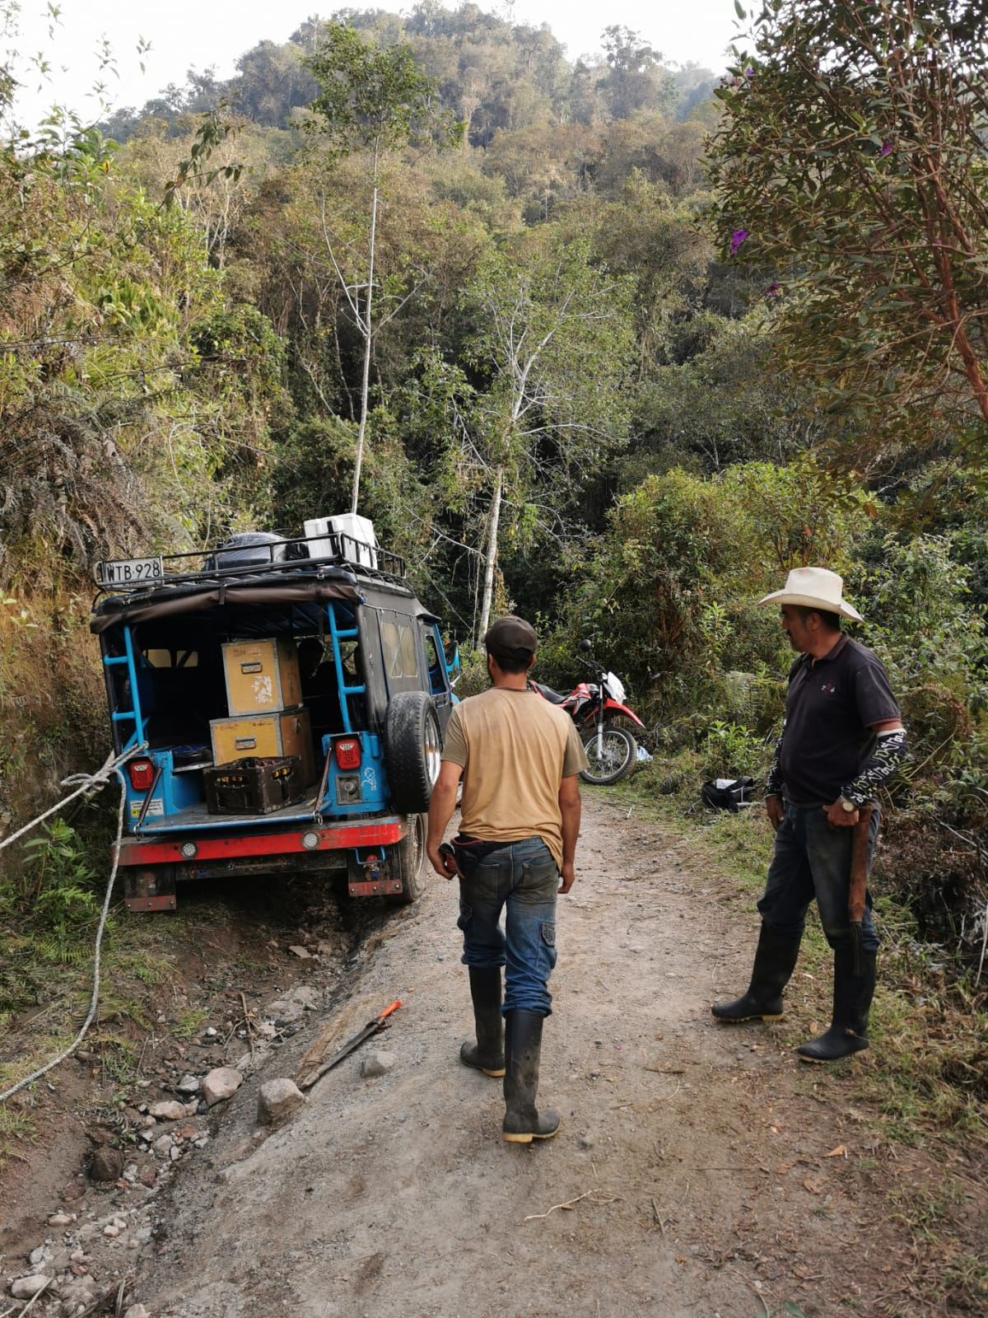
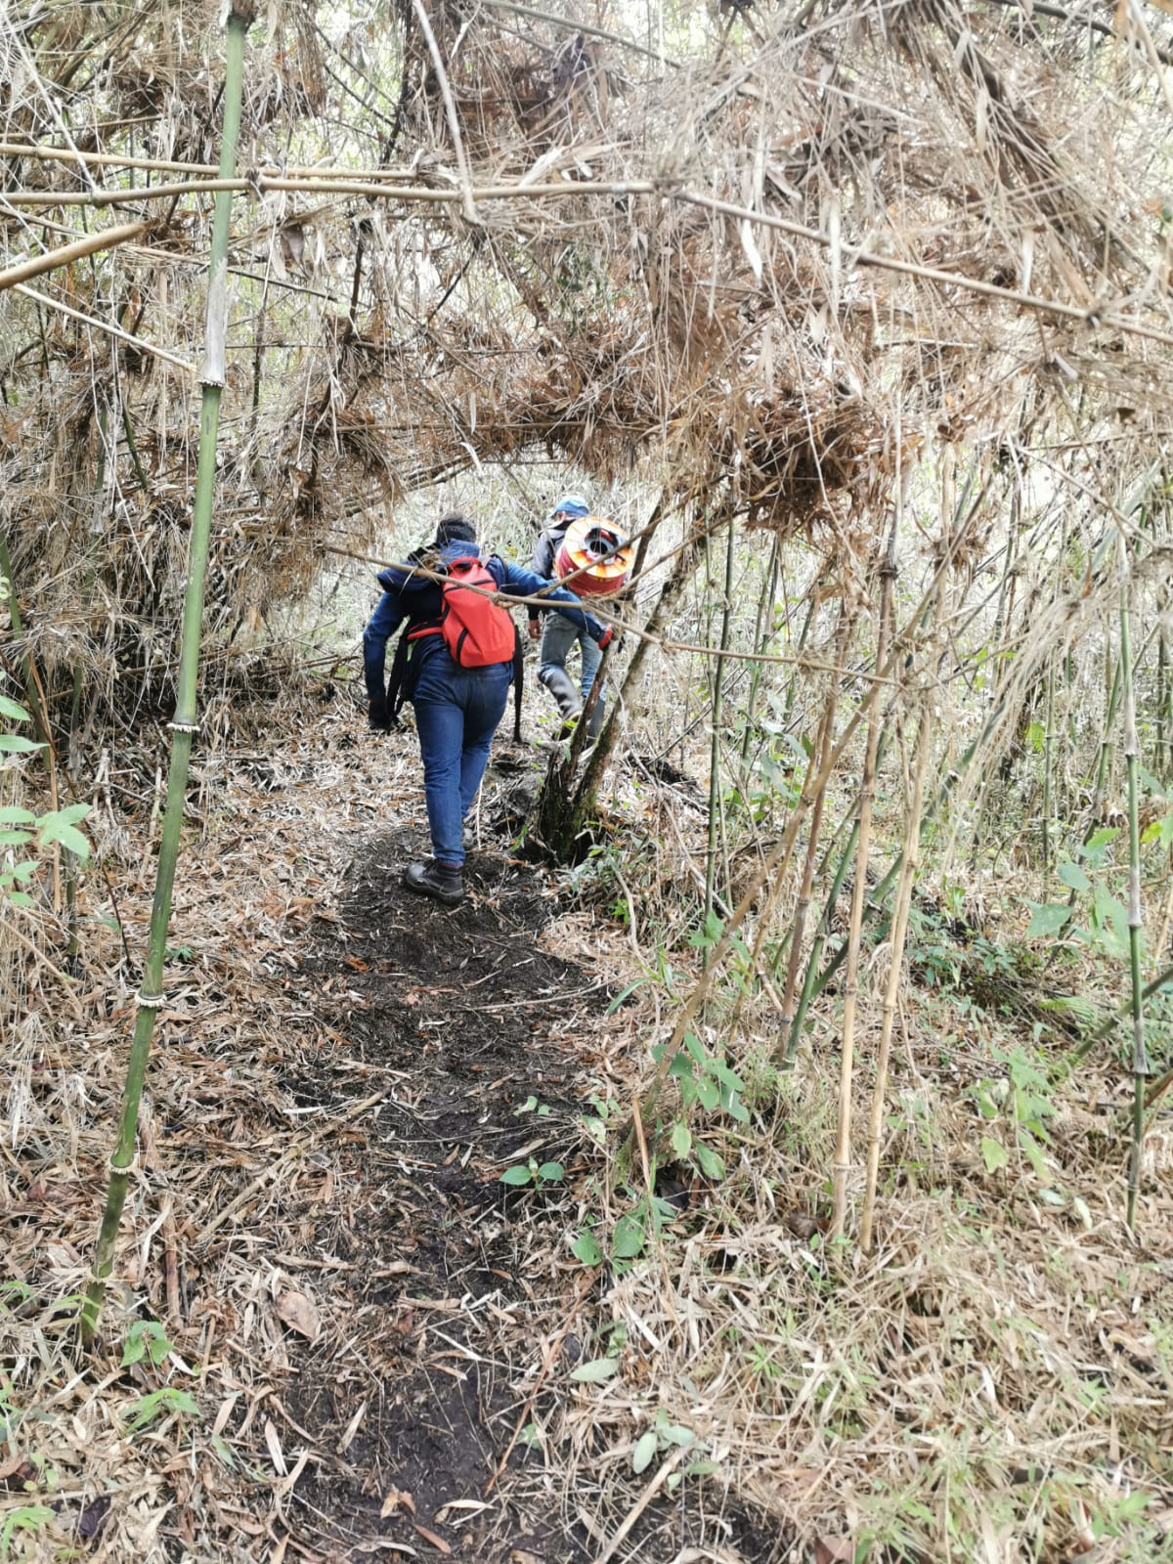
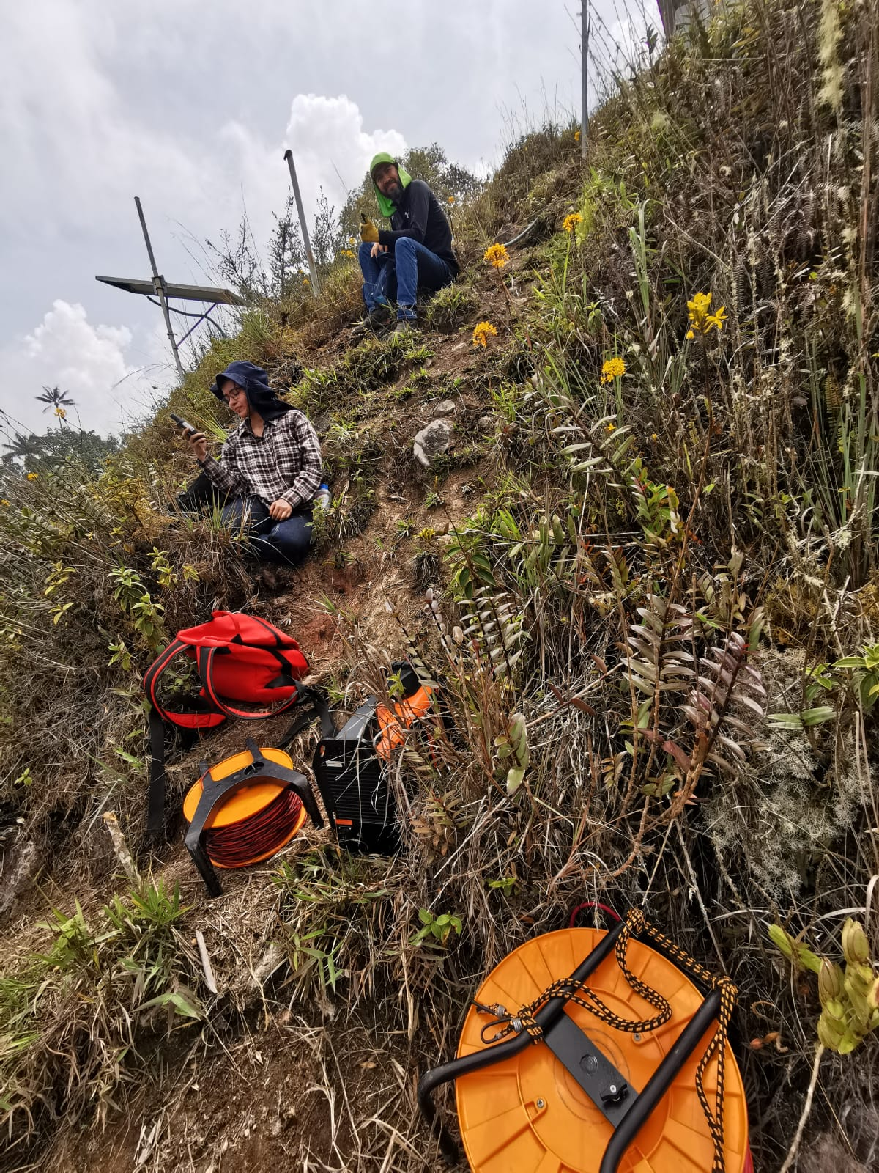
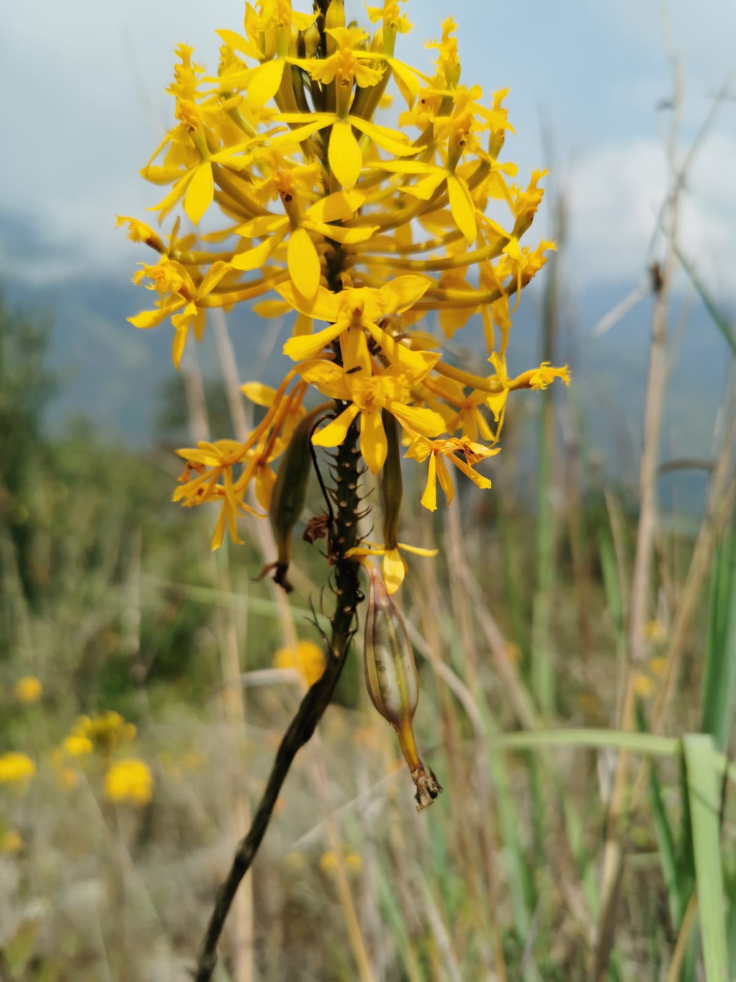
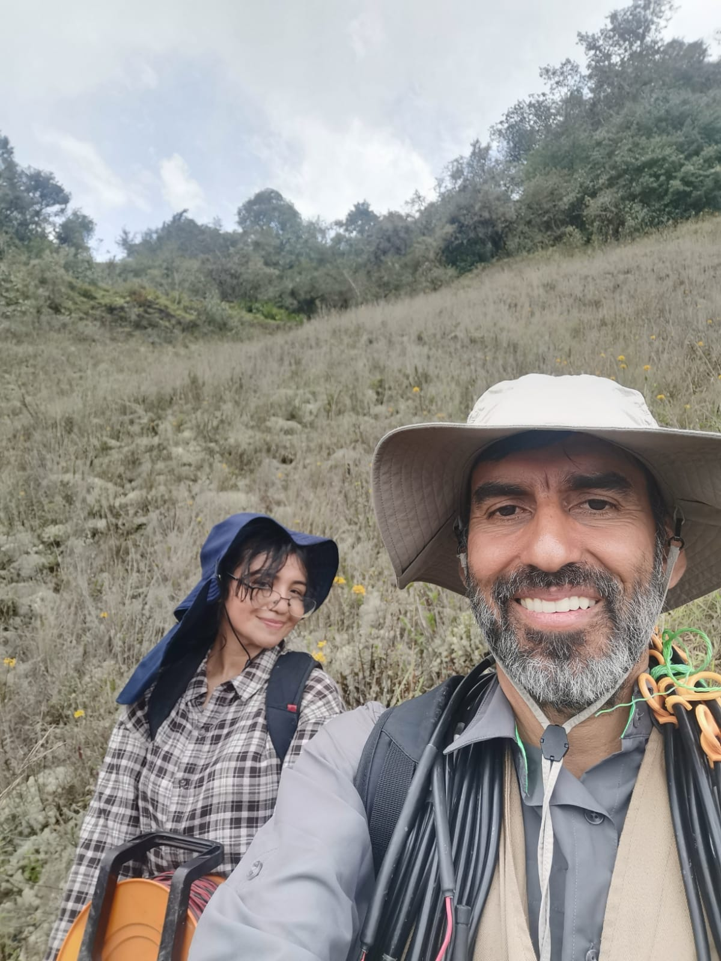
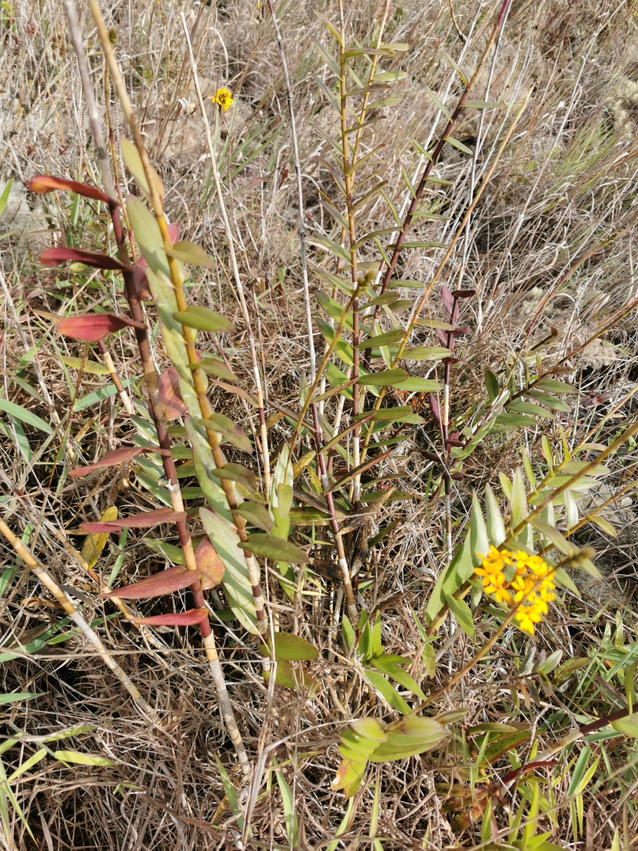

Slide 24
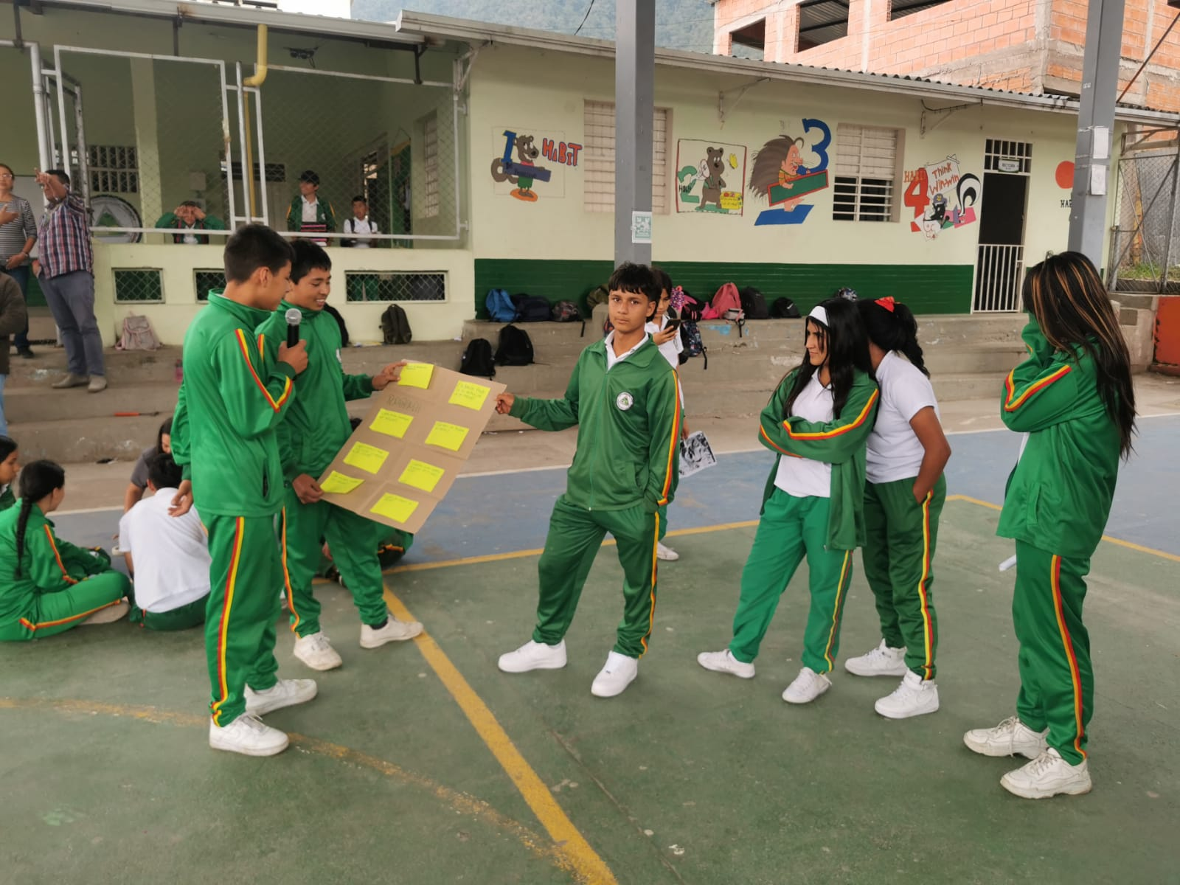
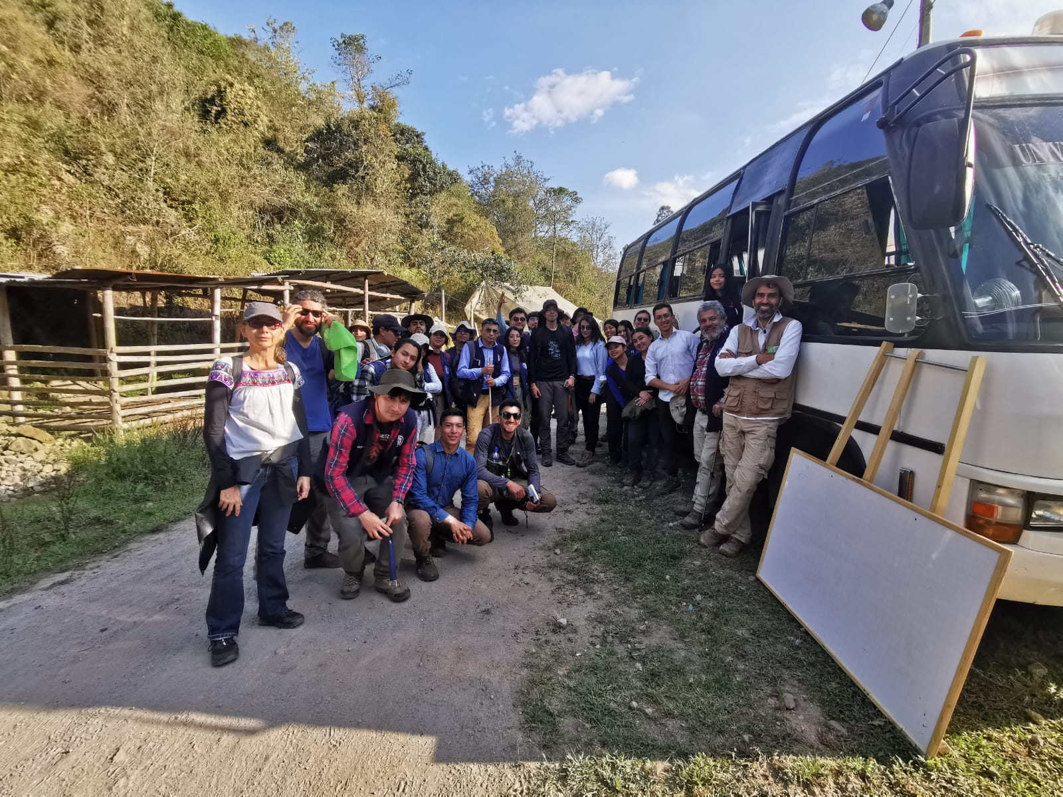
Participatively design and implement a process of social appropriation of knowledge through the dialogue of local and academic knowledge that qualifies the sustainable human development of the communities participating in the project.

Slide 25
Participatively design and implement a process of social appropriation of knowledge through the dialogue of local and academic knowledge that qualifies the sustainable human development of the communities participating in the project.

Slide 26
Participatively design and implement a process of social appropriation of knowledge through the dialogue of local and academic knowledge that qualifies the sustainable human development of the communities participating in the project.
Research hotbed with students from colleges and schools
1- Biodiversity in a lava dome: Social appropriation of knowledge about the Machín Volcano.
2- Cultural Identity at the Machín Summit: An Interdisciplinary Teaching Experiment as a strategy for the social appropriation of knowledge.
3- Machín Volcano as a Regional Economic Power: A STEM Teaching Experiment for the Social Appropriation of Knowledge.

Slide 29
Este proyecto además de los aspectos puramente científicos, se propone adentrarse en las actividades de apropiacion social del conocimiento que significan construir conocimiento CON la comunidad, desde sus experiencias y las experiencias del equipo de trabajo, y representa un gran reto para tratar de acercar la ciencia a las personas no científicas y promover su entendimiento, su uso y hasta la defensa de la misma.
This project, in addition to the purely scientific aspects, aims to delve into the activities of social appropriation of knowledge that mean building knowledge WITH the community, from their experiences and the experiences of the work team, and represents a great challenge to try to bring science closer. to non-scientific people and promote their understanding, use and even defense of it.

