Slide 1
DARK MATTER IN GALACTIC STRUCTURE
Carlos R. Argüelles
Collaborators: J. A. Rueda, R. Ruffini, P.-H. Chavanis, A. Krut, E. A. Becerra-Vergara, M. Díaz, R. Yunis,
M. Mestre, V. Crespi, S. Collazo, F. Vieyro, J. Pelle, C. Millauro
Astro Fest – Bucaramanga 13 - 15 Noviembre, 2024

Slide 2
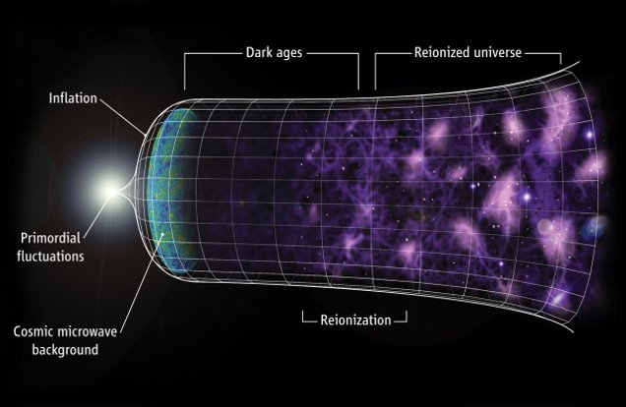

Slide 3
Particle DM paradigm: the nature and mass of the DM candidates?
Adapted from CERN Document server
“Wave-like dark matter”
“light dark matter”
“High-mass dark matter”

Slide 4
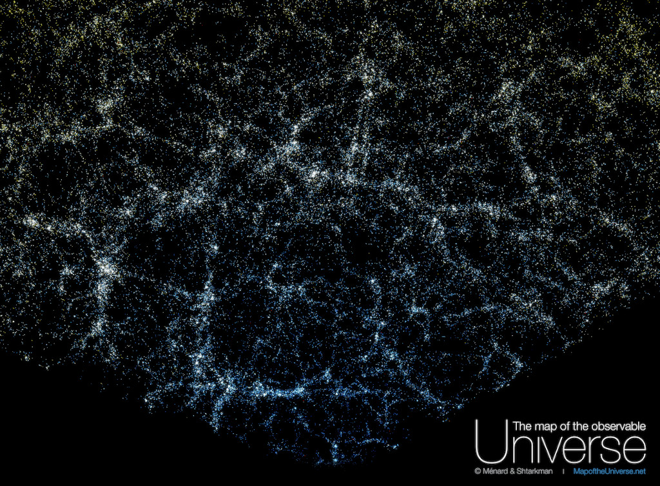
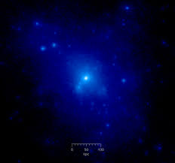
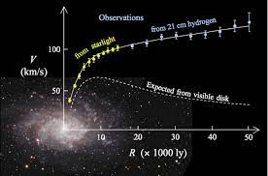
From large scale structure to DM halo-size structures

Slide 5
However.. important open questions on small scales
How can we robustly infer (or know) the inner shape of the DM halos? → Cored?
Cuspy?
Universal?
What about the DM concentration in galactic centers ? → DM spikes? : relevant implications to stellar orbits, etc
Which is the nature of the supermassive dark compact objects at galaxy centers ? → Are all BHs ?
How massive BHs formed and grow in the high z Universe ? → Mass of initial BH seeds?
What is the nature of the connection between the mass of the host galaxy and the BH mass?
Fermions plus Gravity can provide key insights to all of these questions!

Slide 6
DM halo formation: a statistical mechanics approach

Slide 7
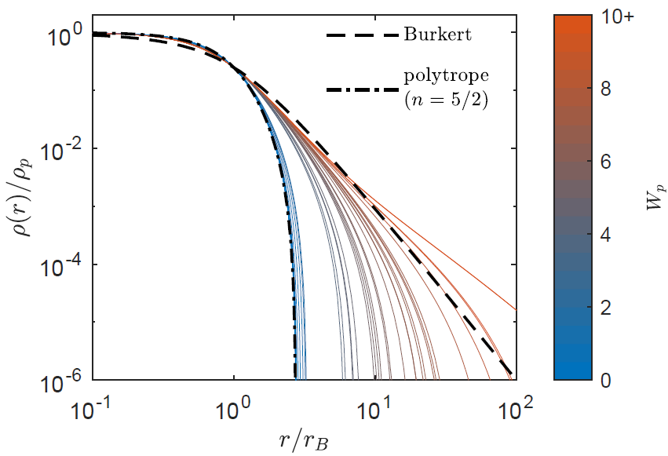
DM halos: an statistical mechanics & thermodynamics approach
Simulations: DM halo formation and overall structure is centered in N-body simulations. Though we still lack a clear understanding on its physical basis.
Statistical mechanics of self-gravitating systems: Maximum entropy principles (MEP) developed in the last decade Pontzen & Governato (2013), Hjorth et al. (2015), Chavanis et al. (2015)
lead to DM profiles in good agreement with simulations & observations.
Self-gravitating systems of fermions: MEP approach applied on a kintetic theory couple to gravity, leads to a most likely coarse-grained phase-space distribution of Fermi-Dirac type:
Chavanis et al. (1998,2004)
(Pauli principle)
DM halos built out of this DF where compared with
observations & simulations Krut, Argüelles et al. Apj (2023)

Slide 8
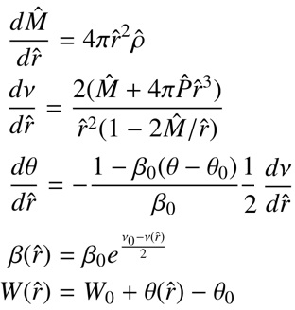
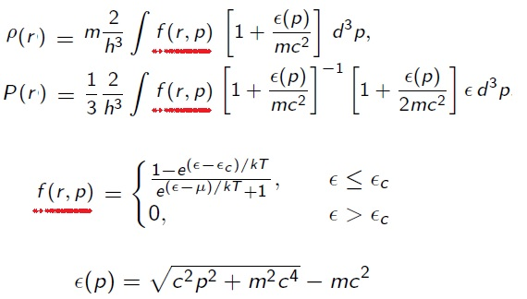
DM halos as equilibrium systems of self-gravitating fermions
Fermions under self-gravity DO ADMIT a perfect fluid approximation
Ruffini & Bonazzola, Phys. Rev. (1969) - by solving Einstein Dirac equations -
We solve Einstein equilibrium equations for Fermi Gas at finite T in hydrostatic equilibrium
(i.e. T.O.V), in spherical symmetry Argüelles, Krut, Rueda, Ruffini, PDU (2018)
T.O.V
KLEIN
TOLMAN
E conserv.
4 free parameters

Slide 9
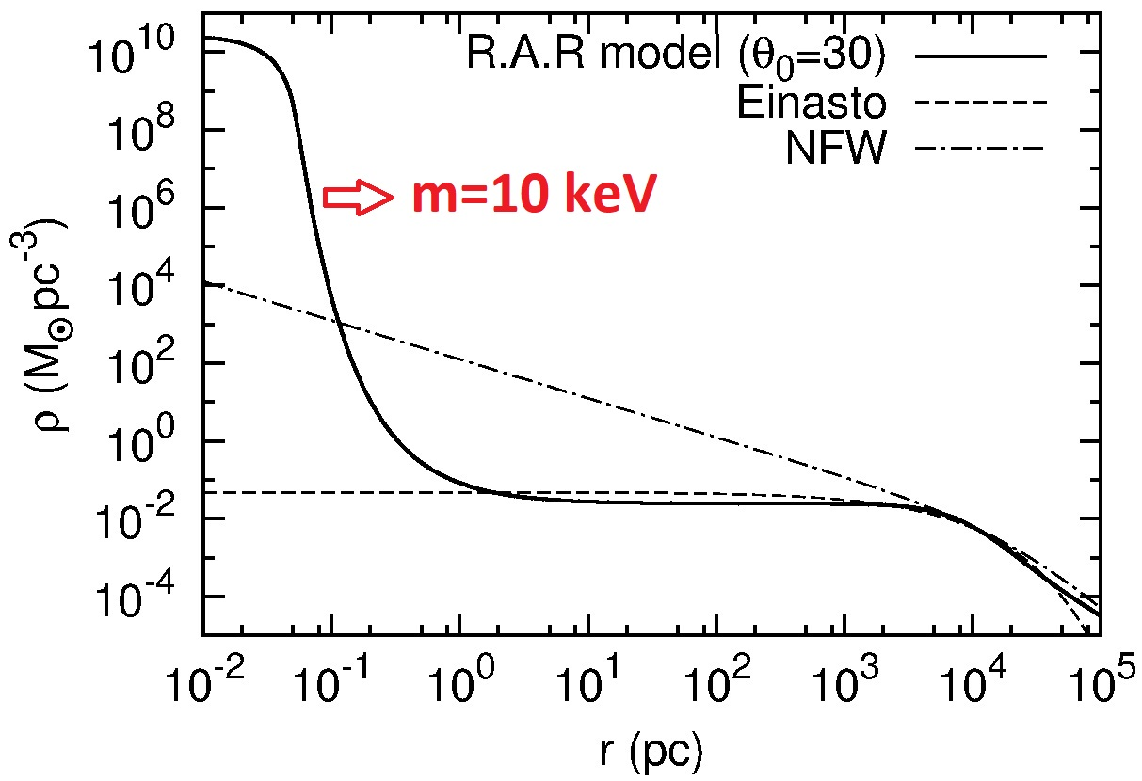
A novel "core – halo" Dark Matter profile for fermions
The highly non-linear systemd of coupled ODE is solved fulfilling a boundary condition problem in agreement with halo observables Ruffini, Argüelles, Rueda, MNRAS (2015)
Hablar Aca sobre:
Boltzmann Hierarchies (poner termino de interacciones)
Quien es f0 en el caso de neutrinos
Example: Typical spiral halo
Rh ~ 10⁴ pc
Mh ~ 10¹¹ Mo
:
The dense central core fulfills the 'quantum condition' :
DM profiles depend on the particle mass (see next slides)
The dense central cores, when compact enough, can mimic the space-time signatures of a BH!

Slide 10
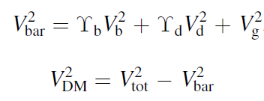
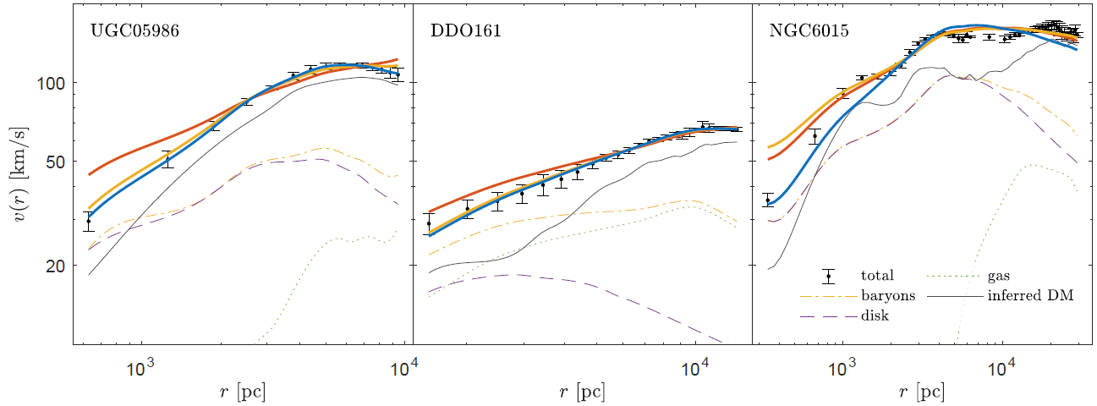
On halos scales: Testing the model with 120 disk galaxies (SPARC)
(Blue): Fermionic DM;
(Yellow): gNFW; (Red): NFW
Krut, Argüelles, Chavanis, Rueda, Ruffini, Apj (2023)​

Slide 11
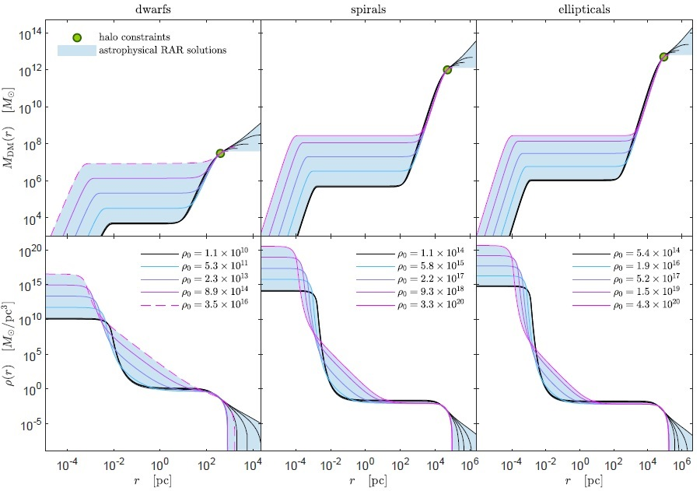
On core & halo scales: fermionic profiles from dwarf to elliptical galaxies
The fermionic model can be applied to any galaxy type, from dwarf, to ellipticals, to galaxy clusters Argüelles, Krut, Rueda, Ruffini, PDU (2019)
For m ~ 50 keV we make a full coverage of free parameters of the theory, for realistic boundary conditions inferred from observables :
Hablar Aca sobre:
Boltzmann Hierarchies (poner termino de interacciones)
Quien es f0 en el caso de neutrinos
DWARFS: eight best resolved MW satellites
SPIRALS: sample of nearby disk galaxies from THINGS
ELLIPTICALS: analyzed via weak lensing

Slide 12
The dense fermion core can collapse into a supermassive BH while surrounded by a DM halo

Slide 13
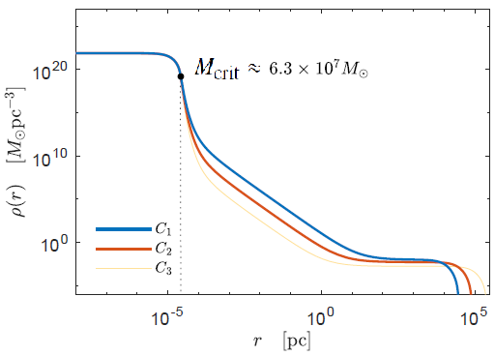
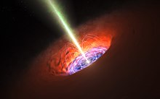
For self-gravitating system of fermions in GR which surpass a given critical mass, the degenerate DM core collapse into a BH though this time surrounded by a halo
Example with m=100 keV (M_vir ~ 10¹⁰ – 10¹² M_sun)
Argüelles et al.(2021)
Obtained from a thermodynamic stability analysis within GR in a cosmological framework
Argüelles, Rueda et al. MNRAS (2023)
BUT...
- How does the DM core reach the point of gravitational collapse?
- How long does it take to the core to reach that point?
- Are those conditions attainable in astrophysical and cosmological situations?

Slide 14
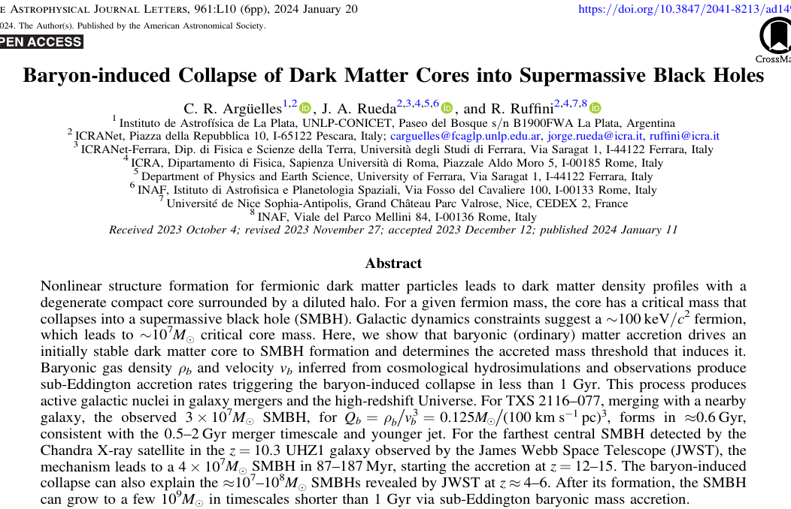
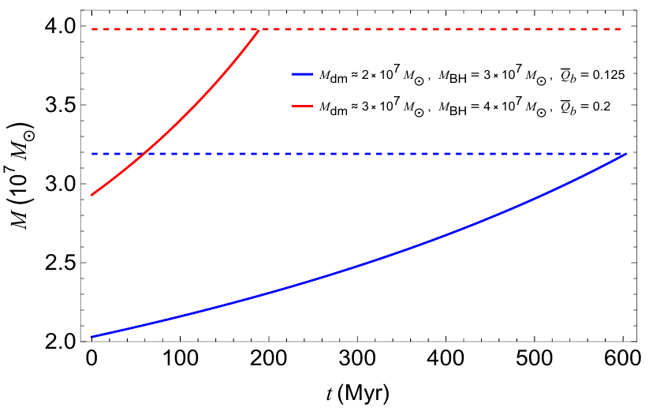
Baryon-induced collapse of DM-cores may explain why SMBH growth so early and so fast in the high z Universe!
Argüelles et al. Apj Lett (2024)
- For e.g. m=100 keV, initially stable DM cores which acrete baryons at typical densities inferred from hydro-simulations, produce sub-Eddington accretion triggering collapse in Δt < 1 Gyr.
- This can explain the farthest SMBH detected by Chandra & JWST in UHZ1 galaxy at z~10

Slide 15
The best case study: The Milky Way

Slide 16
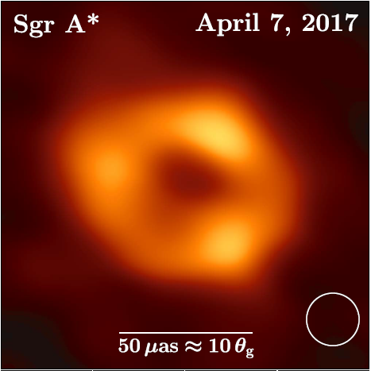
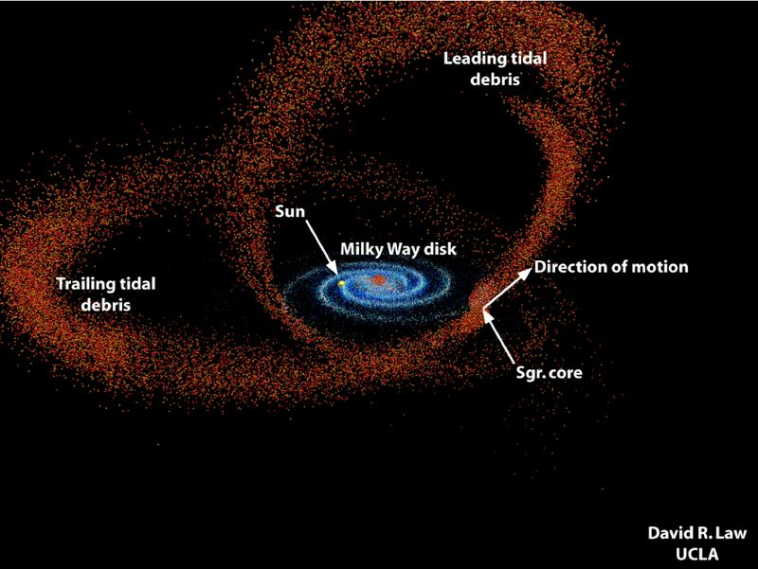
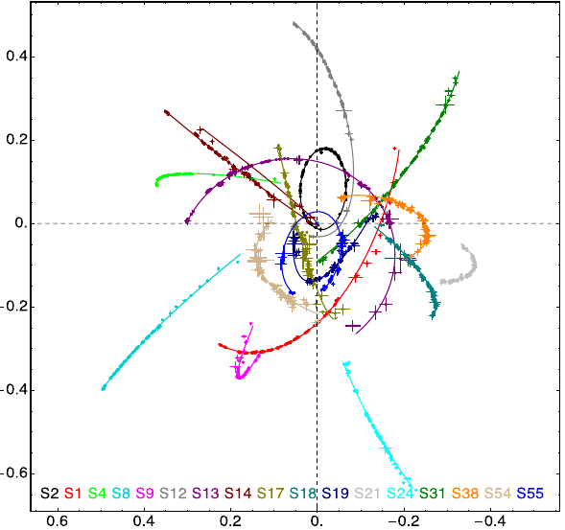
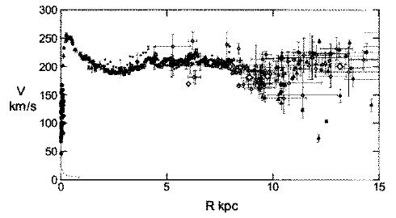
Milky Way observables: from SgrA* to the entire halo
Can a core-halo fermionic DM distribution explain the following set of MW observables without assuming a central BH?
Shadow of SgrA*
EHT collab. ApjL (2022)
Sgr stellar stream
Ibata et al. Apj (2020)
Milky Way rotation curve
S-cluster stars
Gillessen et al. Apj (2017)
Sofue PASJ (2013)

Slide 17
Hablar Aca sobre:
Expresion para los collision terms

Slide 18
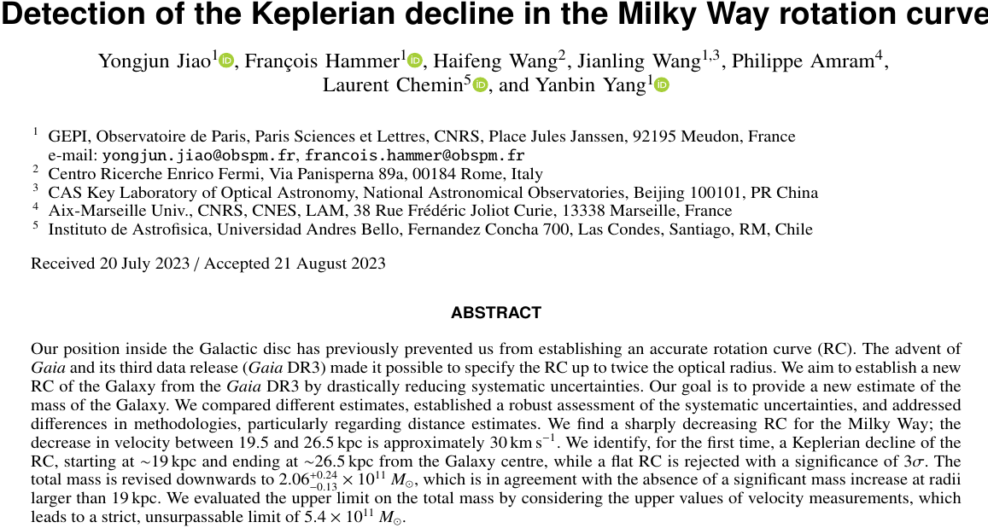

Slide 19
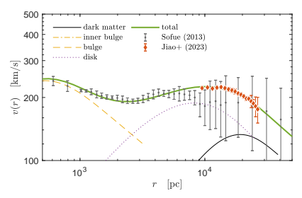
Milky Way observables: Rotation curve using GAIA DR3-data
From a detailed stability analysis of self-gravitating systems of fermions (maxima of entropy):
We find stable fermionic core-halo profiles which can fit the GAIA-DR3 rotation curve for m>200 keV, predicting a total maximum mass for the Milky Way of ~2x10^11 Mo Krut, Argüelles et al (In prep)
m = 250 keV
Mc = 4x10⁶ Mo
M_tot = 2x10¹¹ Mo

Slide 20
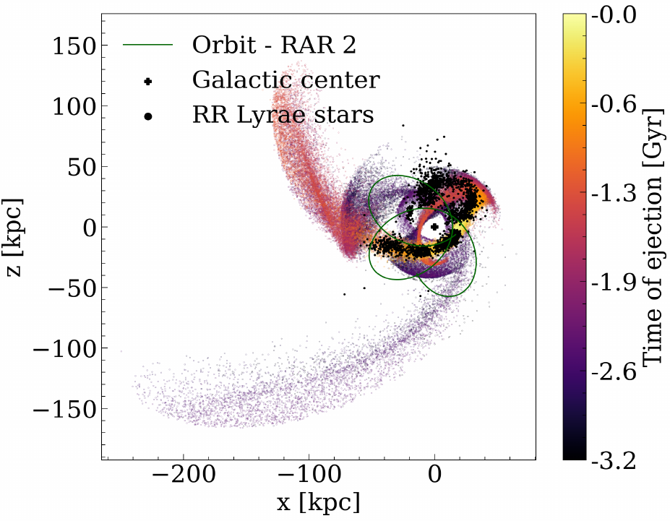
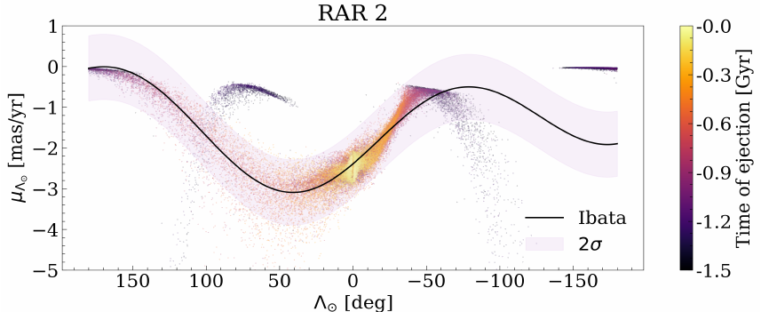
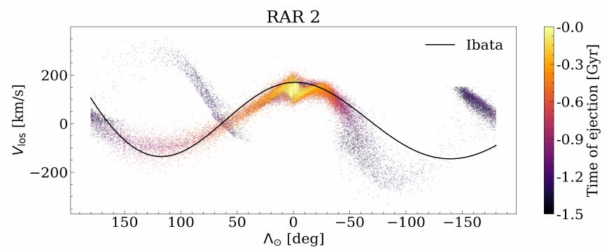
Milky Way observables: stellar streams using GAIA DR2-data
The fermionic core-halo model reproduces the main (6D) features Ibata et al. Apj (2020) of stelllar streams and simultaneously provides a good alternative to the BH scenario
(GD-1 Mestre et al. A&A (2024) and Sgr stream Collazo, Mestre & Argüelles 2024 (Submitted))
The offset through the end of the leading arm can be explained by adding the LMC

Slide 21
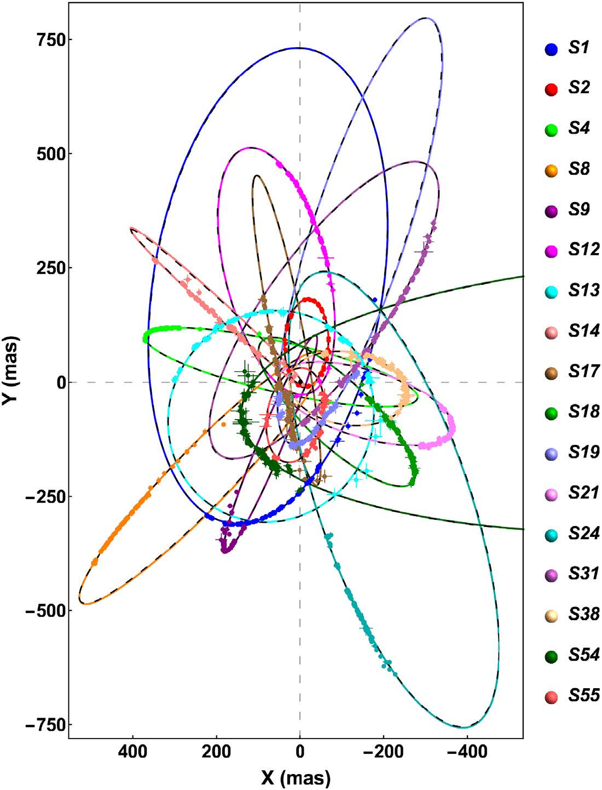
THEORETICAL and OBSERVED 17 best-resolved S-star orbits around SgrA* Gillessen et al. Apj (2017)
THEORETICAL MODELS: calculated by solving the geodesic equation of a test particle in the gravitaitonal field of:
1) Schwarzschild BH of 4.07 x 10⁶ Mo
= 1.6
2) Fermionic DM distribution with
Mc = 3.5 x 10⁶ Mo (fermion mass m= 56 keV)
= 1.5
Becerra-Vergara, Argüelles, et al. MNRAS Lett (2021)
= 1.6
= 1.6
= 1.6

Slide 22
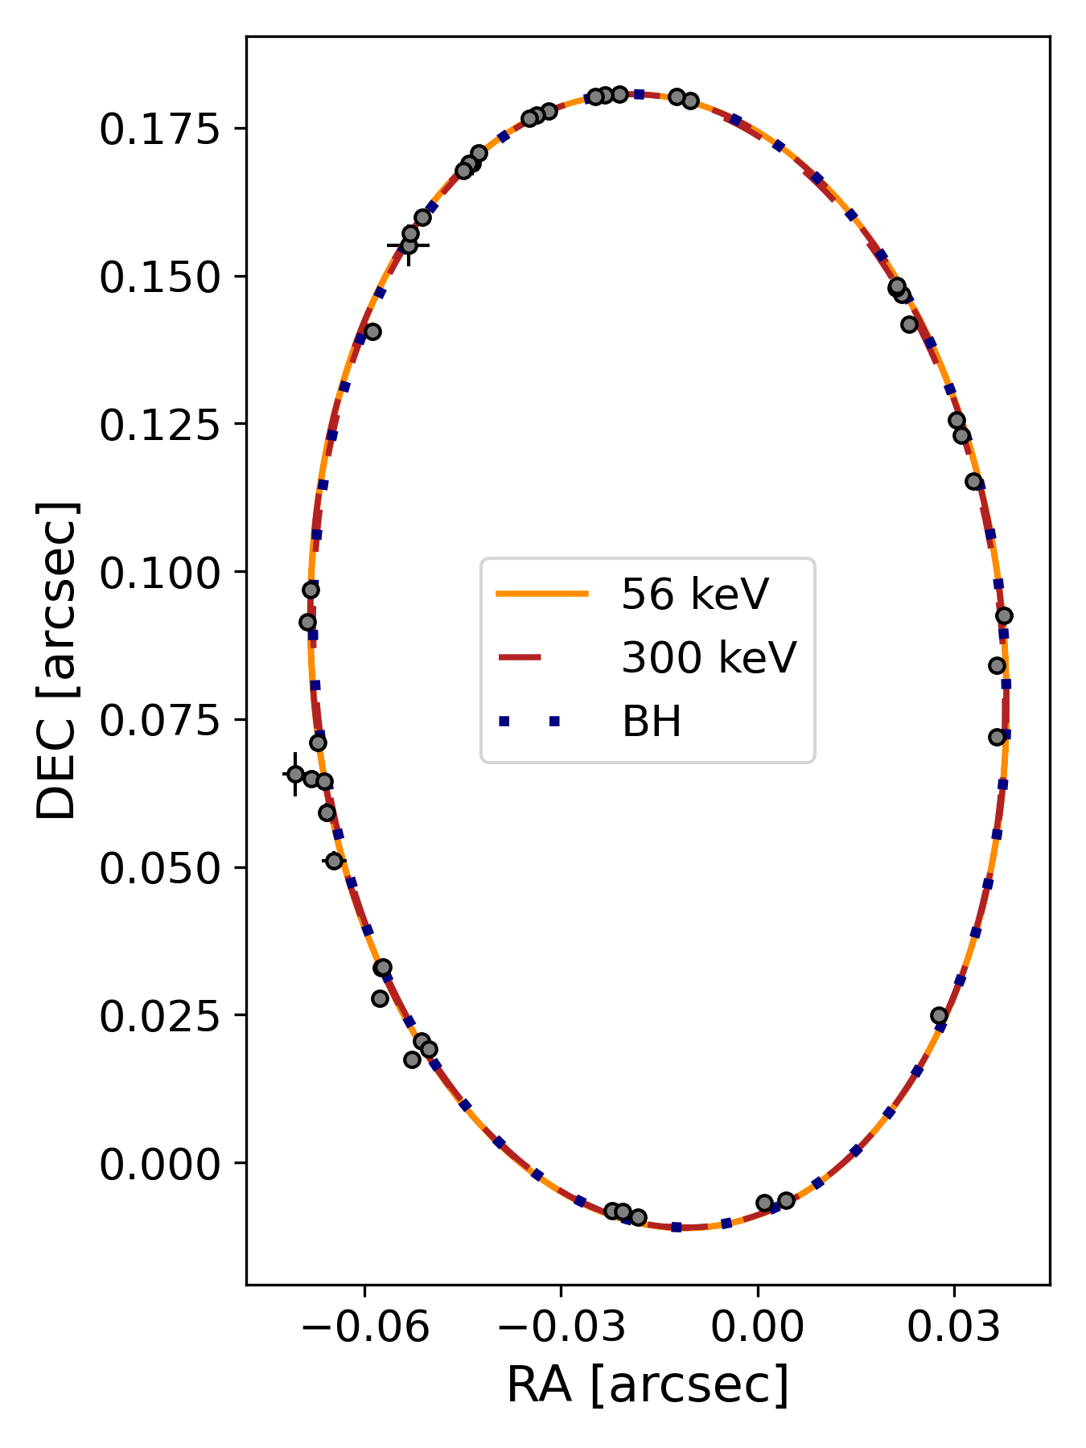
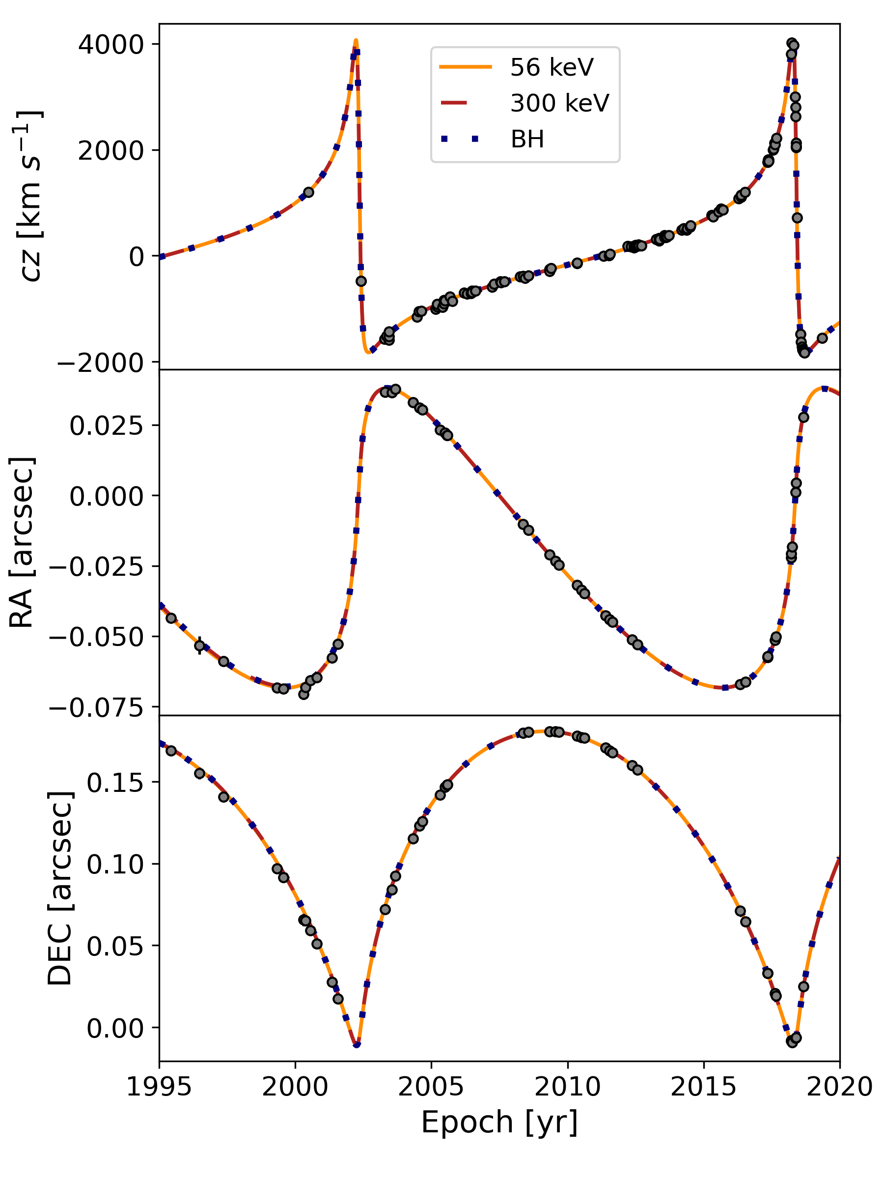
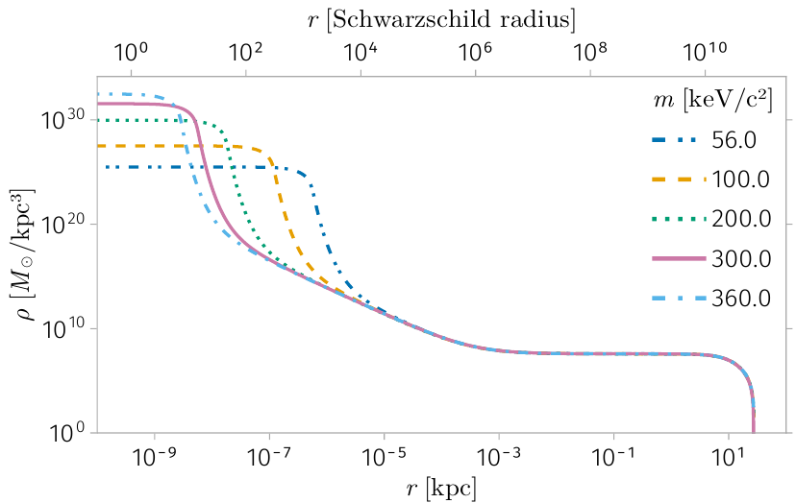
S-2 star: new results from MCMC for higher particle masses
For fixed Milky Way halo inferred from observables, it exist different core-compacities all the way to the critical mass of collapse into a BH
Crespi, Becerra-Vergara, Argüelles, et al. (In preparation)
See Becerra-Vergara et al A&A (2020) & Argüelles et al MNRAS Lett (2022) confirming observed relativistic effects

Slide 23
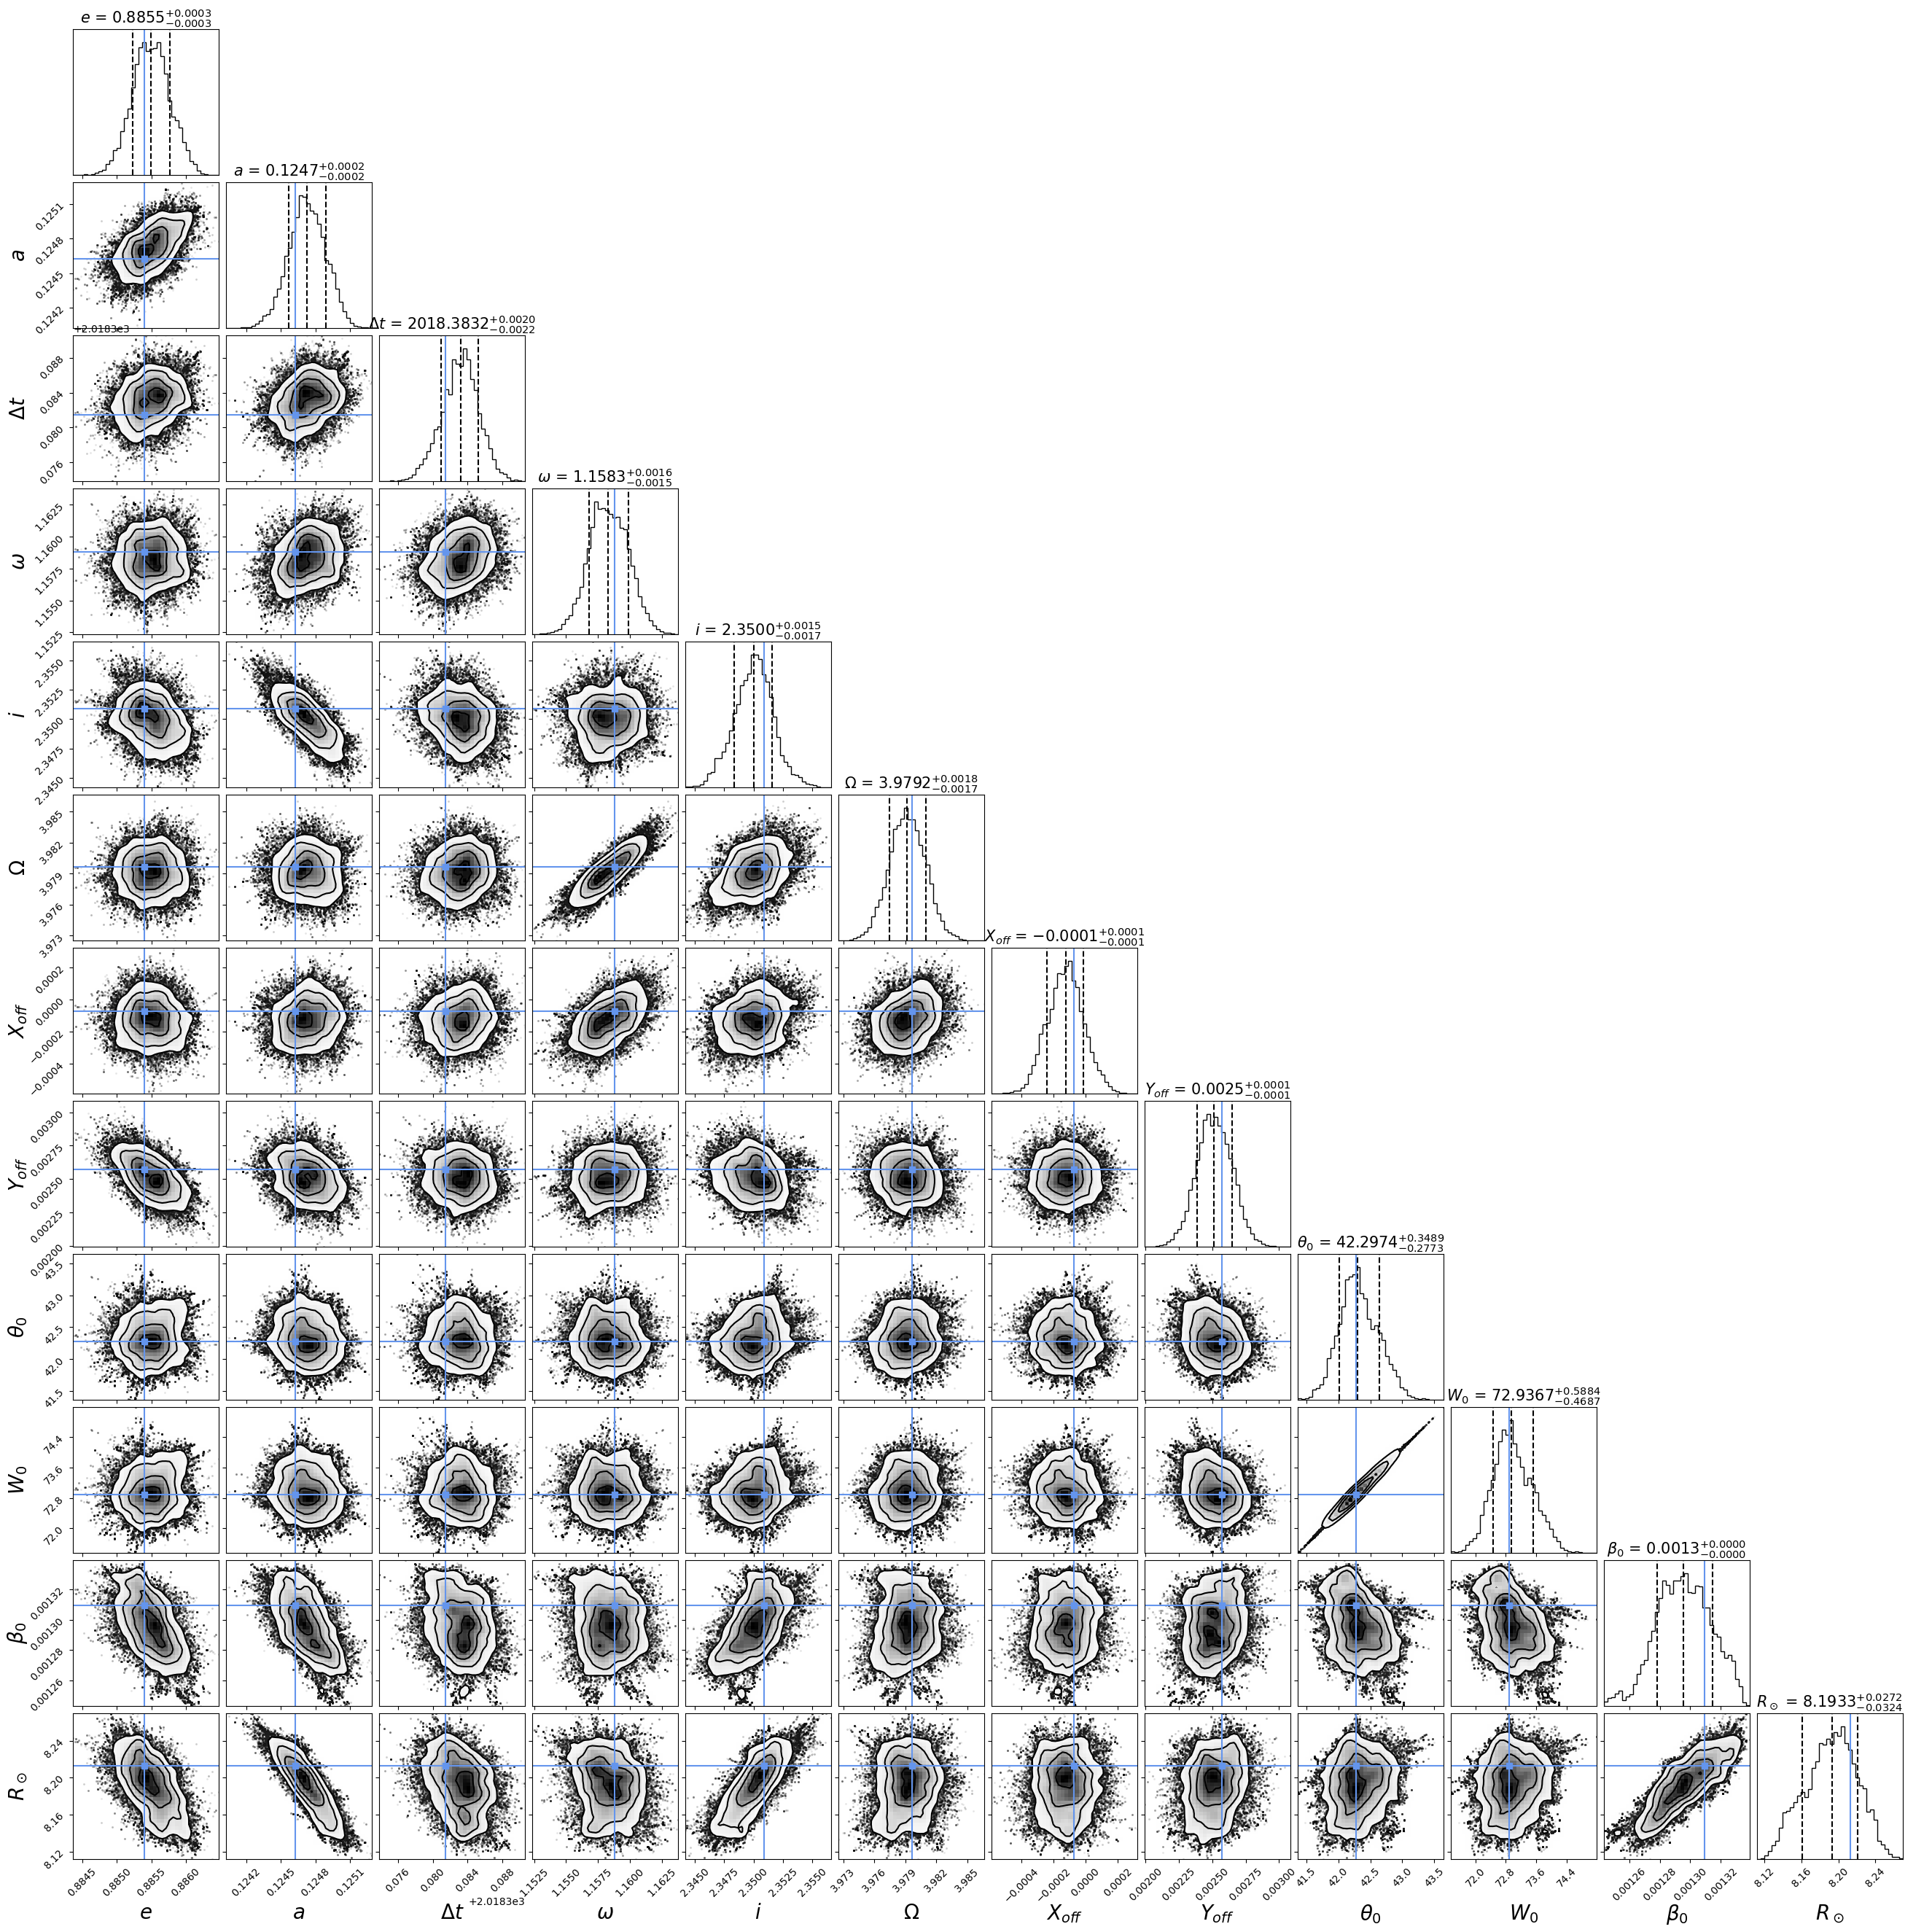
Posteriors of the S2-star orbital parameters
+ RAR model param.
determined from ​a
MCMC method within a core-halo solution (m=300 keV)
Crespi, Becerra-Vergara, Argüelles,
et al. (In preparation)
Best fit RAR model parameters:
θo=42.279
Wo=72.895
βo=1.309x10^(-3)
Orbital elements are below 1% with respect to the BH results

Slide 24
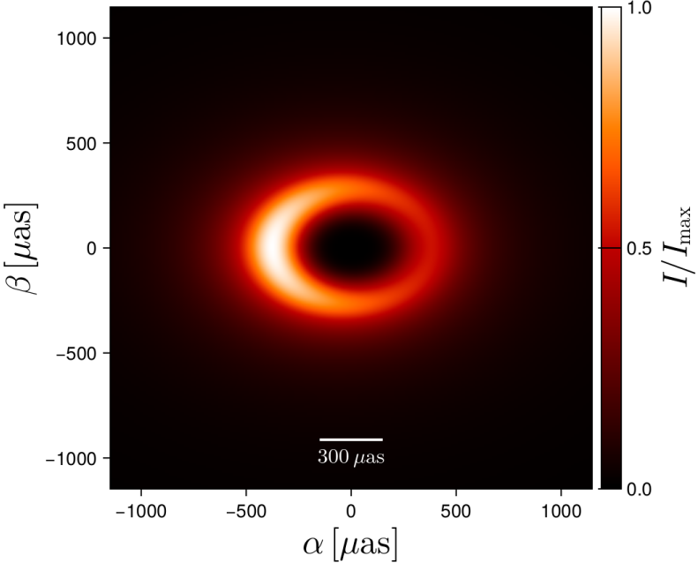
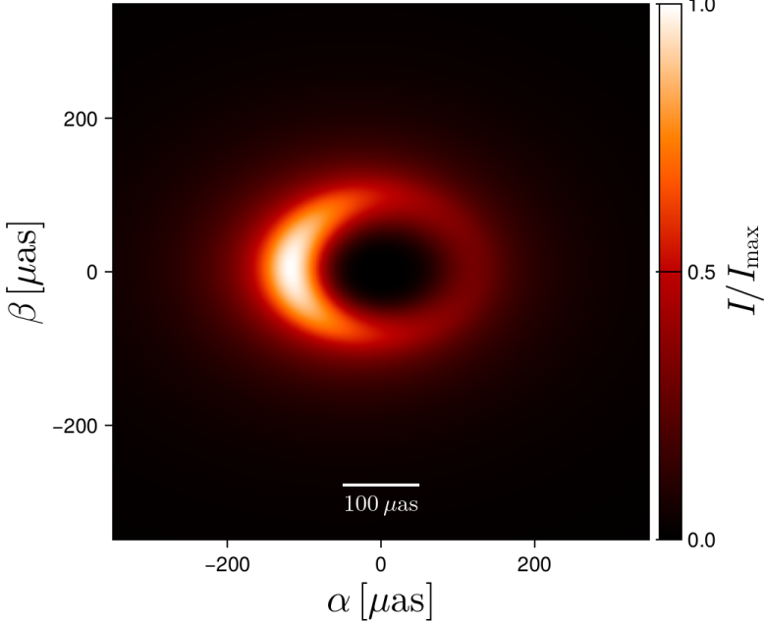
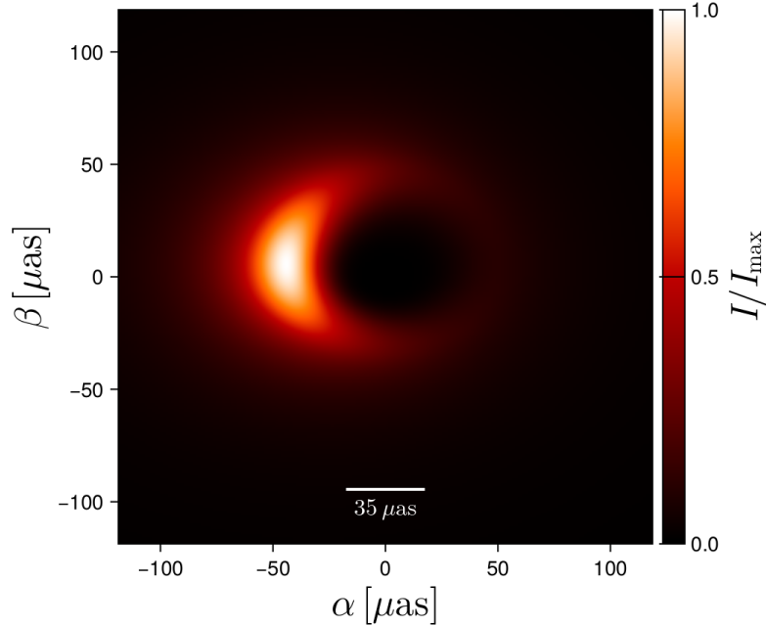
Can the fermion core cast a shadow feature like in the BH scenario?
The EHT analysis support an image dominated by a bright thick ring with diameter of 52 µas ~ 10 Rg/D
(Rg=GM/c^2) The EHT collaboration ApjL (2022)
Compact DM fermion-cores of ~4x10⁶ Mo can develope images similar to the BH case, with a shadow feature and NO photon ring !
Pelle, Argüelles, Vieyro, et al. Submitted (2024)
Full relativistic ray-tracing techniche done for a Milky Way-like case
m=200 keV
m=300 keV
m=378 keV

Slide 25
Conclusions
The DM halo region of fermionic profiles is of “cored” nature in better agreement with observations than traditional CDM cuspy ones
RAR profiles develop a dense, compact & supermassive core (lacking a hard surface) which can mimic the space-time signatures of a massive BH, or eventually collapse into one
The model can help us to explain the nature, formation and fast growth of SMBH in the early Universe
The fermionic model may provide a natural explanation for the connection between massive BHs and surrounding halos
The model provides insights into the nature & mass of the DM particle (sub-MeV)
Thank you !

Slide 26
Back up slides

Slide 27
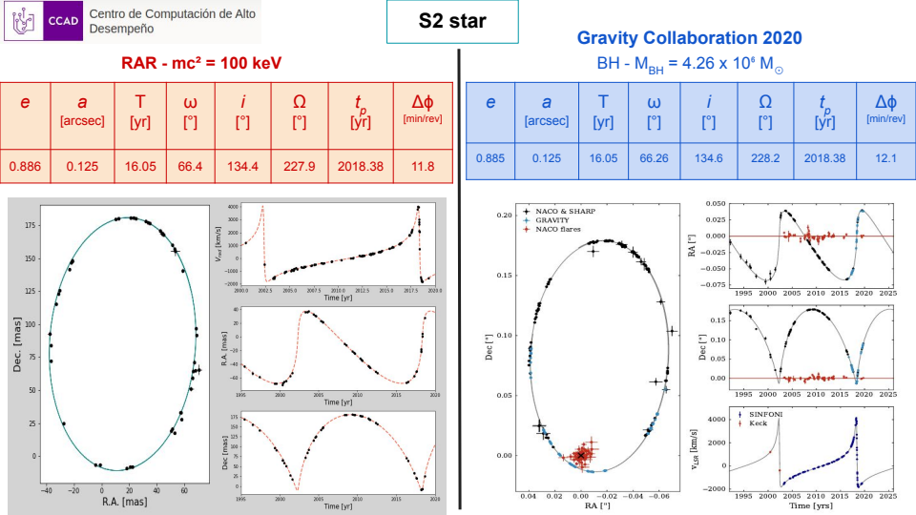

Slide 28
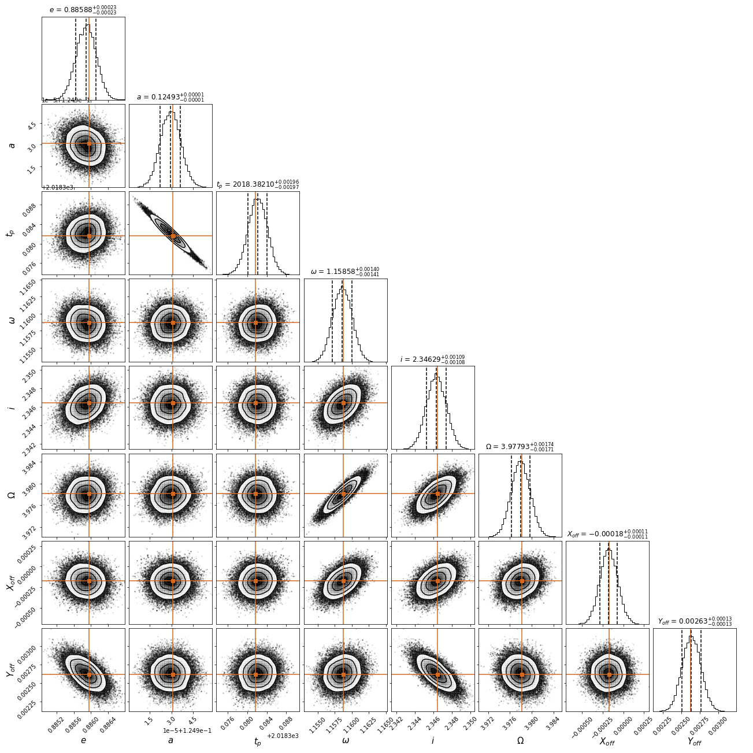
Posteriors of the S2-star orbital parameters
determined from ​a
Monte-Carlo Markov-Chain method within a core-halo non-criritcal
solution (m=100 keV)

Slide 29
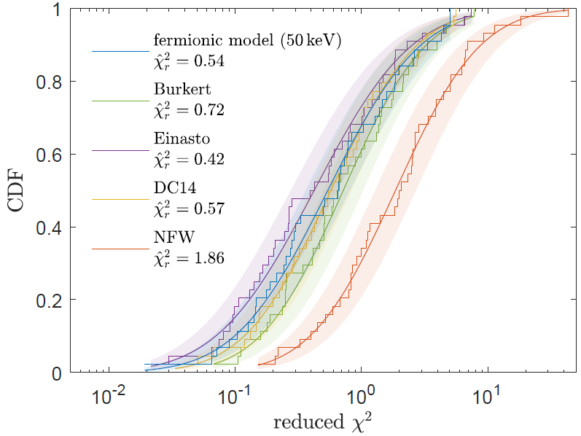
Testing the RAR model with the SPARC data-set of 120 disk galaxies
- RAR profiles which best-fit SPARC galaxies can develope halo shapes similar to Burkert
- Cuspy (NFW) DM profiles are clearly disfavoured w.r.t cored profiles by the SPARC RCs
Krut, Argüelles, Chavanis, Rueda, Ruffini, Apj (2023)​

Slide 30
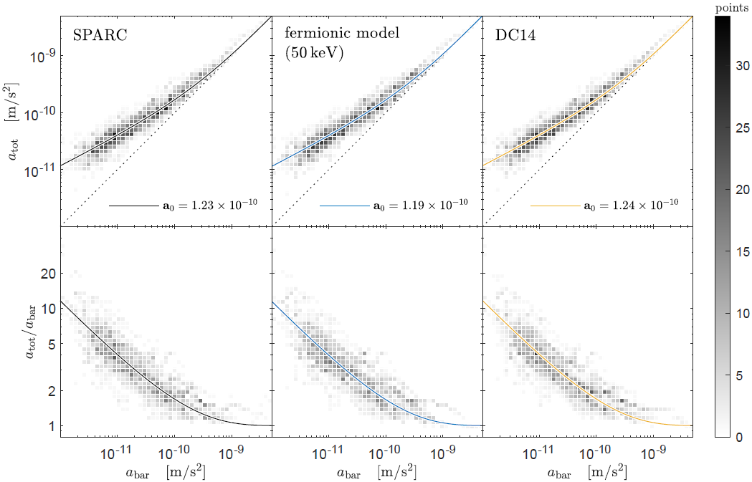
The RAR model explains the Radial Acceleration Relation and the BTFR
Radial Acceleration Relation: Non linear correlation between the radial acceleration caused by the total matter, and the one generated by the baryons only: Valid at any resolved galaxy radii !
These acceleration relations DO NOT imply of any new physics (i.e. MOND), and can be reproduced by the LCDM, and by the fermionic halos obtained from a MEP
Krut, Argüelles, Chavanis,
Rueda, Ruffini, Apj (2023)​

Slide 31
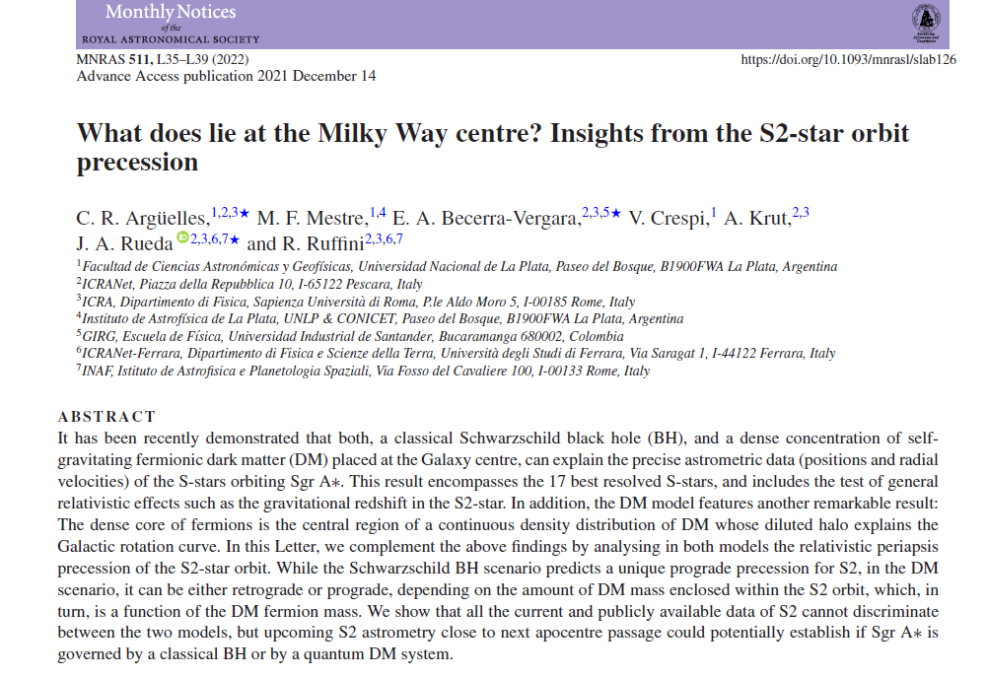

Slide 32
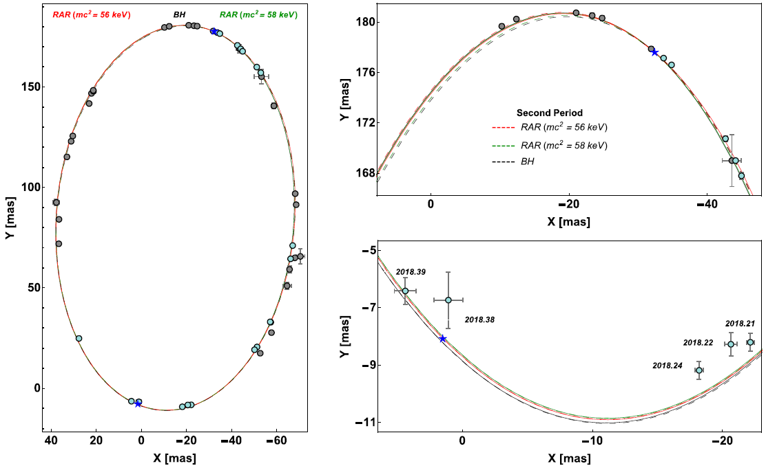
Testing the DM-core alternative to the BH with the S-2 star precession
Argüelles et al. MNRAS Lett. (2022)

Slide 33
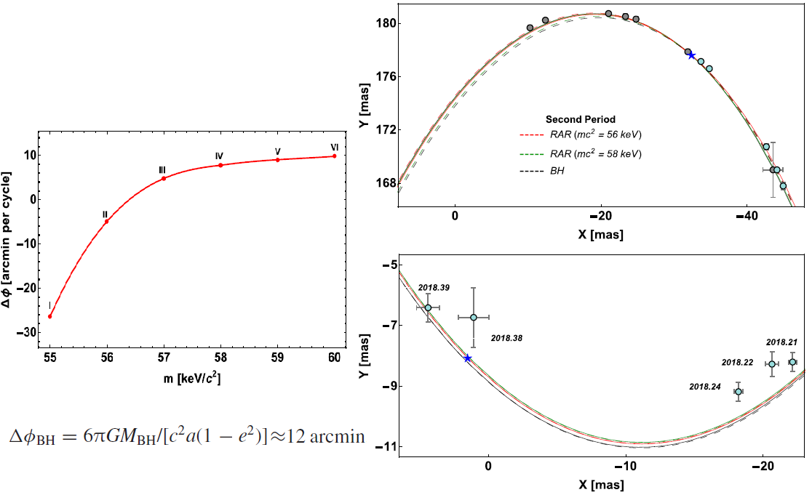
Testing the DM-core alternative with the S-2 star precession
Argüelles et al. MNRAS Lett. (2022)

Slide 34
Rotation Curve fitting using state-of-the-art Machine Learning
We use machine learning tools (grdient descent, through PyTorch) to fit the observed Milky Way RC: Very useful to test semi-analitical models for DM (such as RAR, or Fuzzy DM) : can include > 10 free parameters (Baryonic + DM), minimizing the Loss-function in few hs time
Collazo, Argüelles & Mestre, http://fof.oac.uncor.edu/2022/posters/ (2022)

Slide 35
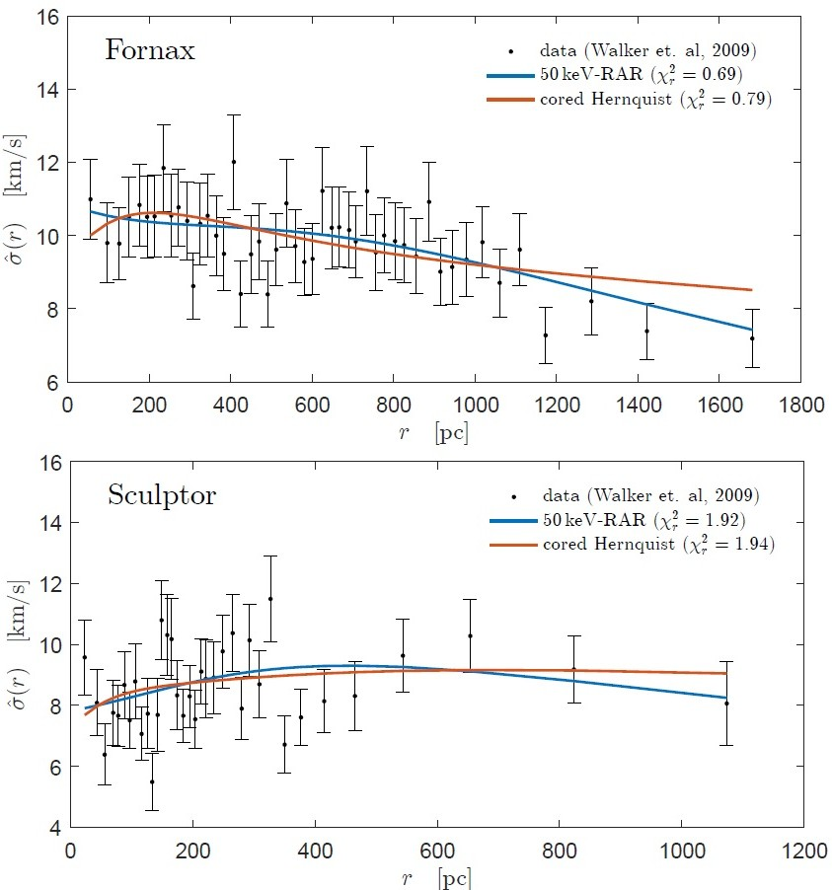
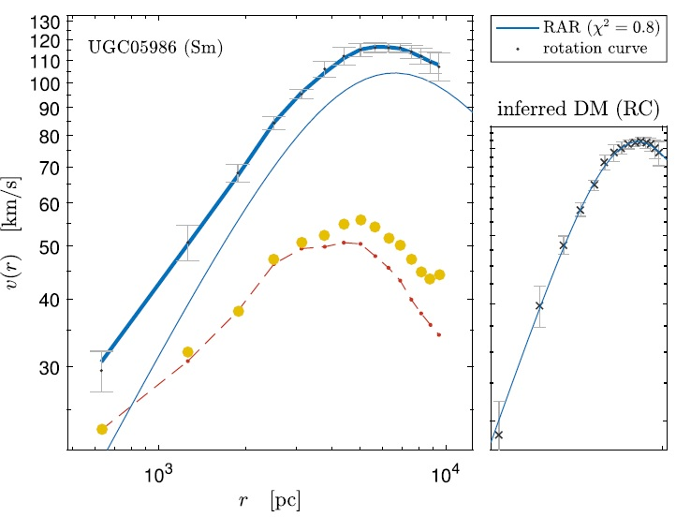
L.o.S dispersion velocity data and high resolution rotation curves in disk galaxies are well reproduced by the model​

Slide 36
Applications: Galactic Scales (Stellar-Stream tracers)

Slide 37
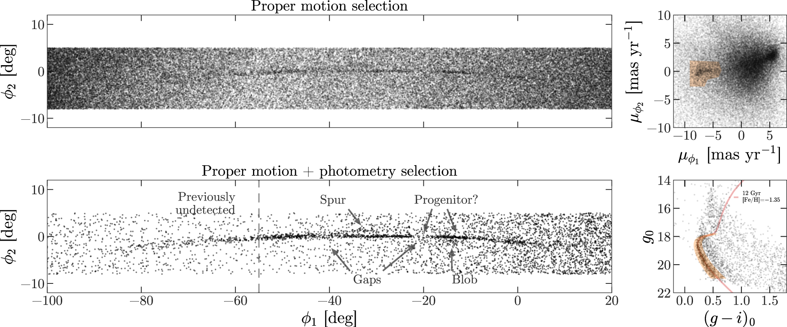
Constraining the fermionic DM model with the GD-1 stream
A cold stream (GD-1) travelling through the halo (shown in self-coordinates along the stream) Price-Whelan & Bonaca, Apj (2018)
Can the Gd-1observables be explained for a Milky Way composed of baryons + fermionic DM model ?

Slide 38
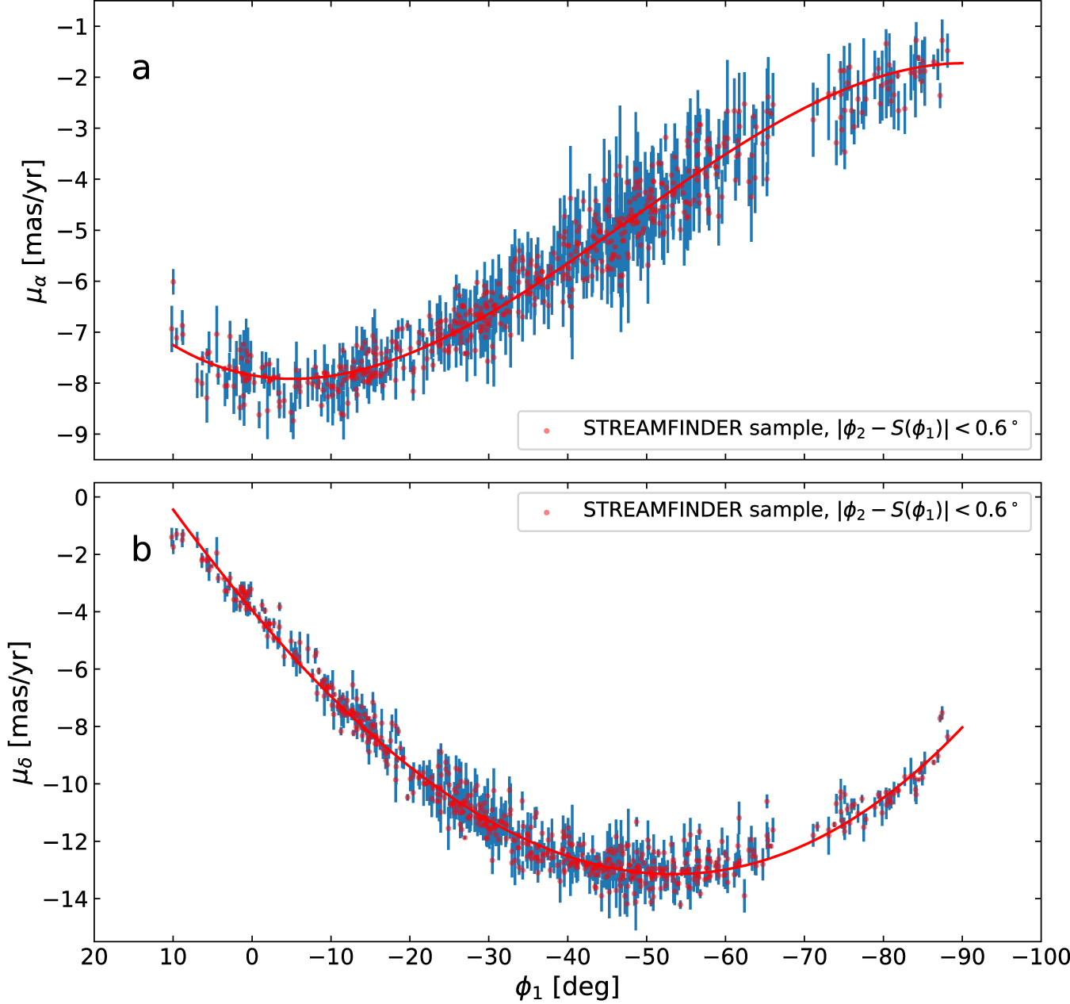
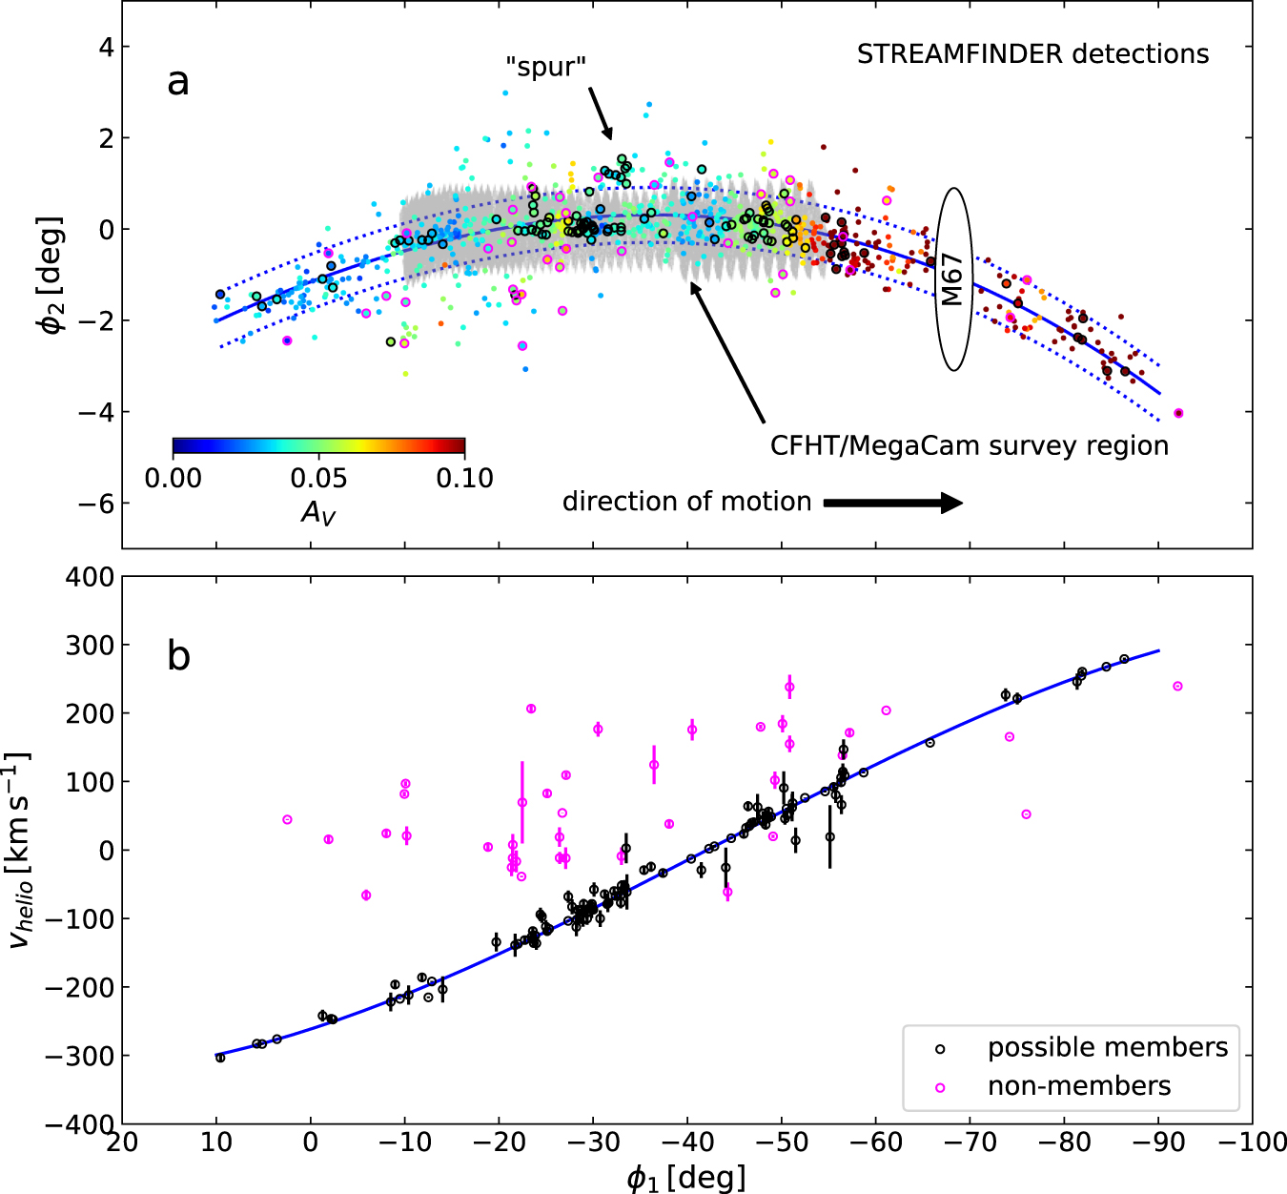
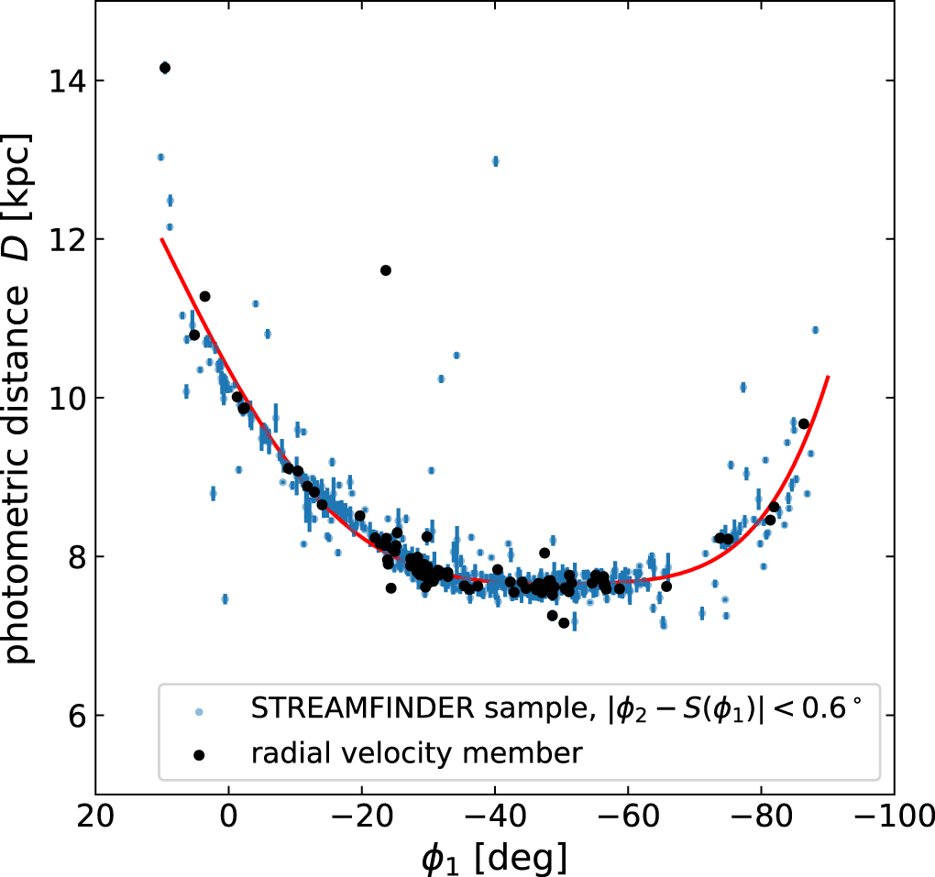
GD-1 observables
Ibata, et al. Apj (2020)
STREAMFINDER (Gaia DR2): 811 star candidate members;
Cross correlation with spectroscopy: 156 stars in RV sample

Slide 39
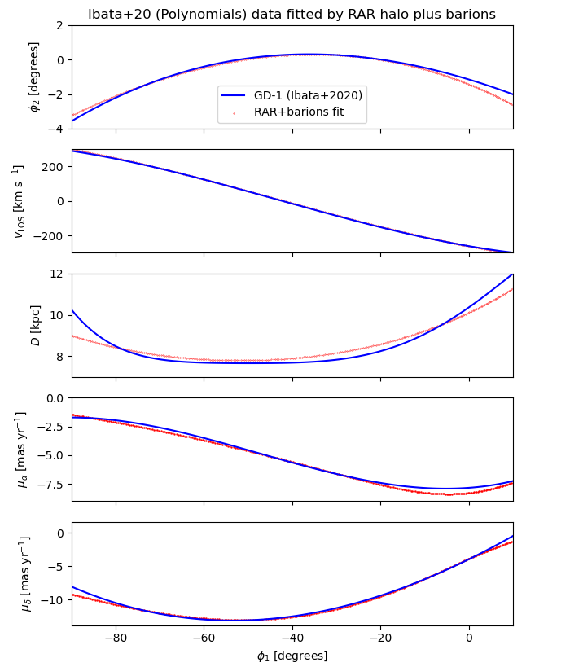
Best-fit RAR model parameters to GD-1
Full model: Galaxy potential + GD-1 stream
Galaxy potential: RAR(θ0, W0) + Baryons (fixed)
(m and β0 fixed to fulfill Mc=M_(SgrA*)
in agreement with S-stars)
GD-1 stream: Orbit (IC) (6 parameters)
We find a best fit parmeters
Θ0=36.2; W0=63.6
In Good agreement with overall rotation curve
(independent tracer!)
Mestre, Argüelles, et al. A&A (2024)

Slide 40
Applications: Cosmological Scales (non linear regime)

Slide 41
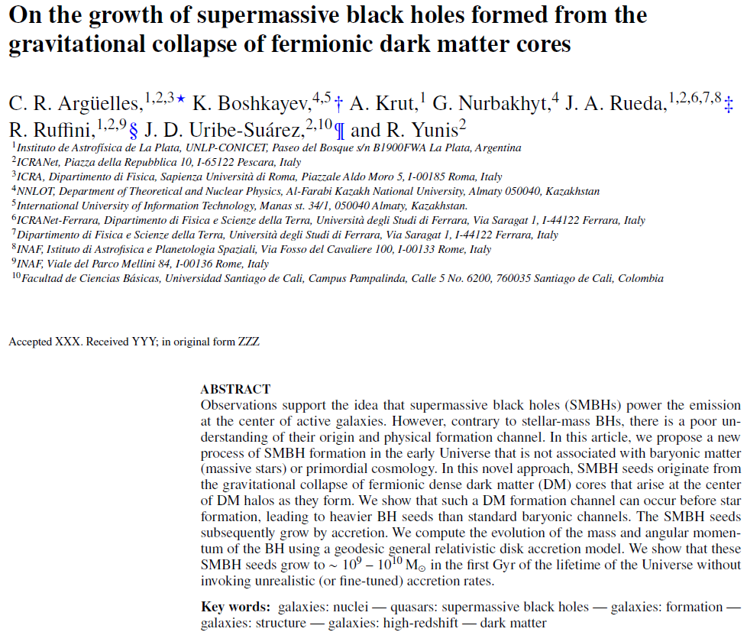

Slide 42
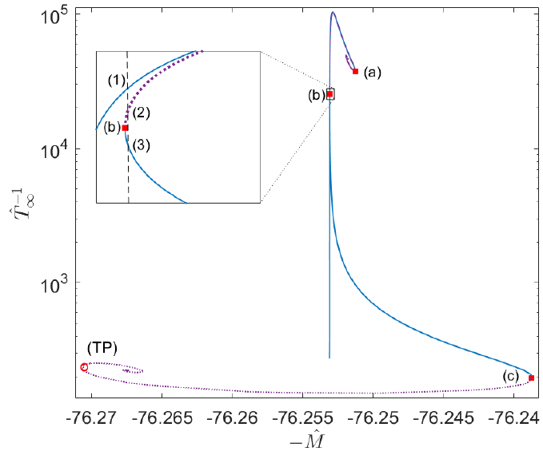
How a self-gravitating system of collisionless fermions reaches the steady state?
Dynamically stability - i.e having f(r,p) solution- DOES NOT necessarily imply thermodynamic stability (Some dynamically stable solutions are more likely in Nature than others)
To find dynamically and thermodynamicaly stable
configurations of fermions in GR, we need
solutions that maximize the global entropy
δ^2 S< 0
Gibbs-Duhem
Stability problem can be solved via the Katz criterion J. Katz, MNRAS (1978) : relies only in the derivatives of the caloric curve (E vs. 1/T∞)
Series of equilibrium along the caloric curve for fixed N and µ. The case of typical DM halos of M ~ 5 x 10¹⁰ Mo Argüelles et al. MNRAS (2021)

Slide 43
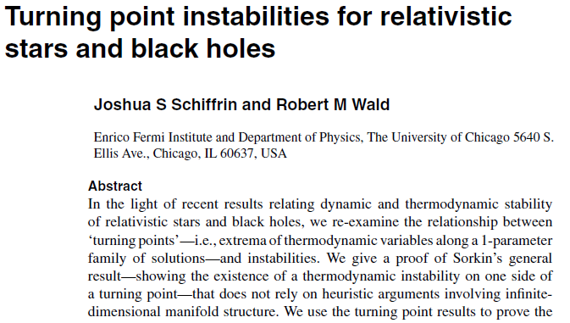
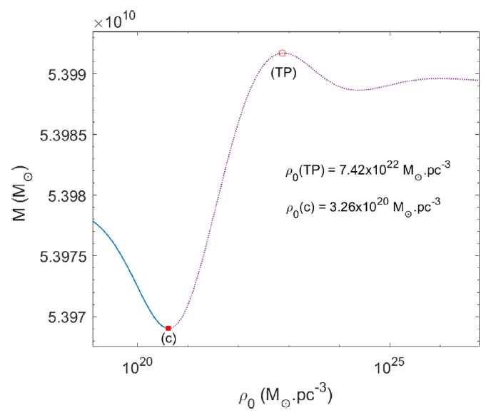
Turning point instability & last stable configuration
Hystorically, the gravitational collapse of a degenerate (and relativistic) `star’ was understood in terms of the onset of a thermodynamic instabiliy at a Turning-Point (TP), e.g. at dM/dρo =0
However TPs don’t provide a necessary condition for thermodynamic instability: the onset of instability can occur prior to the TP (or even without its existence) Schiffrin & Wald (2014)
For our case we have:
Argüelles et al. MNRAS (2021)

Slide 44
How do we obtain realistic DM halos in cosmology via this method ?
One should i) calculate the power spectrum P(k) in a given (~10¹ keV) cosmology (CLASS)
ii) apply the Press-Schechter formalism to obtain M_{vir} = M(R_{vir}) at given z_{vir};
Hablar Aca sobre:
Boltzmann Hierarchies (poner termino de interacciones)
Quien es f0 en el caso de neutrinos
Mass variance
Window top-hat function
Critical overdensity (spherical collapse)
M_{vir} = 5.4 x 10¹⁰ Mo
m=50 keV
iii) Use the stable family of solutions obtained at violent relaxation (i.e. valid at z_{vir}), in agreement with avobe virial constraints
Argüelles et al. MNRAS (2021)

Slide 45
Novel SMBH formation scenario from DM core-collapse
This solution may provide initial seed for the formation of observed SMBHs in active galaxies such as M87 (without the need of unrealistic super – Eddington accretion rates)
The degeneracy pressure of the DM core cannot support its own weight and undergo a core-collapse towards a SMBH-seed from DM ! (i.e. without the need of barionic matter)
Argüelles et al. MNRAS (2021)

Slide 46
Disc accretion for horizonless dark compact objects: the fermion core
We study accretion flow and associated emission using generalized “α-discs” onto the DM-core
Millauro, Argüelles et al. A&A (2024)
Fermionic DM profiles of active galaxies
Example: Mc=10⁷ Mo; M=10¹² Mo
Solution A2 → m=50 keV
Solution B2 → m=200 keV
Emitted flux: it always exist a DM-core comapcity such that the flux is indistinguishable from that of BH of the same mass as the core
Efficiency of energy extraction from the central object
- Geometrically thin & optically thick disc with angular speed ~ Keplerian

Slide 47
Growth of SMBH seeds formed from the gravitational collapse of DM cores
. We compute, in a Kerr metric, the evolution of mass and angular momentum of the BH using a geodesic general relativistic disc accretion model
Argüelles et al. MNRAS (2023)
. The rate at which the rest-mass dm flows inward through the local balance between gravitational acceleratoin and radiation pressure (along z-axis) is calculated
This BH-seeds are larger tan typical baryonic-sedes (e.g. Pop. III stars), and can grow up to 10^9 – 10^(10) Mʘ in a fraction of 1st Gyr of the life of the Universe without invoking unrealistic accretion rates !

Slide 48
Different Massive BH formation channels: Baryonic & Early Universe channels
Volonteri et al. Nat. (2021)​
​
(I) Baryonic channels:
Pop. III stars (1st stars remnants)
Direct collapse of gas clouds
Runnaway collisions in star clusters
(II) Early Universe channels:
(poorly constrained epochs)
Topological defects (cosmic strings, domain walls)
(III) DM channels:
Fermionic DM core-collapse
SIDM (grav. catastrophe)

Slide 49
Success of the LCDM paradigm on large scales
Cosmological perturbation theory
Describes how primordial density perturbations grow into galactic structures due to gravity
Success of CDM:
Cold, colissionless self-gravitating system
Astrophysical observations (CMB, BAO, Ly-α forest, local distribution and evolution of galaxies, etc) ranging from horizon scale (∼ 15000 Mpc) to the typical scale between galaxies (1 Mpc) are all consistent with a Universe that was seeded by a scale invariant primordial spectrum, and that is dominated by dark energy ∼ 70% followed by ∼ 25% of Cold Dark Matter (CDM) and only ∼ 5% of baryons plus radiation [Planck Collaboration et al., 2016]; [Vogelsberger et al., 2014]; [Kitaura, Angulo, et al., 2012]
Lambda-CDM Cosmology
Compelling evidence for non baryonic matter in the CMB: Need for Dark Matter

