Slide 1
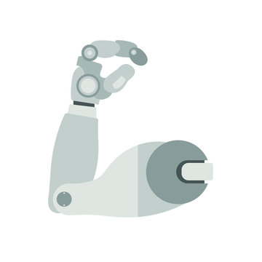
Grasp Classification based on Electromyographic (EMG) signals
Iris Kyranou

Slide 2
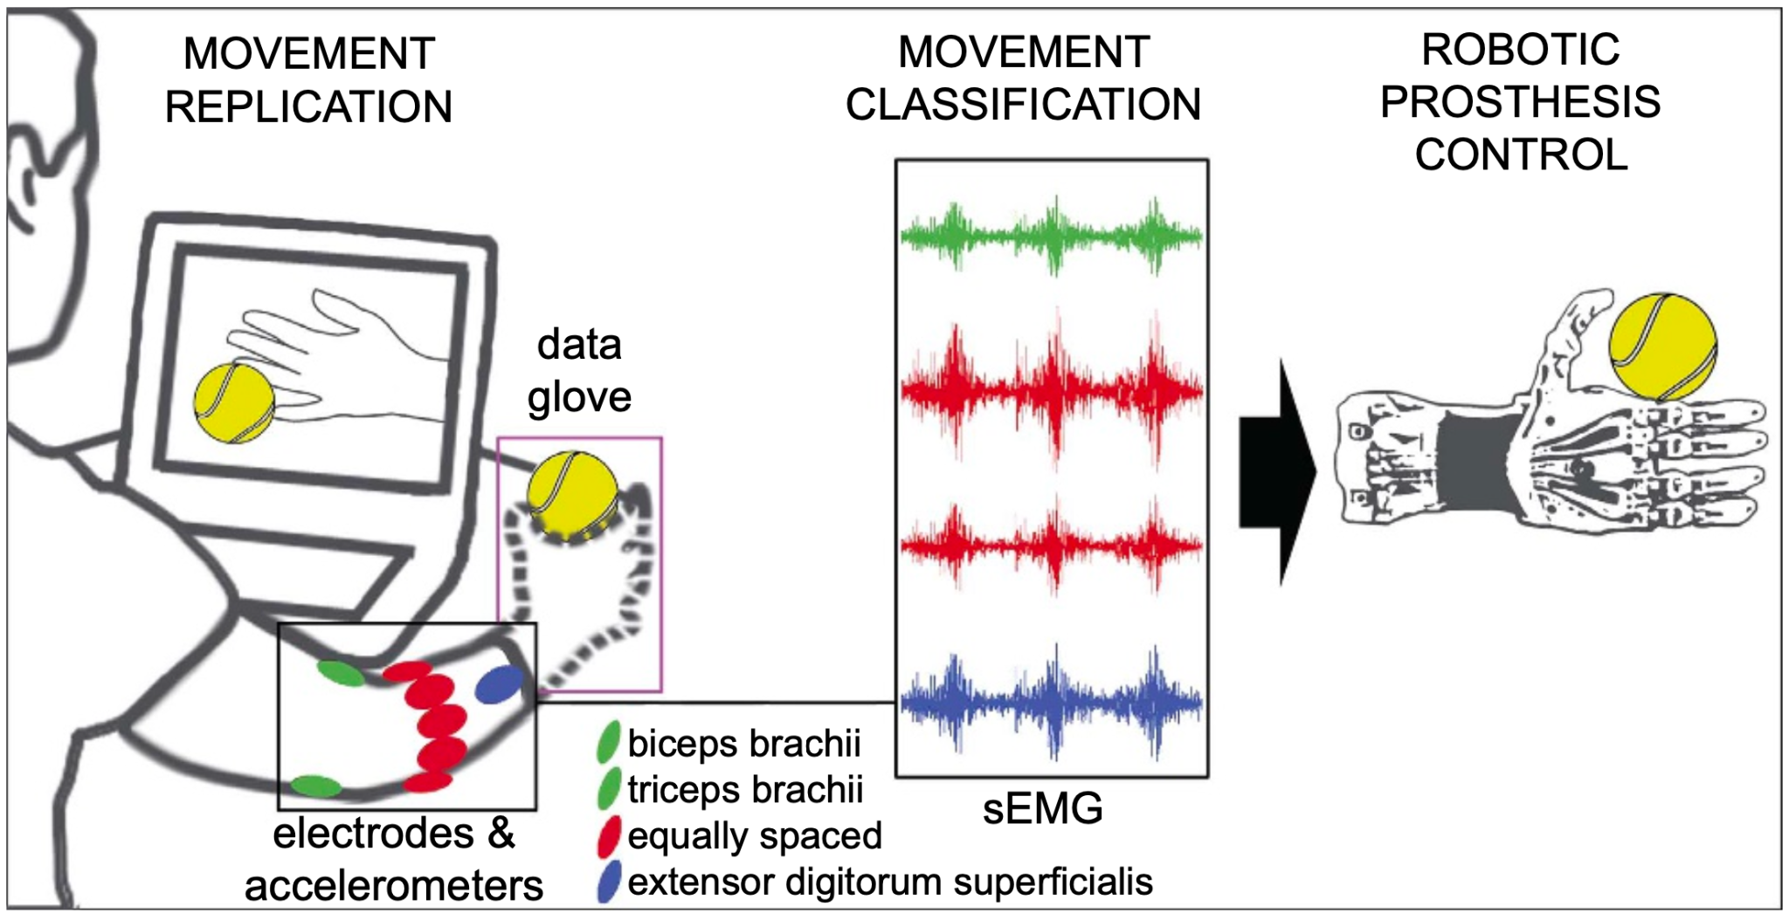
Goal - Control a robotic prosthetic hand
Figure from Atzori et al., 2014

Slide 3
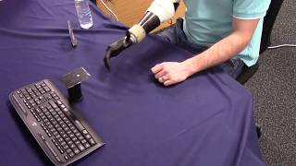
Goal - Control a robotic prosthetic hand

Slide 4
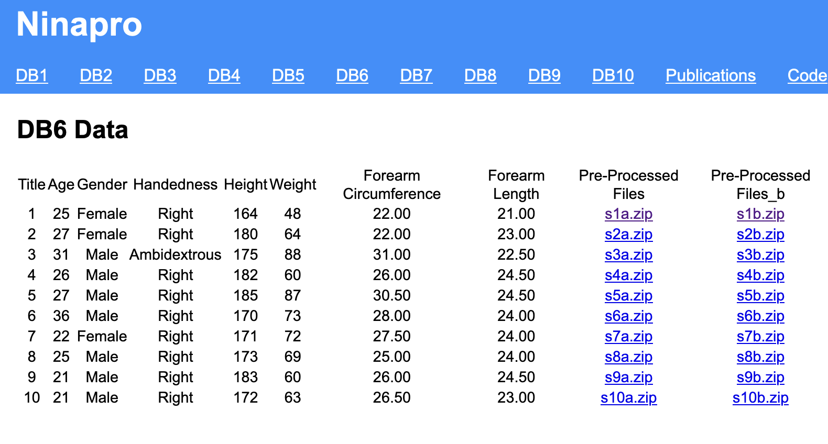
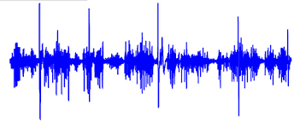
The data
Ninapro dataset
EMG data
Accelerometer data
Stimulus (labels)

Slide 5
The Challenge
Familiarize yourself with the machine learning pipeline for grasp recognition based on the EMG signals:
Raw signal pre-processing
Design of classification algorithm
Test the classification algorithm
Explain the results (visualization, quantification)
Explore the between different sessions’ (a or b) generalization of your algorithm
Can you use the algorithm trained on the ‘a’ set to classify the grasps from the same subjects’ ‘b’ set?
Can you adapt the algorithm to improve the performance of the classifier without retraining the whole model?
Explore the between different subjects’ generalization of your algorithm
Can you adapt the trained model on one (or more) subject(s) to recognize the grasps performed by a subject whose data you have not used in the training?

Slide 6
Questions

