Slide 1
Analysis of anatomical connectivity networks in patients with epilepsy embedded in Euclidean space.
Steven Fernando Rico Aparicio Industrial University of Santander, Colombia Mario Chávez Brain Institute of Paris – Pitié Salpetriere Hospital. Paris, Francia CNRS

Slide 2
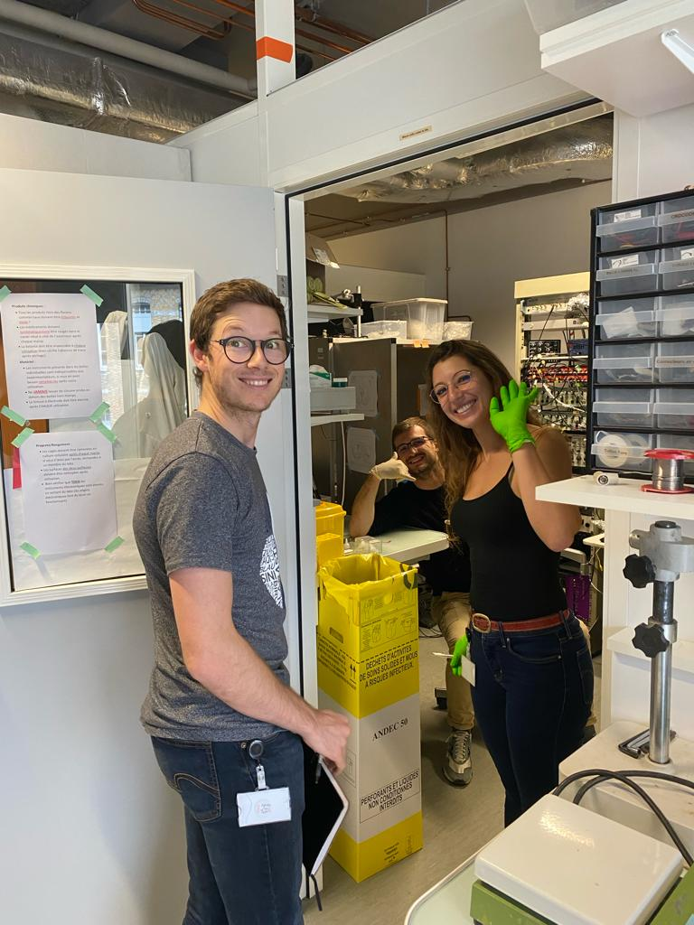
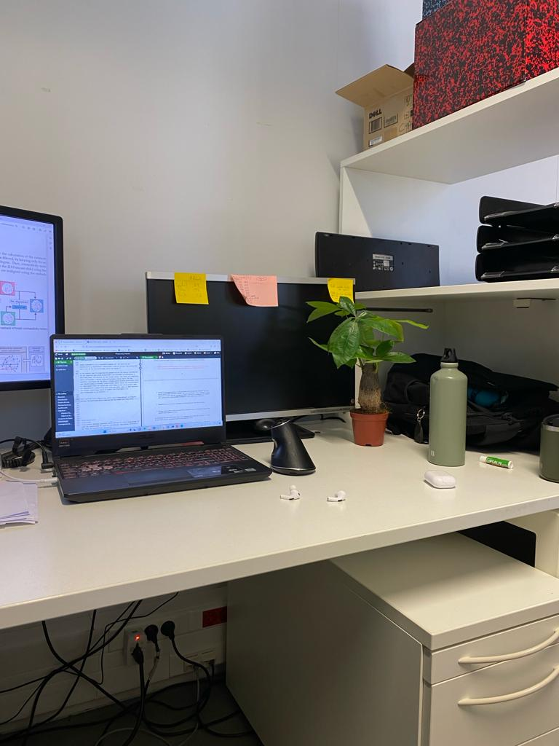
Data
Diffusion Map
Procrustes
Distances
Nodes
$$1$$

Slide 3
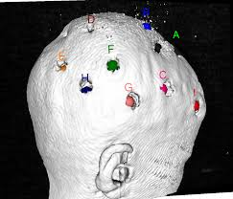
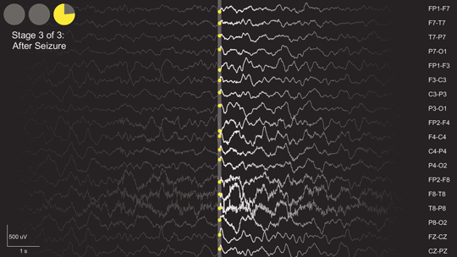
Diffusion Map
Procrustes
Distances
Nodes
Data
intracranial electroencephalography
(iEEG)
Delta < 4 Hz
Theta 4 – 7 Hz
Alpha 8 – 12 Hz
Beta 13 – 30 Hz
Low Gamma
> 30 Hz High Gamma
$$2$$

Slide 4
Diffusion Map
Procrustes
Distances
Nodes
Data
Day
$$1$$
$$2$$
$$3$$
$$4$$
$$…$$
$$m$$
Time of data colection by iEEG
Interictal
Preictal
$$0_{min}$$
$${10}_{min}$$
$$3$$

Slide 5
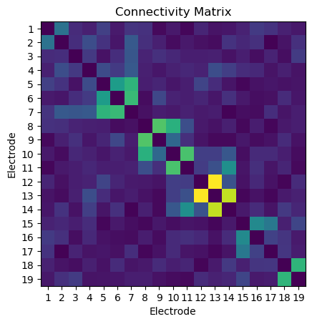
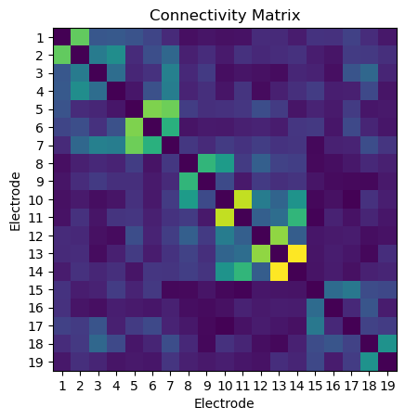
Diffusion Map
Procrustes
Distances
Nodes
Data
$$s_{1}$$
$$s_{2}$$
$$s_{3}$$
$$s_{4}$$
Day
$$1$$
$$2$$
$$3$$
$$4$$
$$…$$
$$m$$
$$…$$
Time of data colection by iEEG
Interictal
Preictal
$$0_{min}$$
$${10}_{min}$$
$$s_{n}$$
$$4$$

Slide 6
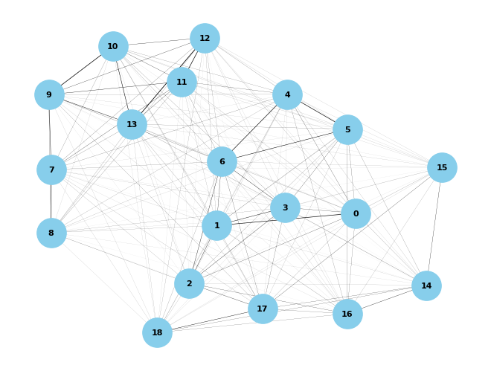
Data
Diffusion Map
Procrustes
Distances
Nodes
Creation of graphs
INTERICTAL
PREICTAL
$$7$$

Slide 7
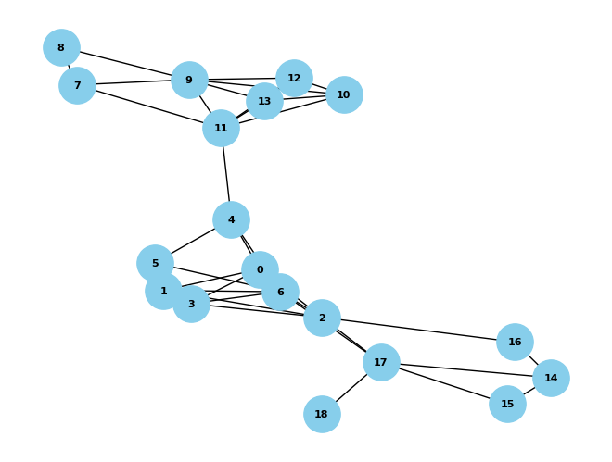
Data
Diffusion Map
Procrustes
Distances
Nodes
Creation of graphs
and filtering by spanning tree with mean degree 3
INTERICTAL
PREICTAL
$$8$$

Slide 8
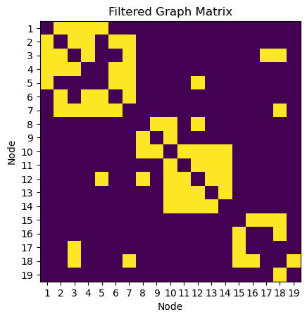
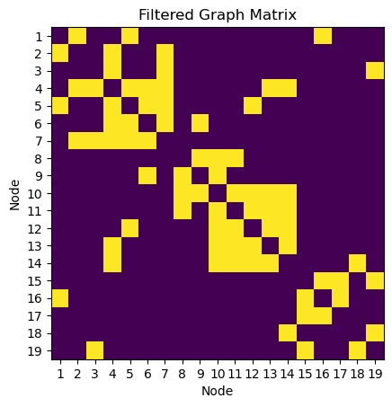
Data
Diffusion Map
Procrustes
Distances
Nodes
Creation of graphs
INTERICTAL
INTERICTAL
and filtraiting by spanning tree with mean degree 3
PREICTAL
PREICTAL
and Binarization
$$9$$

Slide 9
Data
Procrustes
Distances
Nodes
Diffusion Map
Nonlinear dimensionality reduction technique of a data set in Euclidean space whose coordinates can be computed from the eigenvectors and eigenvalues of a diffusion operator on the data.
This reduction technique works by using the degree of the graph to find the probability of transition between all the data.
The eigenvalues and eigenvectors of the transition matrix provide the representation of the initial graph as a cloud of points in a lower dimensional space.
Shan, S., & Daubechies, I. (2022). Diffusion maps: Using the semigroup property for parameter tuning
$$10$$

Slide 10
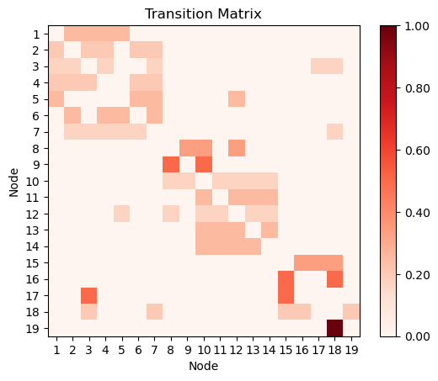
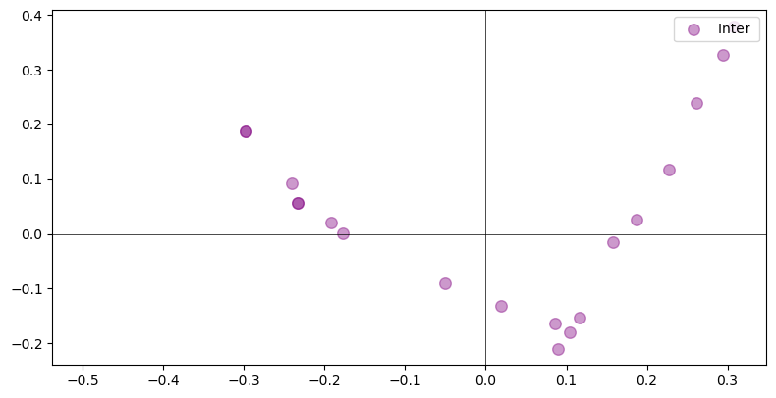
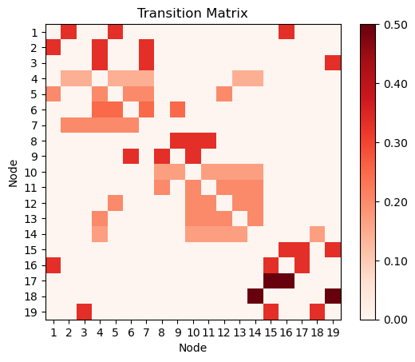
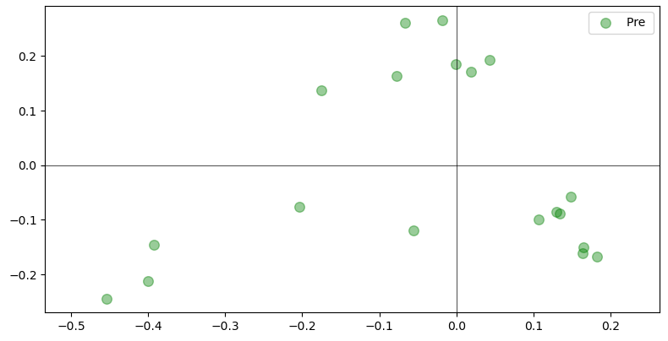
Data
Diffusion Map
Procrustes
Distances
Nodes
2D Spatial Distribution of the Embedding in Euclidean Space
2D Spatial Distribution of the Embedding in Euclidean Space
$$11$$

Slide 11
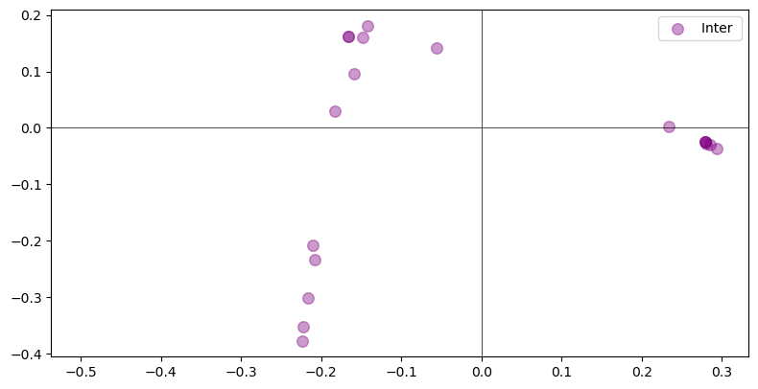
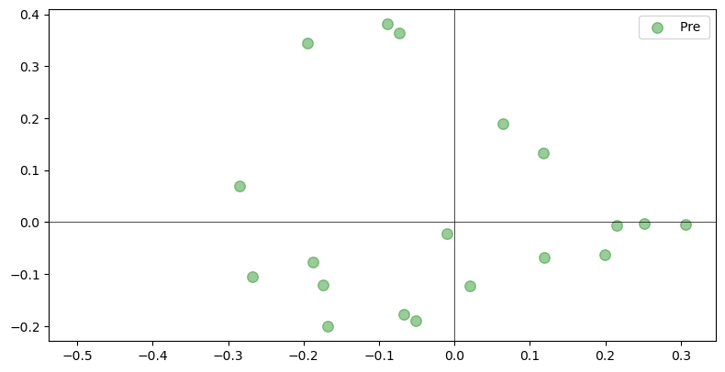
Data
Diffusion Map
Procrustes
Distances
Nodes
2D Spatial Distribution of the Embedding in Euclidean Space
$$…$$
$$…$$
2D Spatial Distribution of the Embedding in Euclidean Space
$$12$$

Slide 12
Data
Diffusion Map
Distances
Nodes
Procrustes
Generalized Procrustes Analysis (GPA) is a multivariate exploratory technique that involves transformations (i.e., translation, rotation, reflection and isotropic rescaling) of individual data matrices to provide optimal comparability.
$$13$$

Slide 13
Data
Diffusion Map
Procrustes
Distances
Nodes
$$…$$
$$…$$
$$14$$

Slide 14
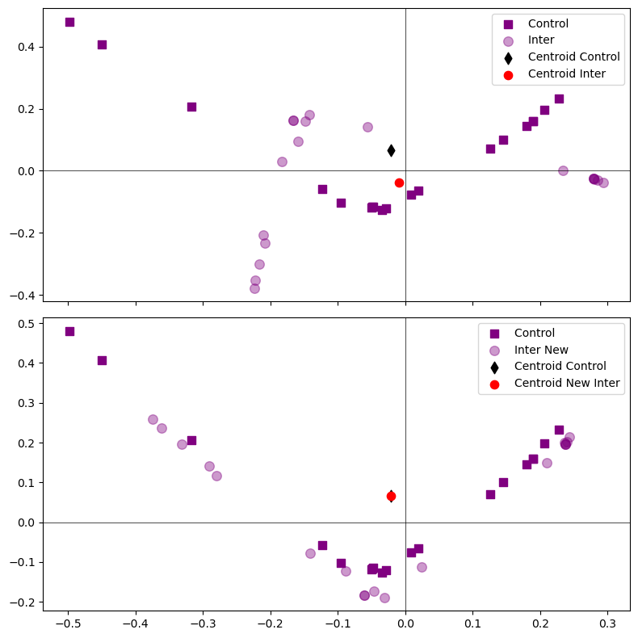
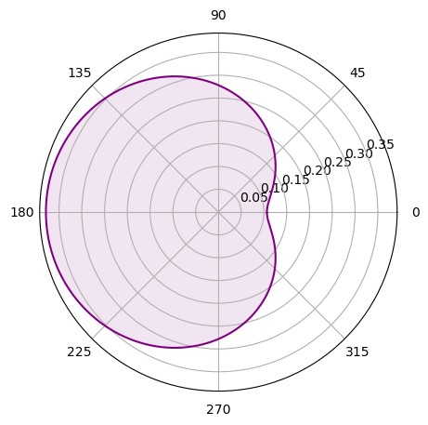
Data
Diffusion Map
Procrustes
Distances
Nodes
2D Spatial Distribution of the Embedding in Euclidean Space
$$…$$
$$…$$
Final aligment’s RMS values on rotation
$$15$$

Slide 15
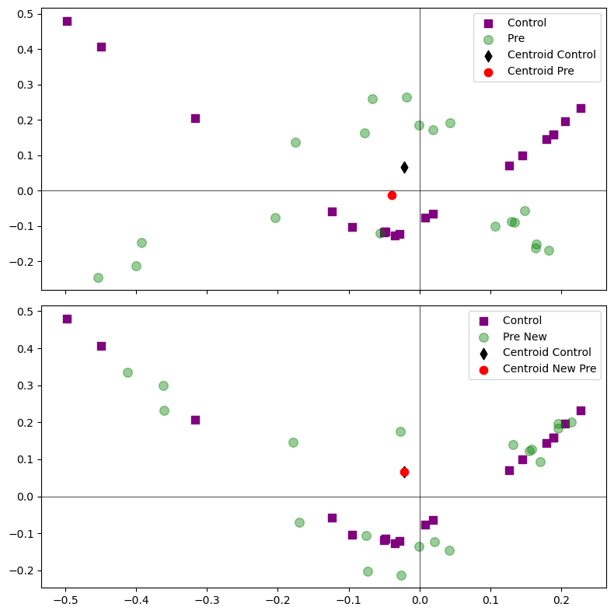
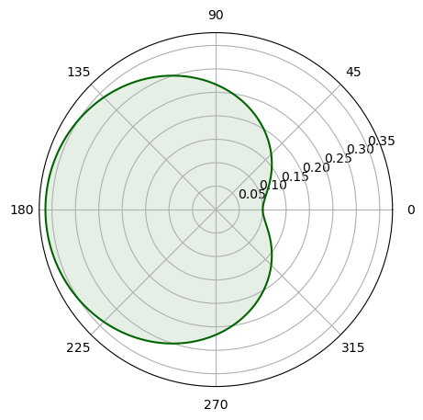
Data
Diffusion Map
Procrustes
Distances
Nodes
2D Spatial Distribution of the Embedding in Euclidean Space
$$…$$
$$…$$
Final aligment’s RMS values on rotation
$$16$$

Slide 16
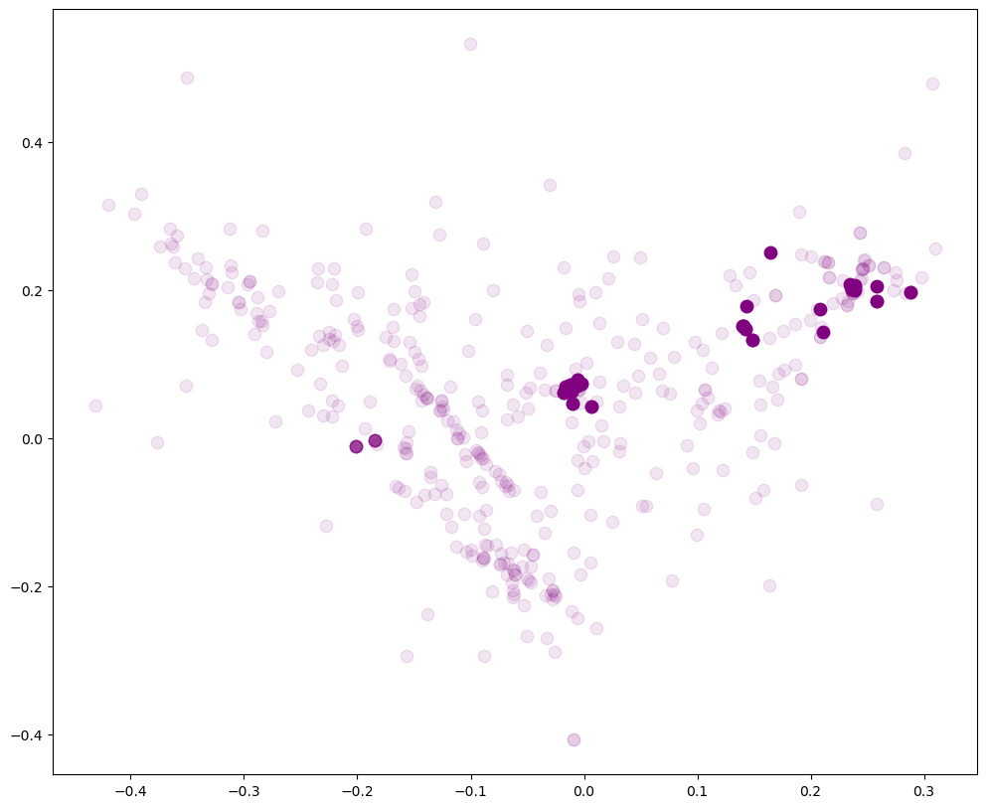
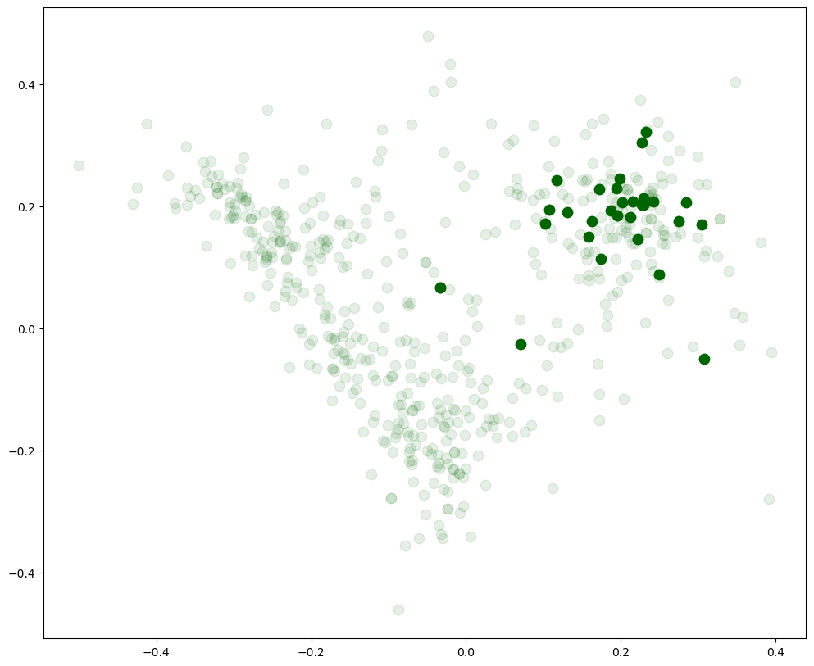
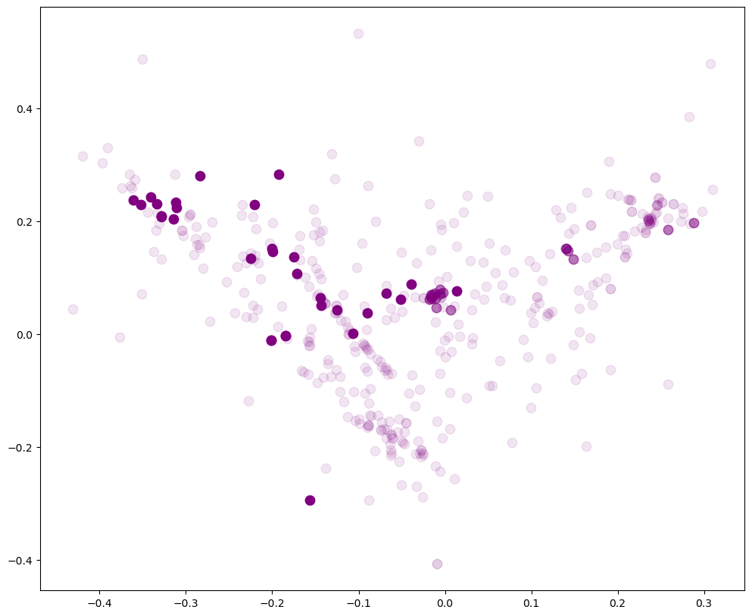
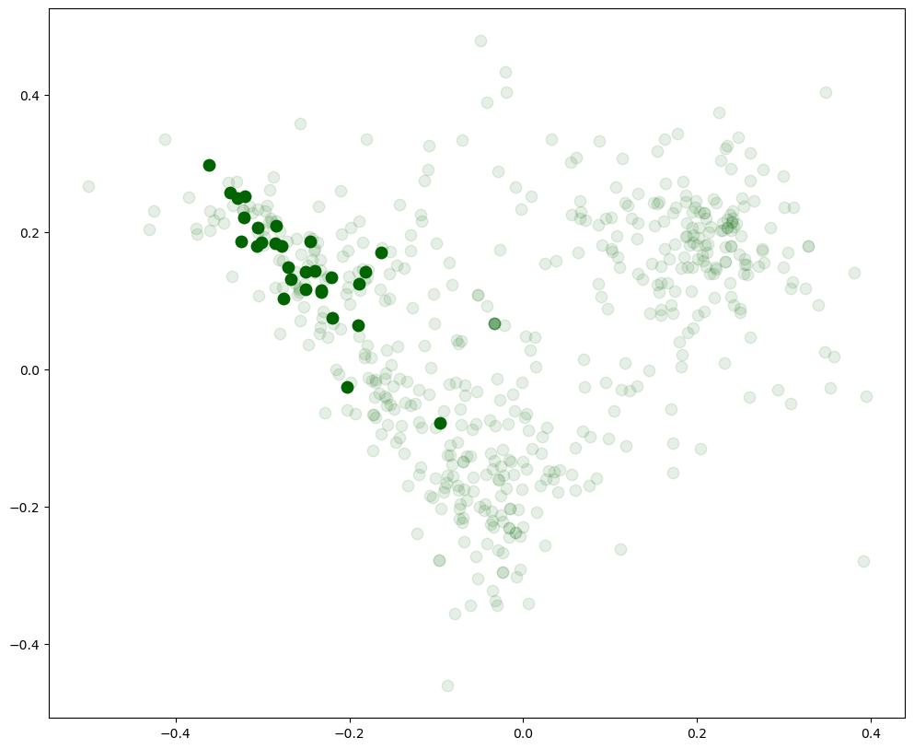
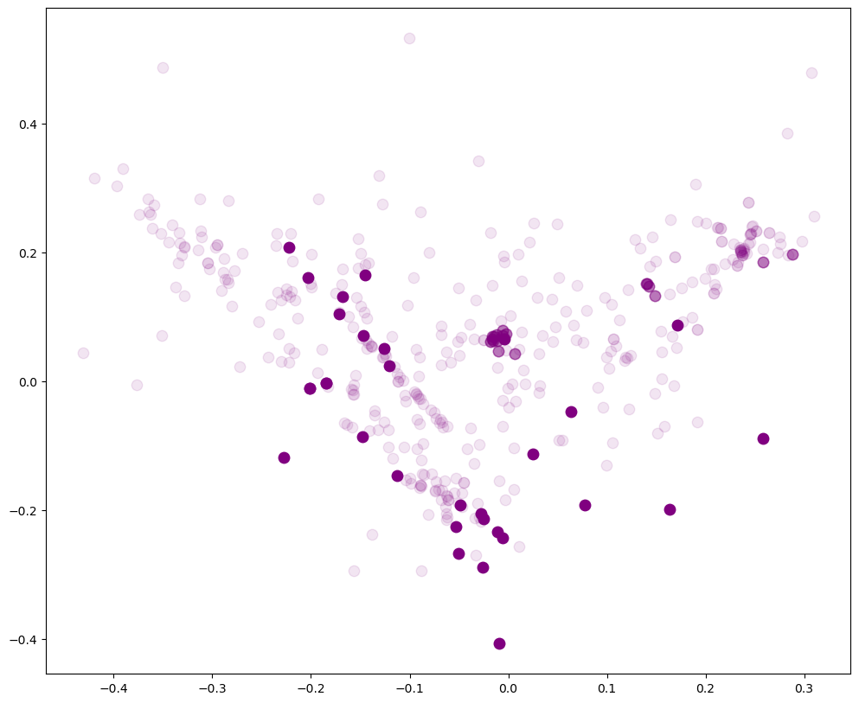
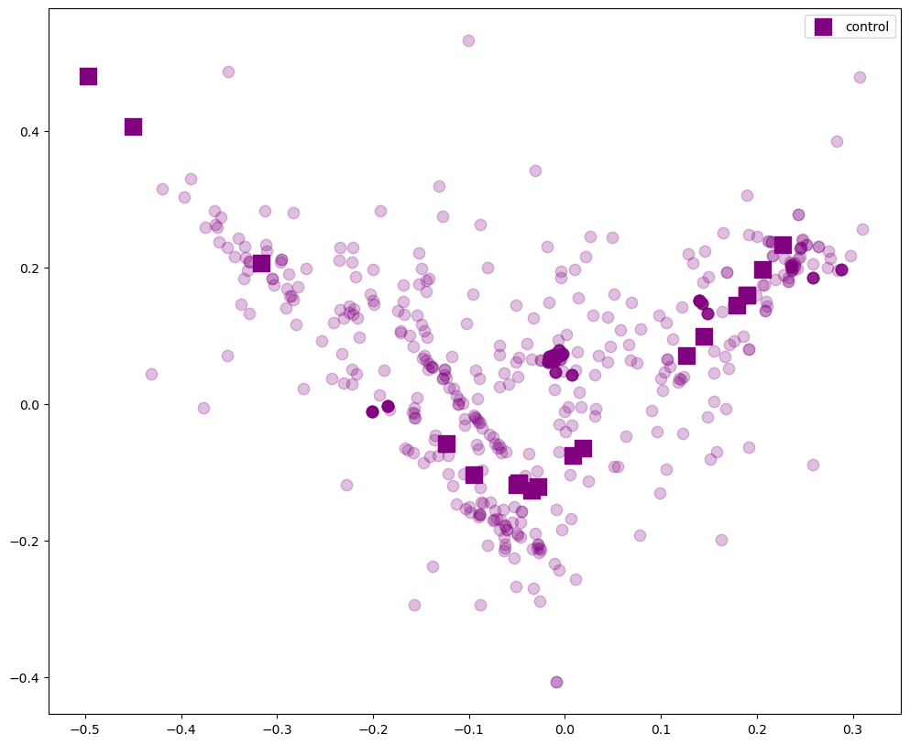
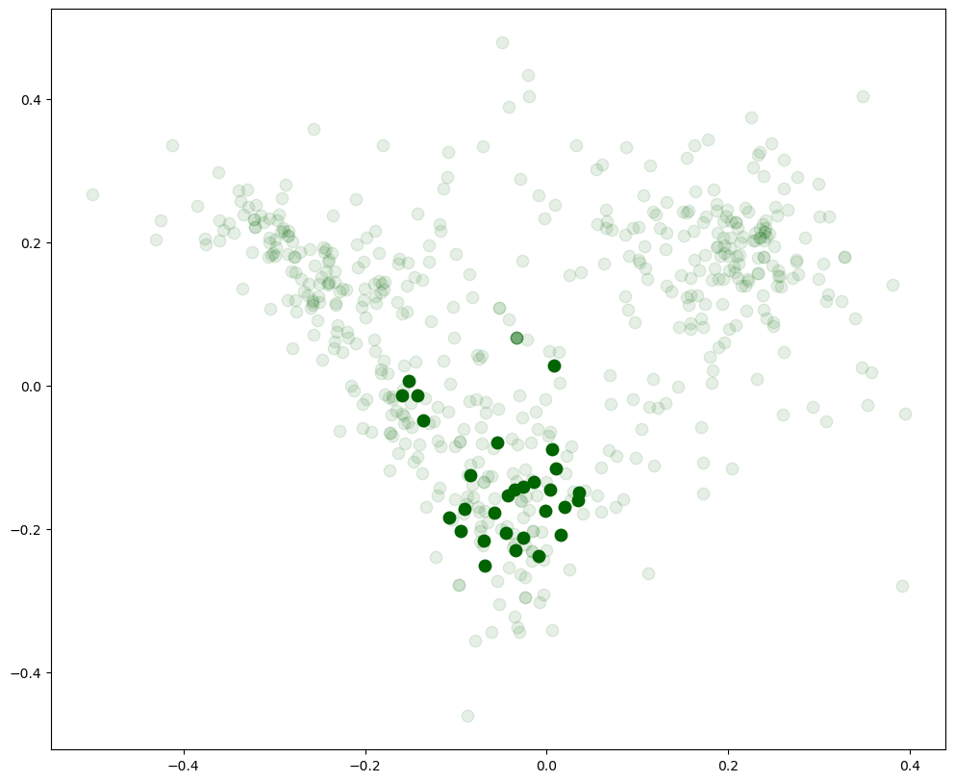
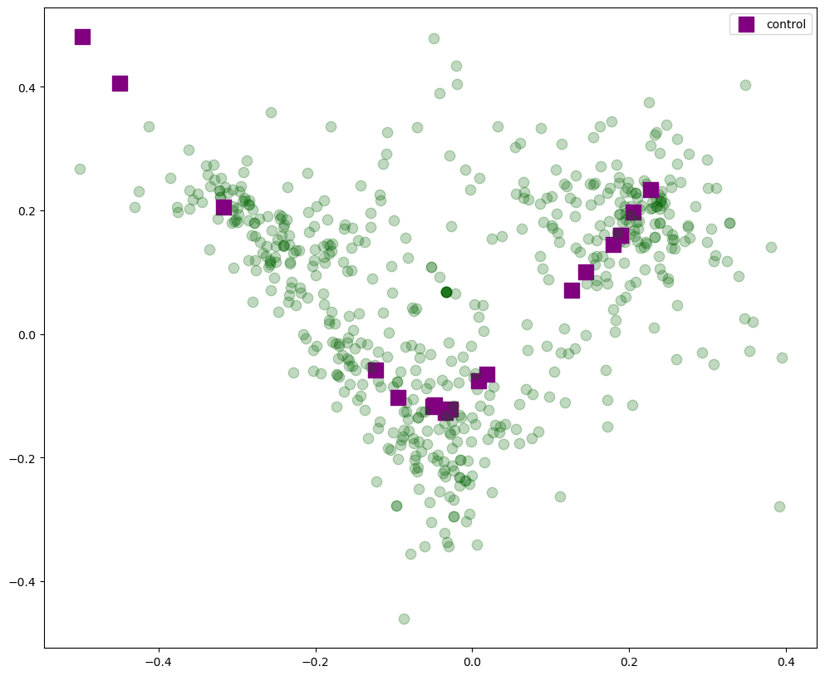
Data
Diffusion Map
Procrustes
Distances
Nodes
Spatial Distribution of the Complete data Embedding
Spatial Distribution of the Complete data Embedding
$$17$$

Slide 17
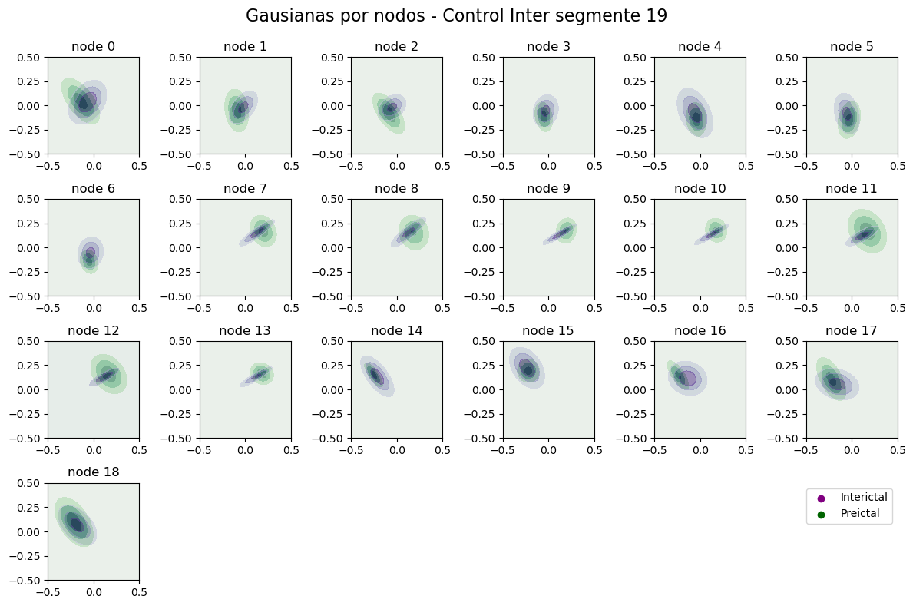
Data
Diffusion Map
Procrustes
Distances
Nodes
Distribution of the Spatial Position of the Data Node by Node
$$18$$

Slide 18
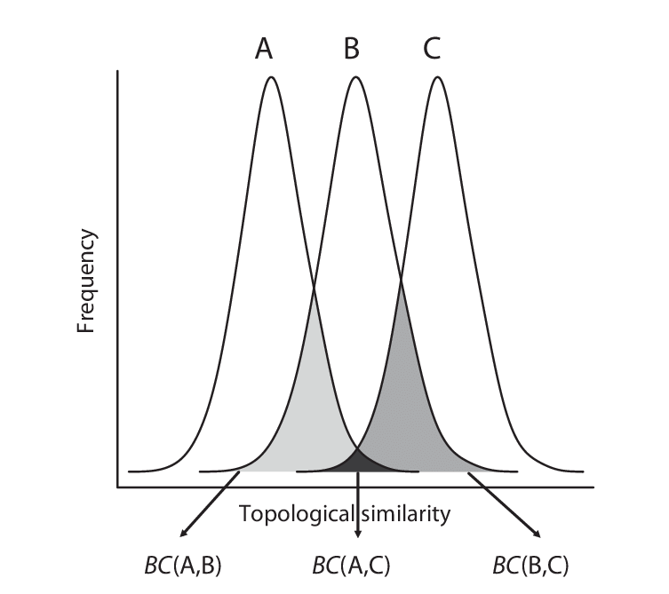
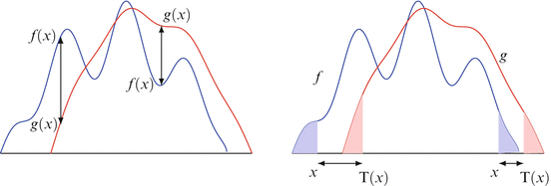
Data
Diffusion Map
Procrustes
Nodes
Metrics to measure the distance between two probability distributions
Distances
Bhattacharyya
Wasserstein
$$D_{B}\left(p_{1}, p_{2}\right)=\frac{1}{8}{\left(μ_{1}−μ_{2}\right)}^{T}Σ^{−1}\left(μ_{1}−μ_{2}\right)+\frac{1}{2}\ln\left( \frac{detΣ}{\sqrt{detΣ_{1}detΣ_{2}} }\right)$$
$D_{W}={\left|\left|m_{1}−m_{2}\right|\right|}^{2}+trace\left(C_{1}+C_{2}−2{\left(C_{2}^{\frac{1}{2}}C_{1}C_{2}^{\frac{1}{2}}\right)}^{\frac{1}{2}}\right)$
$$19$$

Slide 19
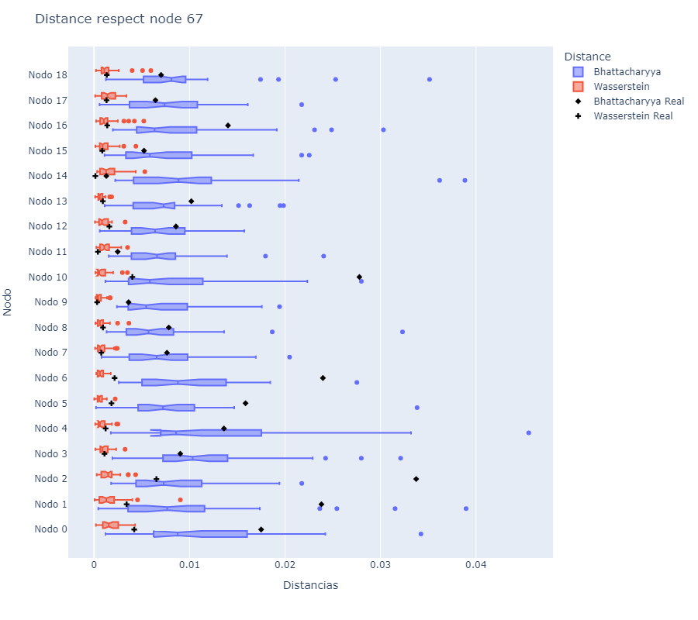
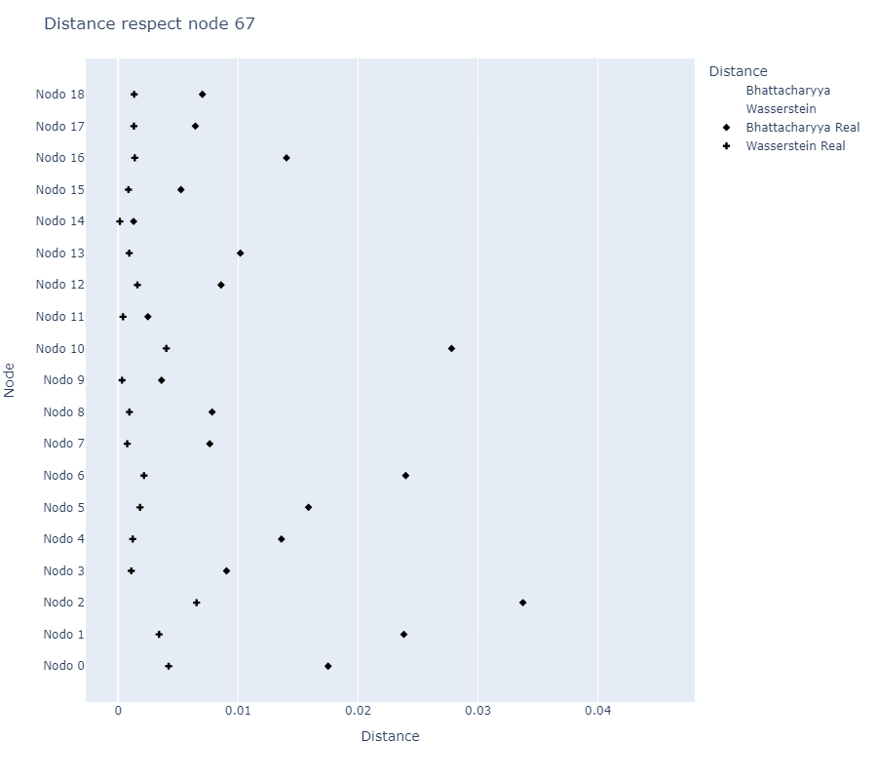
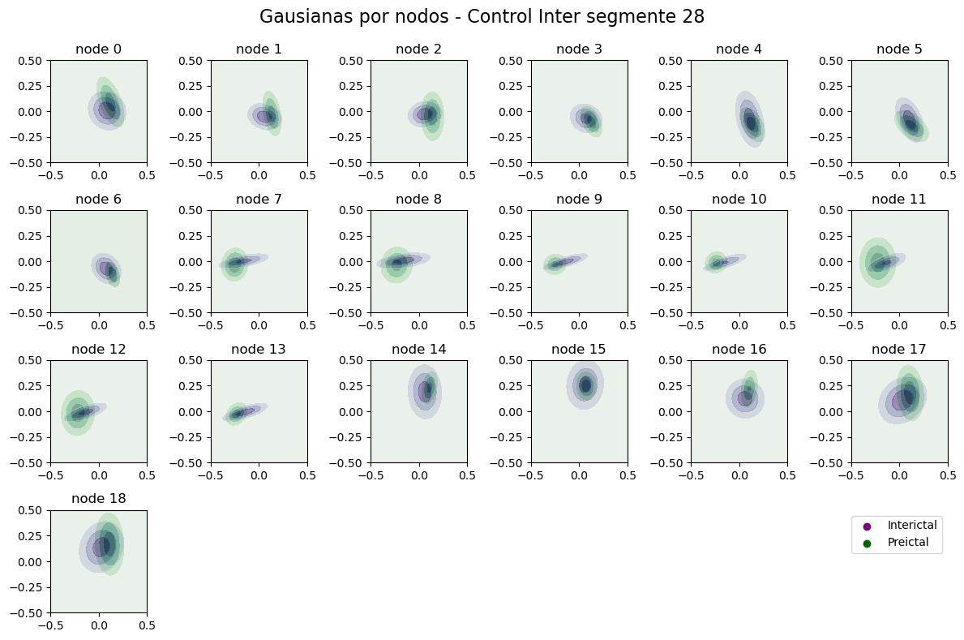
Data
Diffusion Map
Procrustes
Distances
Nodes
Distance between distribution Node by Node
$$…$$
$$…$$
The random test (shuffling) is to defined the base line
$$20$$

Slide 20
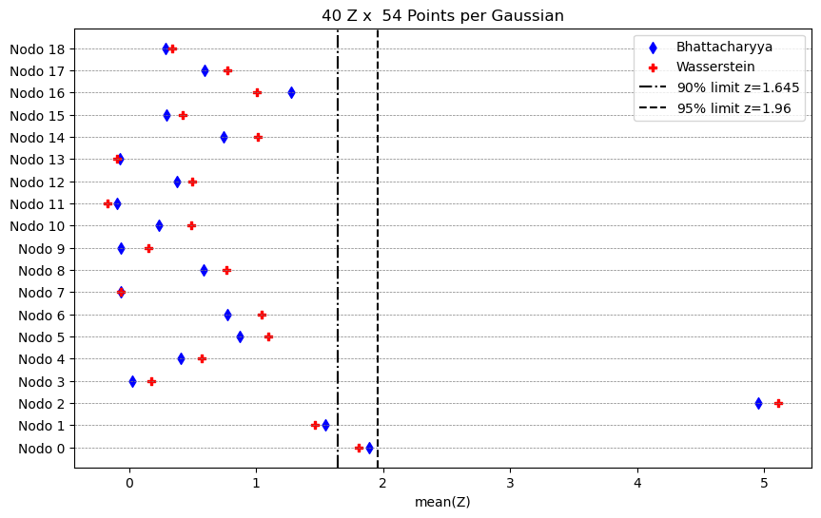
Data
Diffusion Map
Procrustes
Distances
Nodes
Measurements normalized by z scores
Distance between distribution Node by Node
$$Z=\frac{x−μ}{σ}$$
Z scores for each node
$$21$$

Slide 21
Data
Diffusion Map
Procrustes
Distances
Nodes
$$…$$
$$…$$
$$22$$

Slide 22
Data
Diffusion Map
Procrustes
Distances
Nodes
$$…$$
$$…$$
$$23$$

Slide 23
Data
Diffusion Map
Procrustes
Distances
Nodes
$$24$$

Slide 24
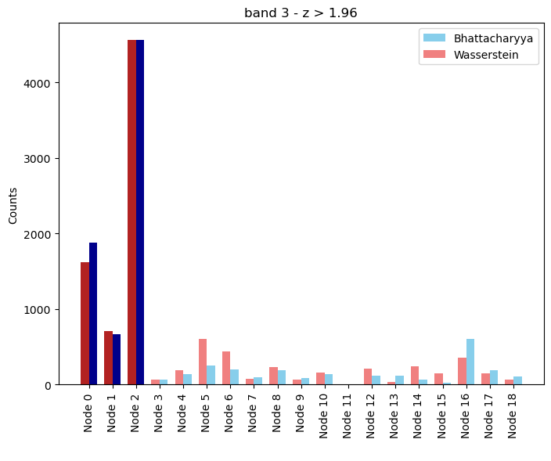
Data
Diffusion Map
Procrustes
Distances
Nodes
Conclusion
In a first approach, embedding iEEG data in the Euclidean space of diffusion maps allows us to identify local connectivity patterns in the network nodes, highlighting those with potential to differentiate seizure states in epilepsy patients.
Impact
This is information that is of interest to clinical staff. We can go back to the brain and point out the region of interest where something is happening. We can also correlate if our node corresponds to the center of the seizure event.
$$25$$

Slide 26
Data
Diffusion Map
Procrustes
Distances
Nodes

Slide 27
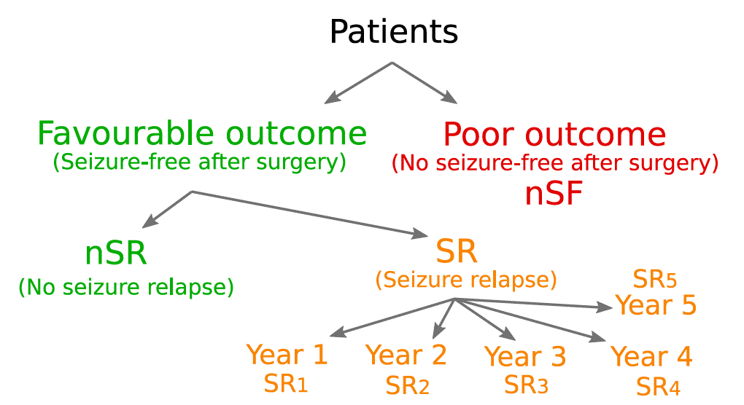
Data
Diffusion Map
Procrustes
Distances
Nodes
$$10\%−20\%$$
Martin Guillemaud et al. Epileptic seizure forecasting with hyperbolic embedding of brain networks. Article submitted, 2023.

Slide 28
Diffusion Map
Procrustes
Distances
Nodes
Data
intracranial electroencephalography
(iEEG)
method to record an electrogram of the spontaneous electrical activity of the brain. EEG is the gold standard diagnostic procedure to confirm epilepsy. The sensitivity of a routine EEG to detect interictal epileptiform discharges at epilepsy centers has been reported to be in the range of 29–55%
Delta < 4 Hz
Theta 4 – 7 Hz
Alpha 8 – 12 Hz
Beta 13 – 30 Hz
Low Gamma
> 30 Hz High Gamma

Slide 29
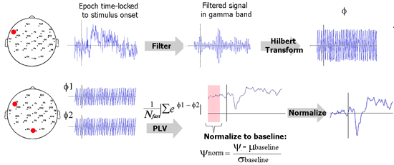
Diffusion Map
Procrustes
Distances
Nodes
Data
Use of the Phase Locking Value Method (PLV) to construct the conectivitty matrixes with the iEEG signals
intracranial electroencephalography
(iEEG)

Slide 30
Diffusion Map
Procrustes
Distances
Nodes
Data
Band Beta Interictal 8 days Preictal 3 days
Band Alpha Interictal 10 days Preictal 2 days
Band High Gamma Interictal 2 days Preictal 2 days
Day
Band Low Gamma
Interictal 9 days Preictal 3 days
$$1$$
$$2$$
$$3$$
$$4$$
$$…$$
$$m$$
Time of data colection by iEEG
Interictal
Preictal
$$0_{min}$$
$${10}_{min}$$

Slide 31
Data
Procrustes
Distances
Nodes
Diffusion Map
Nonlinear dimensionality reduction technique of a data set in Euclidean space whose coordinates can be computed from the eigenvectors and eigenvalues of a diffusion operator on the data.
This reduction technique works by using the degree of the graph to find the probability of transition between all the data, creating a connection with the spectral theory of random walk.
$$p(x, y)=\frac{w\left(x, y\right)}{{\sum{ }}_{z∈ Ω} w(x, z)}$$
Shan, S., & Daubechies, I. (2022). Diffusion maps: Using the semigroup property for parameter tuning
$$φ_{j}^{T} P=λ_{j}φ_{j}^{T} and P ψ_{j}=λ_{j}ψ_{j}$$
The eigenvalues and eigenvectors of the transition matrix $(P)$ provide the representation of the initial graph as a cloud of points in a lower dimensional space.
$$Ψ_{t}: x→ \left({λ_{\text{1}}^{t}ψ_{\text{1}}\text{(}\text{x}\text{)} \atop \begin{aligned}λ_{\text{2}}^{t}ψ_{\text{2}}\text{(}\text{x}\text{)} \\ ⋮ \\ λ_{\text{q}\text{(}\text{t}\text{)}}^{t}ψ_{\text{q}\text{(}\text{t}\text{)}}\text{(}\text{x}\text{) }\end{aligned}}\right)$$
Lafon, S., & Lee, A. B. (2006). Diffusion maps and coarse-graining: A unified framework for dimensionality reduction, graph partitioning, and data set parameterization

Slide 32
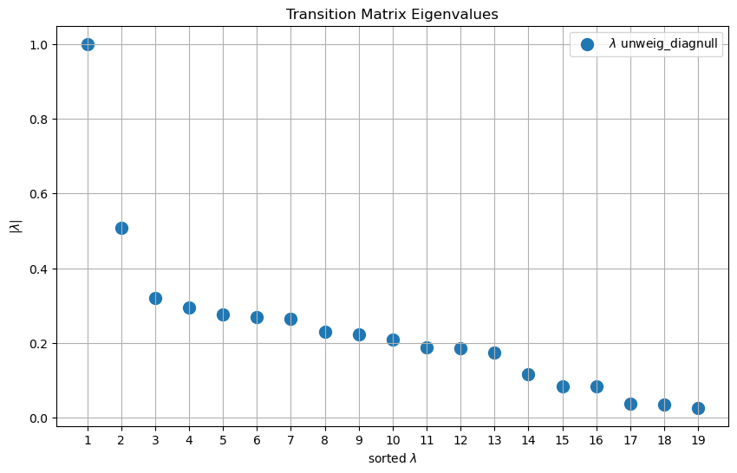
Data
Diffusion Map
Procrustes
Distances
Nodes
2D Spatial Distribution of the Embedding in Euclidean Space

Slide 33
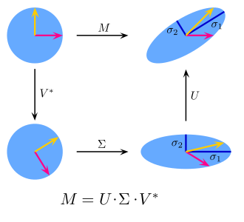
Data
Diffusion Map
Distances
Nodes
Procrustes
Generalized Procrustes Analysis (GPA) is a multivariate exploratory technique that involves transformations (i.e., translation, rotation, reflection and isotropic rescaling) of individual data matrices to provide optimal comparability.
First, it is necessary to compute the baricenter of the two dataset and translate the to the origin of the space.
This problem is equivalent to finding the nearest orthogonal matrix to a given matrix $M=BA^{T}$ using the singular value decomposition
$$M=U∑V^{T}$$
Where the transformation matrix is
$$R=UV^{T}$$

Slide 34
Data
Diffusion Map
Procrustes
Nodes
Distances
Bhattacharyya
Wasserstein
$$D_{B}\left(p_{1}, p_{2}\right)=\frac{1}{8}{\left(μ_{1}−μ_{2}\right)}^{T}Σ^{−1}\left(μ_{1}−μ_{2}\right)+\frac{1}{2}\ln\left( \frac{detΣ}{\sqrt{detΣ_{1}detΣ_{2}} }\right)$$
$D_{W}={\left|\left|m_{1}−m_{2}\right|\right|}^{2}+trace\left(C_{1}+C_{2}−2{\left(C_{2}^{\frac{1}{2}}C_{1}C_{2}^{\frac{1}{2}}\right)}^{\frac{1}{2}}\right)$
$$Σ=\frac{Σ_{1}+Σ_{2}}{2}$$
It is based on the measure of overlapping areas under the probability curves of the two distributions.
It measures the minimum "cost" necessary to transform one probability distribution into another.

Slide 35
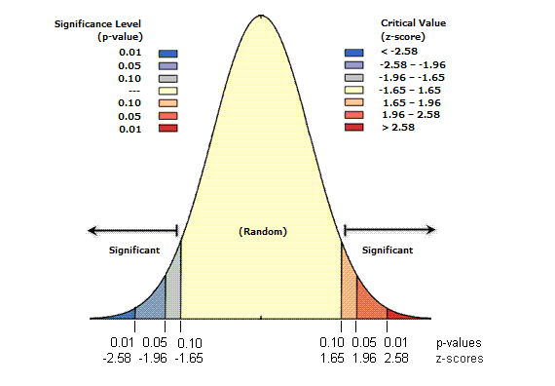
Data
Diffusion Map
Procrustes
Distances
Nodes
Measurements normalized by z scores
$$Z=\frac{x−μ}{σ}$$

Slide 36
Data
Diffusion Map
Procrustes
Distances
Nodes

Slide 37
Data
Diffusion Map
Procrustes
Distances
Nodes

Slide 38
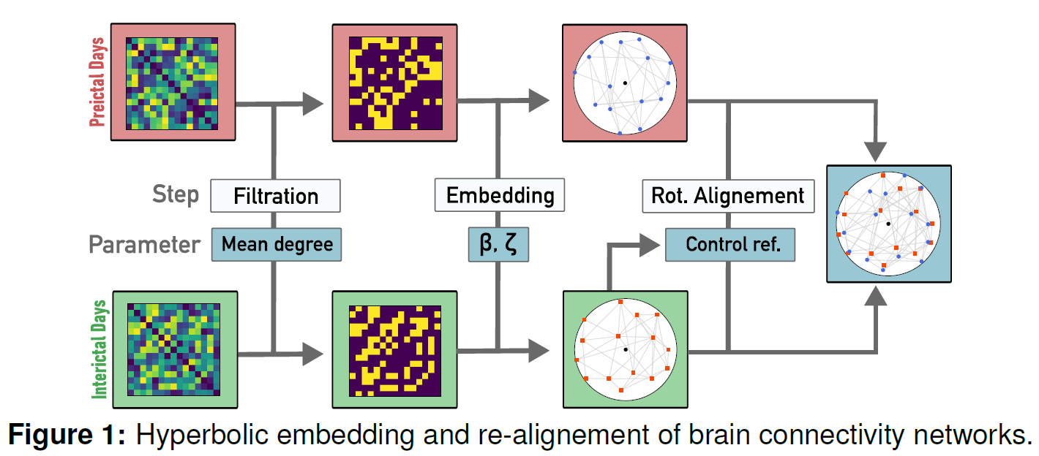
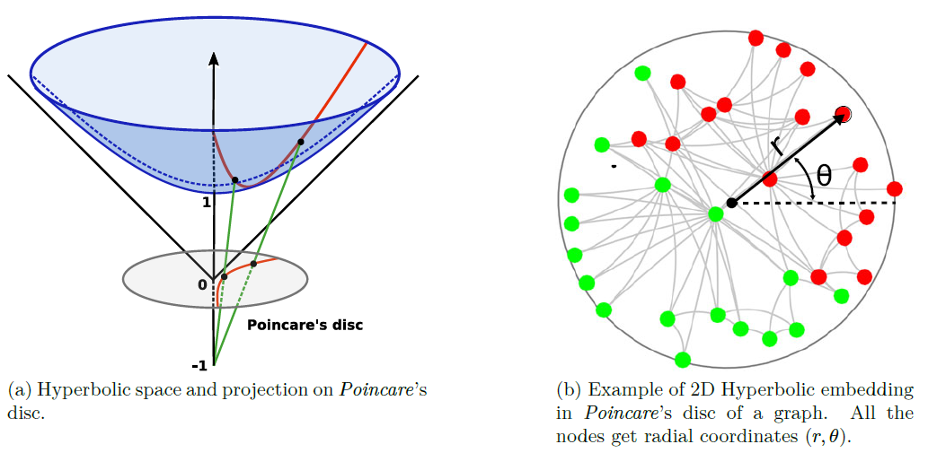
Data
Diffusion Map
Procrustes
Distances
Nodes
Martin Guillemaud et al. Epileptic seizure forecasting with hyperbolic embedding of brain networks. Article submitted, 2023.
Embedding these networks in hyperbolic geometry has high likelihood of identifying pre-seizure brain connectivity patterns and give light under the success prediction of the epilepsy surgery outcome.

Slide 39
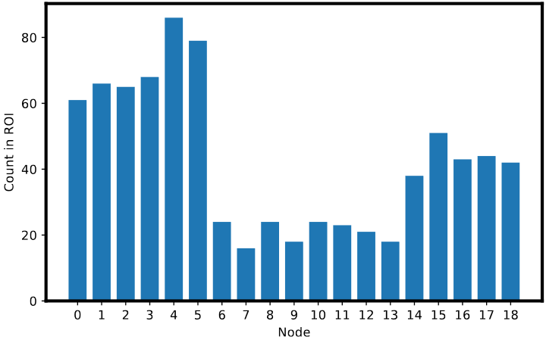
Data
Diffusion Map
Procrustes
Distances
Nodes
Conclusion
Results of Martin Guillemaud et al. Epileptic seizure forecasting with hyperbolic embedding of brain networks
In a first approach, embedding iEEG data in the Euclidean space of diffusion maps allows us to identify local connectivity patterns in the network nodes, highlighting those with potential to differentiate seizure states in epilepsy patients.
Impact
This is information that is of interest to clinical staff. We can go back to the brain and point out the region of interest where something is happening. We can also correlate if our node corresponds to the center of the seizure event.
$$25$$

Slide 40
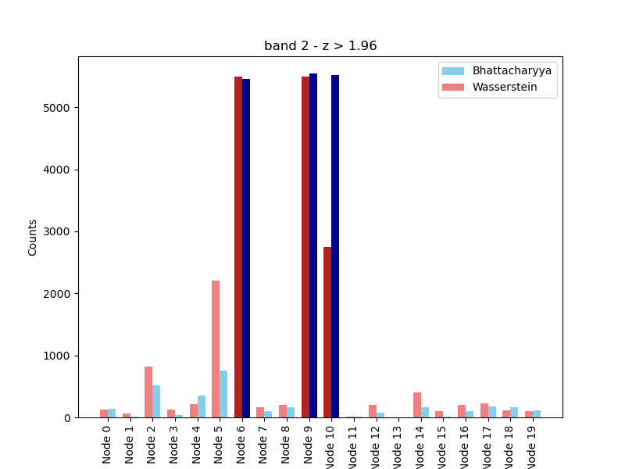
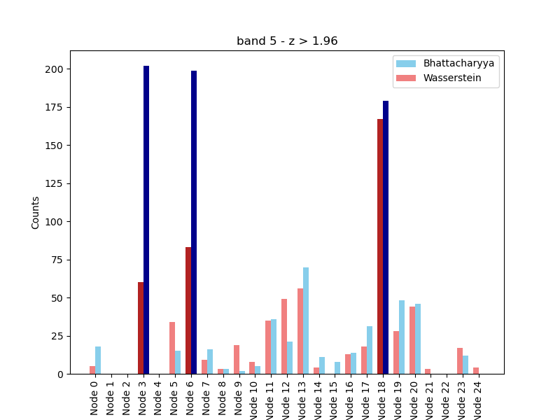
Data
Diffusion Map
Procrustes
Distances
Nodes

