Slide 1

Revisiting the electronic properties of disclinated graphene sheets
${\text{Nicol}\text{á}\text{s} \text{Fern}\text{á}\text{ndez}}^{1}$ , ${\text{Pierre} \text{Pujol}}^{2}$, ${\text{Mario} \text{Sol}\text{í}\text{s}}^{3,4}$, and ${\text{Te}\text{ó}\text{filo} Vargas}^{5}$
${}^{1}$Facultad de Ciencias Físicas, Universidad Nacional Mayor de San Marcos, Avenida Venezuela s/n Cercado de Lima, Lima 15081, Lima, Peru.
${}^{2}$Laboratoire de Physique Théorique, CNRS and Université de Toulouse, UPS, 31062 Toulouse, France.
${}^{3}$Centro Atómico Bariloche, CNEA and CONICET, R8402AGP San Carlos de Bariloche, Rio Negro, Argentina.
${}^{4}$Instituto Balseiro, UNCuyo, R8402AGP San Carlos de Bariloche, Rio Negro, Argentina.
${}^{5}$Grupo de Física Teórica GFT and Grupo de Astronomía SPACE, Universidad Nacional Mayor de San Marcos, Avenida Venezuela s/n Cercado de Lima, Lima 15081, Lima, Peru.

Slide 2
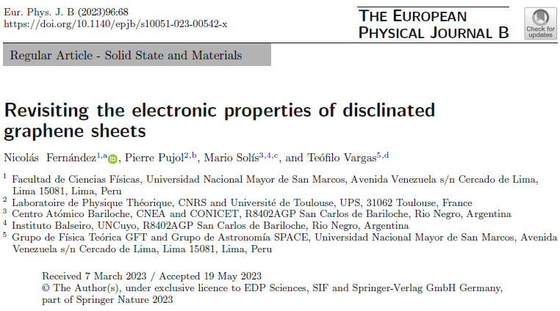
ABSTRACT
The interplay between topological defects, such as dislocations or disclinations, and the electronic degrees of freedom in graphene have been extensively studied. In the literature, for the study of this kind of problems, it is in general used either a gauge theory or a curved spatial Riemannian geometry approach, where, in the geometric case, the information about the defects is contained in the metric and the spin connection. However, these topological defects can also be associated with a Riemann–Cartan geometry where curvature and torsion plays an important role. In this article, we study the interplay between a wedge disclination in a planar graphene sheet and the properties of its electronic degrees of freedom. Our approach relies on its relation with elasticity theory through the so called elastic-gauge, where their typical coefficients, as for example the Poisson’s ratio, appear directly in the metric, and consequently also in the electronic spectrum.
https://doi.org/10.1140/epjb/s10051-023-00542-x
2

Slide 3
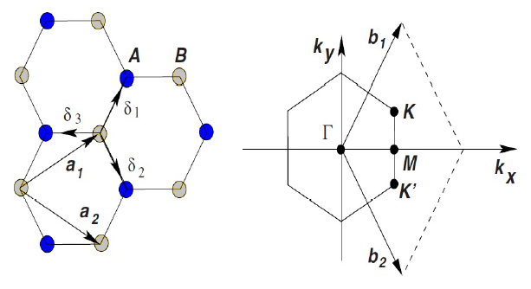
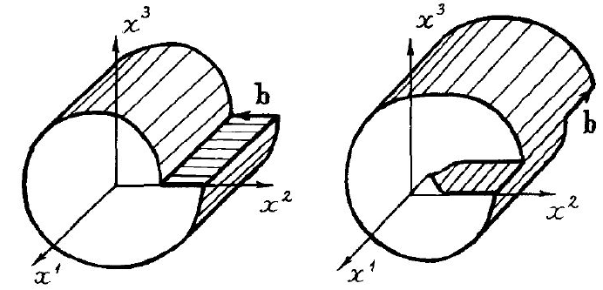
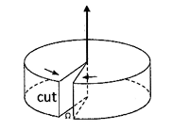


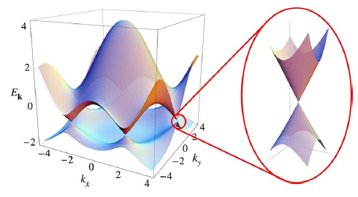

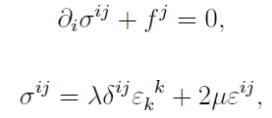

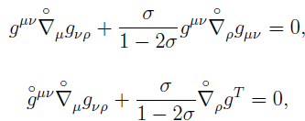

INTRODUCTION
Graphene energy spectrum
Topological defects as geometric distortions
Linear metric
Elasticity equations
$$E_{±}\left(k\right)=±t\sqrt{1+4cos\left(\frac{3}{2}k_{x}a\right)cos\left(\frac{\sqrt{3}}{2}k_{y}a\right)+4\cos^{2}\left(\frac{\sqrt{3}}{2}k_{y}a\right)}$$
Elastic gauge
EMERGENT DIRAC PHYSICS
3

Slide 4

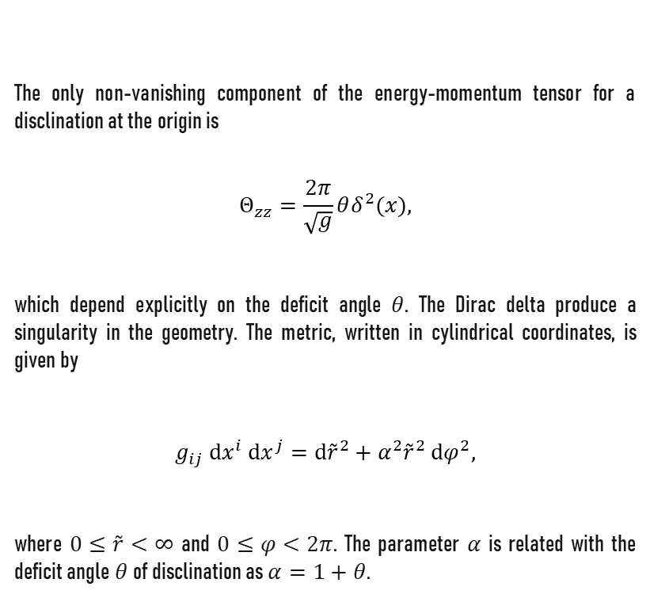
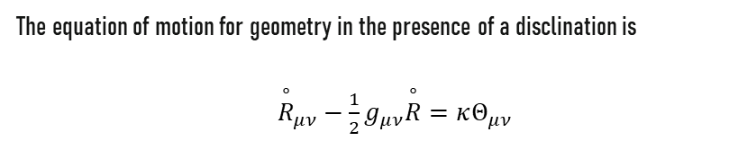
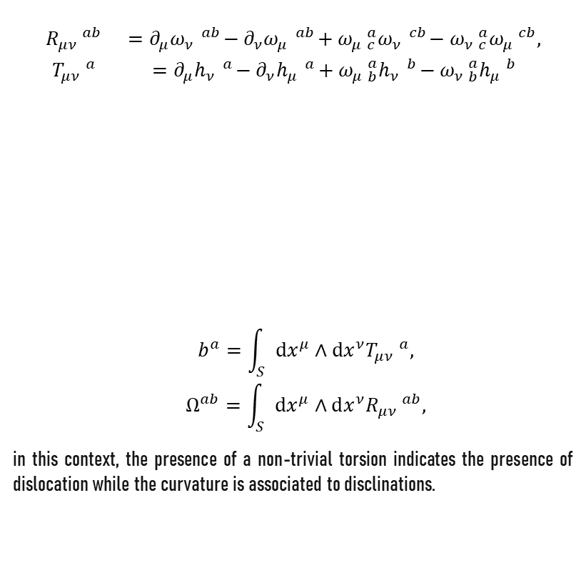
Wedge disclination and its associated metric
In the geometric approach of defects, the flat Minkowskian space-time metric is replaced by a curved metric in a Riemann–Cartan manifold; the line element is
The equation of motion for geometry in the presence of a disclination is
${\overset{∘}{R}}_{μν}−\frac{1}{2}g_{μν}\overset{∘}{R}=κΘ_{μν}$
$$ds^{2}=g_{μν}dx^{μ}dx^{ν}=dt^{2}−g_{ij} dx^{i} dx^{j},$$
The only non-vanishing component of the energy-momentum tensor for a disclination at the origin is
$$Θ_{zz}=\frac{2π}{\sqrt{g}}θδ^{2}(x),$$
which depend explicitly on the deficit angle $θ$. The Dirac delta produce a singularity in the geometry. The metric, written in cylindrical coordinates, is given by
$$g_{ij} dx^{i} dx^{j}=d{\overset{˜}{r}}^{2}+α^{2}{\overset{˜}{r}}^{2} dφ^{2},$$
where $0≤\overset{˜}{r}<∞$ and $0≤φ<2π$. The parameter $α$ is related with the deficit angle $θ$ of disclination as $α=1+θ$.
(1)
(4)
$$\begin{matrix}R_{μν} ^{ab} & =∂_{μ}ω_{ν} ^{ab}−∂_{ν}ω_{μ} ^{ab}+ω_{μ} _{c}^{a}ω_{ν} ^{cb}−ω_{ν} _{c}^{a}ω_{μ} ^{cb}, \\ T_{μν} ^{a} & =∂_{μ}h_{ν} ^{a}−∂_{ν}h_{μ} ^{a}+ω_{μ} _{b}^{a}h_{ν} ^{b}−ω_{ν} _{b}^{a}h_{μ} ^{b}\end{matrix}$$
$$\begin{matrix} & b^{a}=\int_{S}{ } dx^{μ}∧dx^{ν}T_{μν} ^{a}, \\ & Ω^{ab}=\int_{S}{ } dx^{μ}∧dx^{ν}R_{μν} ^{ab},\end{matrix}$$
in this context, the presence of a non-trivial torsion indicates the presence of dislocation while the curvature is associated to disclinations.
(5)
(2)
(6)
(3)
4

Slide 5
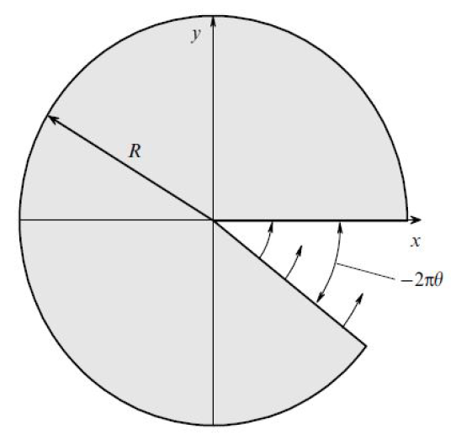
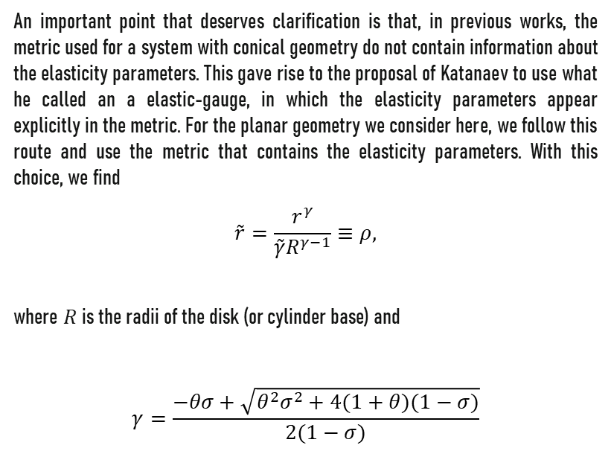
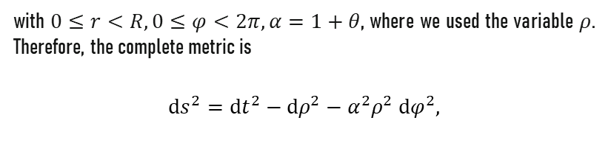

Wedge disclination and its associated metric
An important point that deserves clarification is that, in previous works, the metric used for a system with conical geometry do not contain information about the elasticity parameters. This gave rise to the proposal of Katanaev to use what he called an a elastic-gauge, in which the elasticity parameters appear explicitly in the metric. For the planar geometry we consider here, we follow this route and use the metric that contains the elasticity parameters. With this choice, we find
$$\overset{˜}{r}=\frac{r^{γ}}{\overset{˜}{γ}R^{γ−1}}≡ρ,$$
where $R$ is the radii of the disk (or cylinder base) and
$$γ=\frac{−θσ+\sqrt{θ^{2}σ^{2}+4(1+θ)(1−σ)}}{2(1−σ)}$$
with $0≤r<R,0≤φ<2π,α=1+θ$, where we used the variable $ρ$. Therefore, the complete metric is
$$ds^{2}=dt^{2}−dρ^{2}−α^{2}ρ^{2} dφ^{2},$$
(10)
(7)
(8)
here the Poisson's ratio is denoted by $σ$. Hence, we find
$$g_{ij} dx^{i} dx^{j}=dρ^{2}+α^{2}ρ^{2} dφ^{2},$$
(9)
Wedge disclination
5

Slide 6
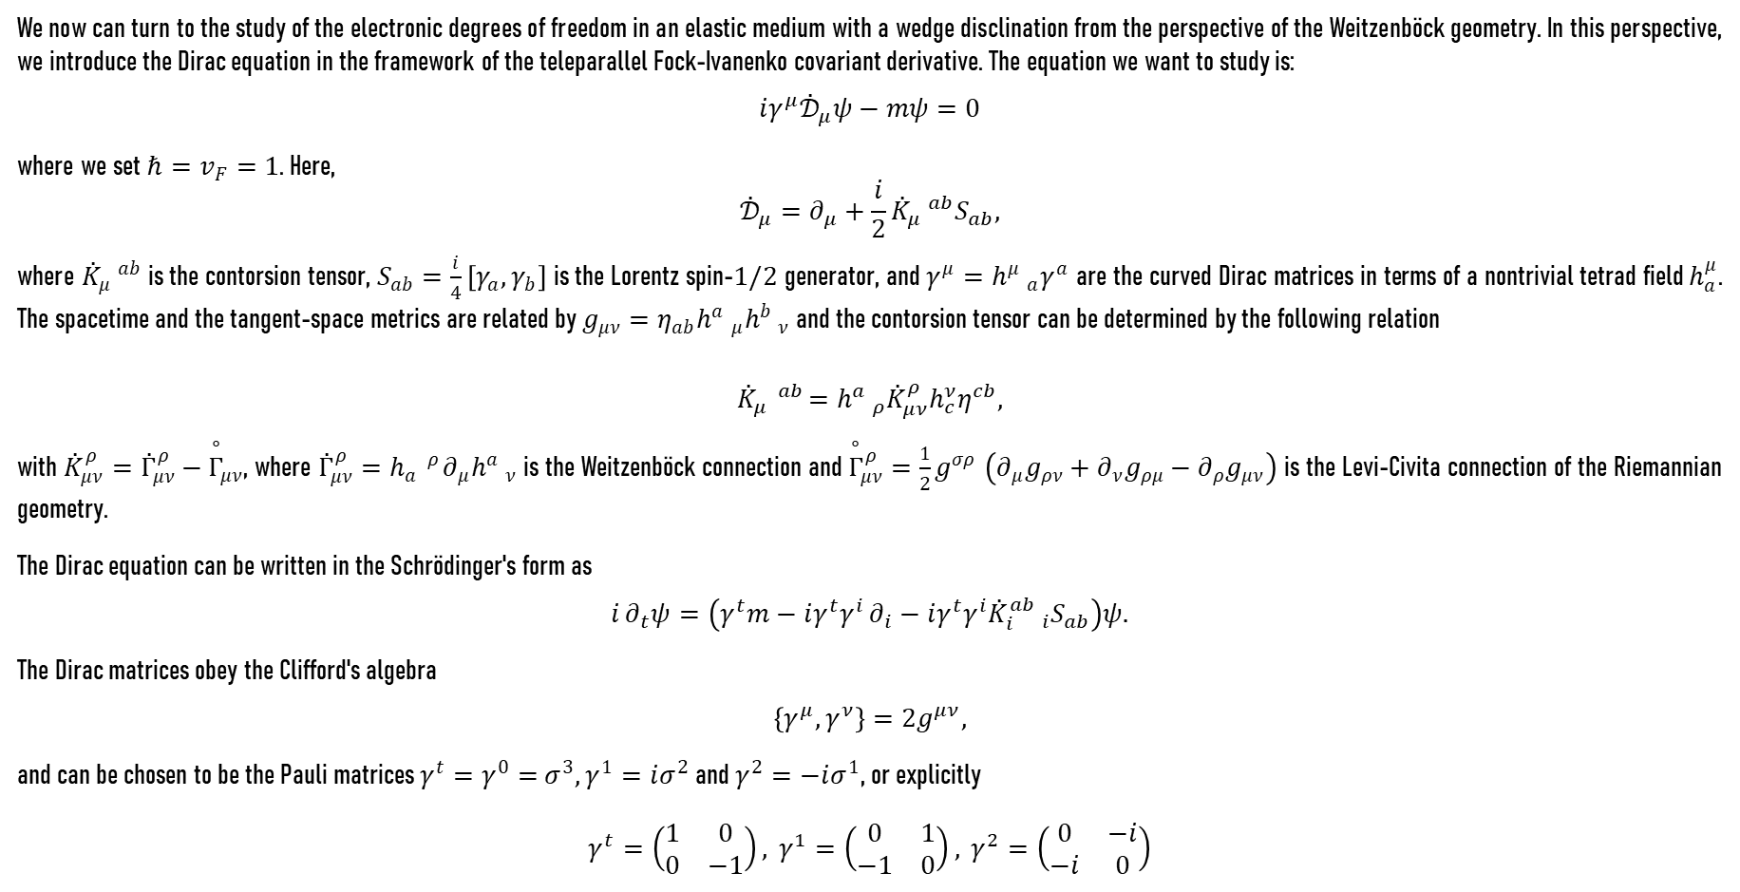
Wedge disclinations and Dirac equation
We now can turn to the study of the electronic degrees of freedom in an elastic medium with a wedge disclination from the perspective of the Weitzenböck geometry. In this perspective, we introduce the Dirac equation in the framework of the teleparallel Fock-Ivanenko covariant derivative. The equation we want to study is:
$$iγ^{μ}{\overset{˙}{𝒟}}_{μ}ψ−mψ=0$$
where we set $ℏ=v_{F}=1$. Here,
$${\overset{˙}{𝒟}}_{μ}=∂_{μ}+\frac{i}{2}{\overset{˙}{K}}_{μ} ^{ab}S_{ab},$$
where ${\overset{˙}{K}}_{μ} ^{ab}$ is the contorsion tensor, $S_{ab}=\frac{i}{4}\left[γ_{a},γ_{b}\right]$ is the Lorentz spin-$1/2$ generator, and $γ^{μ}=h^{μ} _{a}γ^{a}$ are the curved Dirac matrices in terms of a nontrivial tetrad field $h_{a}^{μ}$. The spacetime and the tangent-space metrics are related by $g_{μν}=η_{ab}h^{a} _{μ}h^{b} _{ν}$ and the contorsion tensor can be determined by the following relation
$${\overset{˙}{K}}_{μ} ^{ab}=h^{a} _{ρ}{\overset{˙}{K}}_{μν}^{ρ}h_{c}^{ν}η^{cb},$$
with ${\overset{˙}{K}}_{μν}^{ρ}={\overset{˙}{Γ}}_{μν}^{ρ}−{\overset{∘}{Γ}}_{μν}$, where ${\overset{˙}{Γ}}_{μν}^{ρ}=h_{a} ^{ρ}∂_{μ}h^{a} _{ν}$ is the Weitzenböck connection and ${\overset{∘}{Γ}}_{μν}^{ρ}=\frac{1}{2}g^{σρ}$ $\left(∂_{μ}g_{ρν}+∂_{ν}g_{ρμ}−∂_{ρ}g_{μν}\right)$ is the Levi-Civita connection of the Riemannian geometry.
The Dirac equation can be written in the Schrödinger's form as
$$i∂_{t}ψ=\left(γ^{t}m−iγ^{t}γ^{i}∂_{i}−iγ^{t}γ^{i}{\overset{˙}{K}}_{i}^{ab} _{i}S_{ab}\right)ψ.$$
The Dirac matrices obey the Clifford's algebra
$$\left\{γ^{μ},γ^{ν}\right\}=2g^{μν},$$
and can be chosen to be the Pauli matrices $γ^{t}=γ^{0}=$ $σ^{3},γ^{1}=iσ^{2}$ and $γ^{2}=−iσ^{1}$, or explicitly
$$γ^{t}=\left(\begin{matrix}1 & 0 \\ 0 & −1\end{matrix}\right), γ^{1}=\left(\begin{matrix}0 & 1 \\ −1 & 0\end{matrix}\right), γ^{2}=\left(\begin{matrix}0 & −i \\ −i & 0\end{matrix}\right)$$
(11)
(12)
(13)
(14)
(15)
(16)
6

Slide 7
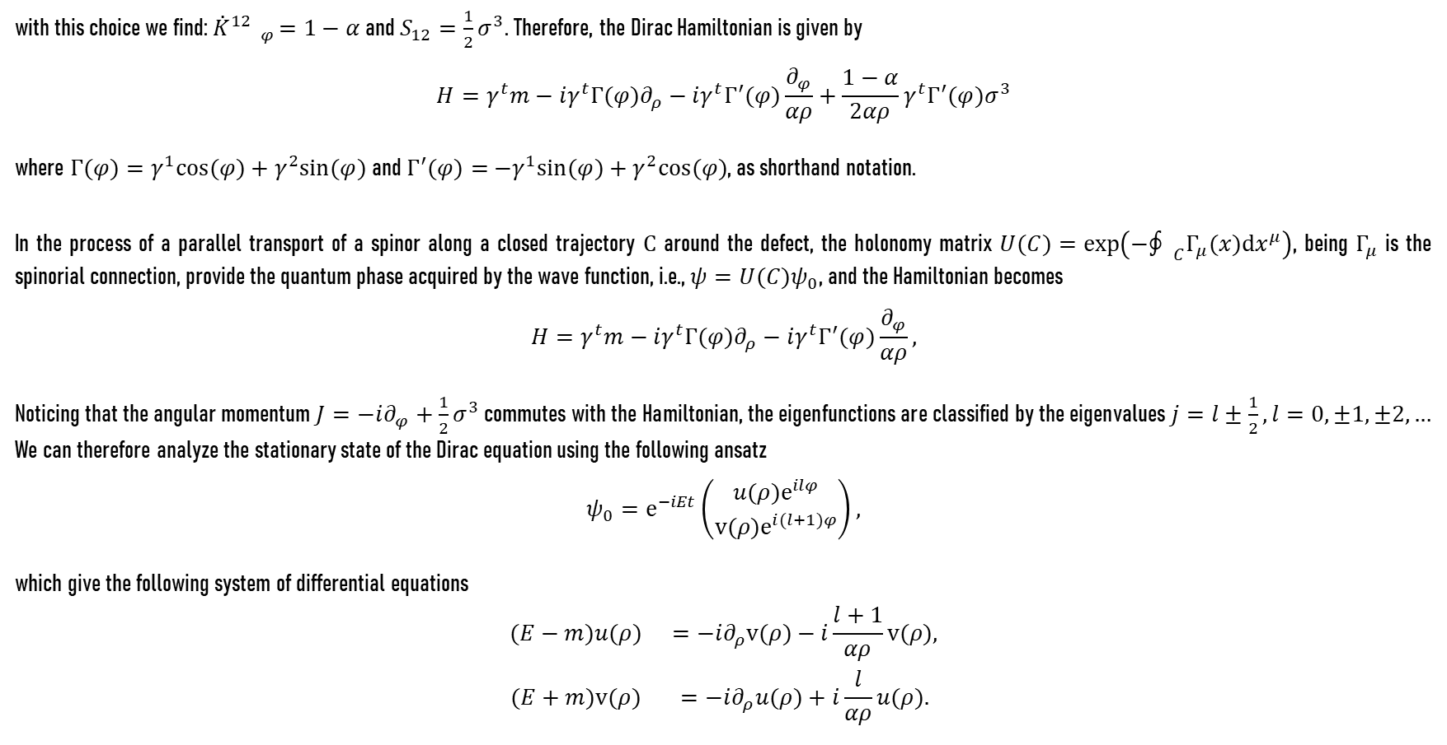
Wedge disclinations and Dirac equation
with this choice we find: ${\overset{˙}{K}}^{12} _{φ}=1−α$ and $S_{12}=\frac{1}{2}σ^{3}$. Therefore, the Dirac Hamiltonian is given by
$$H=γ^{t}m−iγ^{t}Γ(φ)∂_{ρ}−iγ^{t}Γ^{′}(φ)\frac{∂_{φ}}{αρ}+\frac{1−α}{2αρ}γ^{t}Γ^{′}(φ)σ^{3}$$
where $Γ(φ)=γ^{1}cos(φ)+γ^{2}sin(φ)$ and $Γ^{′}(φ)=$ $−γ^{1}sin(φ)+γ^{2}cos(φ)$, as shorthand notation.
In the process of a parallel transport of a spinor along a closed trajectory $C$ around the defect, the holonomy matrix $U(C)=$ $exp\left(−{\text{∮} }_{C}Γ_{μ}(x)dx^{μ}\right)$, being $Γ_{μ}$ is the spinorial connection, provide the quantum phase acquired by the wave function, i.e., $ψ=U(C)ψ_{0}$, and the Hamiltonian becomes
$$H=γ^{t}m−iγ^{t}Γ(φ)∂_{ρ}−iγ^{t}Γ^{′}(φ)\frac{∂_{φ}}{αρ},$$
Noticing that the angular momentum $J=−i∂_{φ}+\frac{1}{2}σ^{3}$ commutes with the Hamiltonian, the eigenfunctions are classified by the eigenvalues $j=l±\frac{1}{2},l=0,±1,±2,…$ We can therefore analyze the stationary state of the Dirac equation using the following ansatz
$$ψ_{0}=e^{−iEt}\left(\begin{matrix}u(ρ)e^{ilφ} \\ v(ρ)e^{i(l+1)φ}\end{matrix}\right),$$
which give the following system of differential equations
$$\begin{matrix}(E−m)u(ρ) & =−i∂_{ρ}v(ρ)−i\frac{l+1}{αρ}v(ρ), \\ (E+m)v(ρ) & =−i∂_{ρ}u(ρ)+i\frac{l}{αρ}u(ρ).\end{matrix}$$
(17)
(18)
(19)
(20)
7

Slide 8
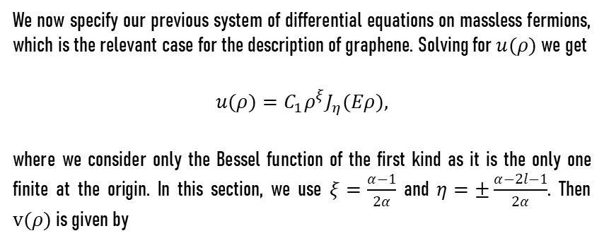
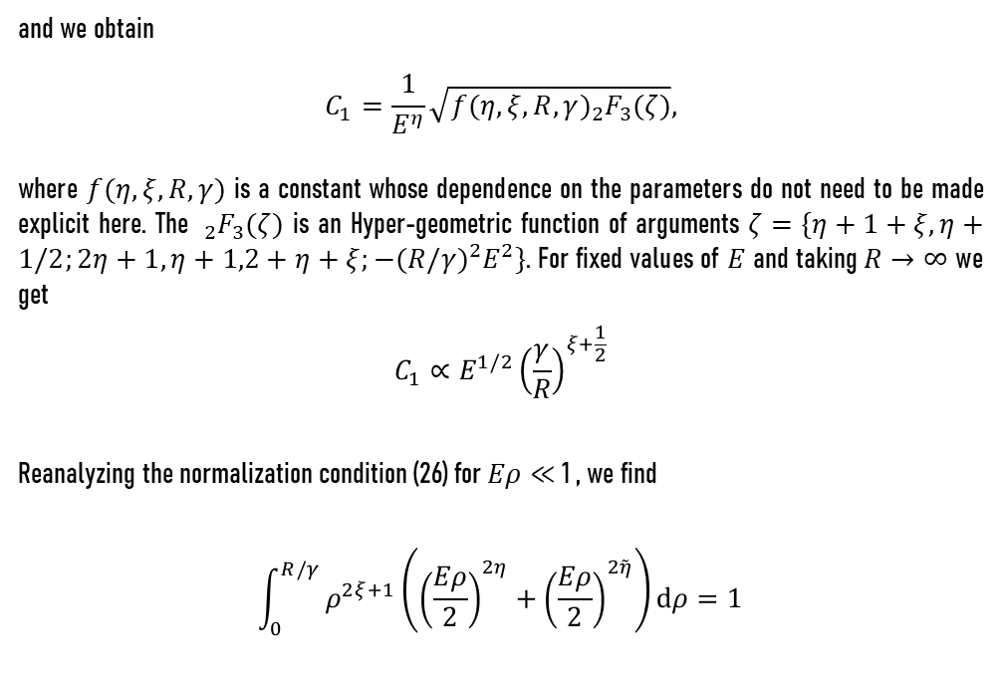
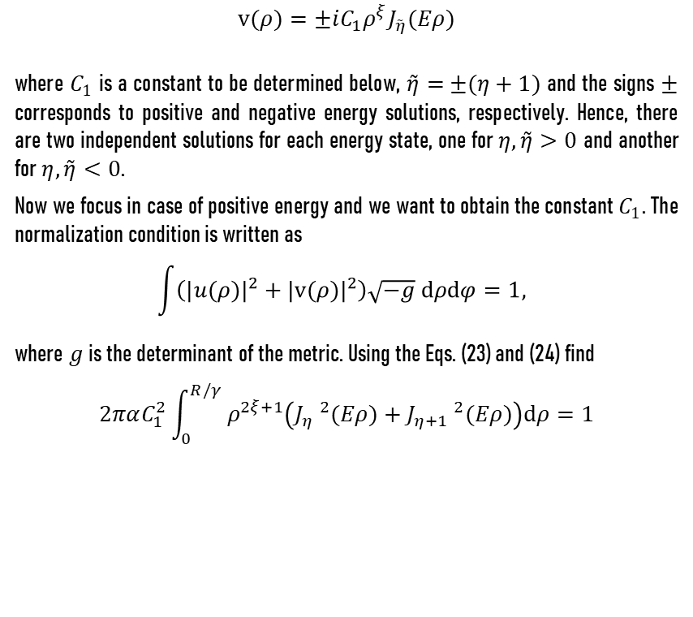
Massless fermions in disclinated planar graphene
We now specify our previous system of differential equations on massless fermions, which is the relevant case for the description of graphene. Solving for $u(ρ)$ we get
$$u(ρ)=C_{1}ρ^{ξ}J_{η}(Eρ),$$
where we consider only the Bessel function of the first kind as it is the only one finite at the origin. In this section, we use $ξ=\frac{α−1}{2α}$ and $η=±\frac{α−2l−1}{2α}$. Then $v(ρ)$ is given by
and we obtain
$$C_{1}=\frac{1}{E^{η}}\sqrt{f(η,ξ,R,γ)_{2}F_{3}(ζ)},$$
where $f(η,ξ,R,γ)$ is a constant whose dependence on the parameters do not need to be made explicit here. The $_{2}F_{3}(ζ)$ is an Hyper-geometric function of arguments $ζ=\{η+1+ξ,η+1/2;2η+1,η+1,2+$ $\left.η+ξ;−(R/γ)^{2}E^{2}\right\}$. For fixed values of $E$ and taking $R→∞$ we get
$$C_{1}∝E^{1/2}{\left(\frac{γ}{R}\right)}^{ξ+\frac{1}{2}}$$
Reanalyzing the normalization condition (26) for $Eρ≪$ 1 , we find
$$\int_{0}^{R/γ}{ }ρ^{2ξ+1}\left({\left(\frac{Eρ}{2}\right)}^{2η}+{\left(\frac{Eρ}{2}\right)}^{2\overset{˜}{η}}\right)dρ=1$$
(25)
(21)
(22)
$$v(ρ)=±iC_{1}ρ^{ξ}J_{\overset{˜}{η}}(Eρ)$$
where $C_{1}$ is a constant to be determined below, $\overset{˜}{η}=$ $±(η+1)$ and the signs $±$ corresponds to positive and negative energy solutions, respectively. Hence, there are two independent solutions for each energy state, one for $η,\overset{˜}{η}>0$ and another for $η,\overset{˜}{η}<0$.
Now we focus in case of positive energy and we want to obtain the constant $C_{1}$. The normalization condition is written as
$$\int{\left(|u(ρ)|^{2}+|v(ρ)|^{2}\right)\sqrt{−g} dρdφ=1, }$$
where $g$ is the determinant of the metric. Using the Eqs. (23) and (24) find
$$2παC_{1}^{2}\int_{0}^{R/γ}{ }ρ^{2ξ+1}\left(J_{η} ^{2}(Eρ)+J_{η+1} ^{2}(Eρ)\right)dρ=1$$
(26)
(27)
(23)
(24)
8

Slide 9
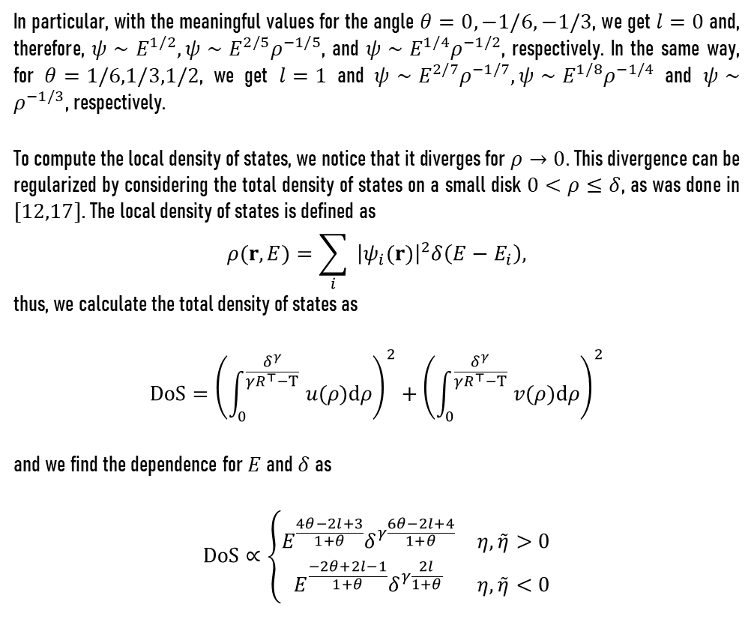
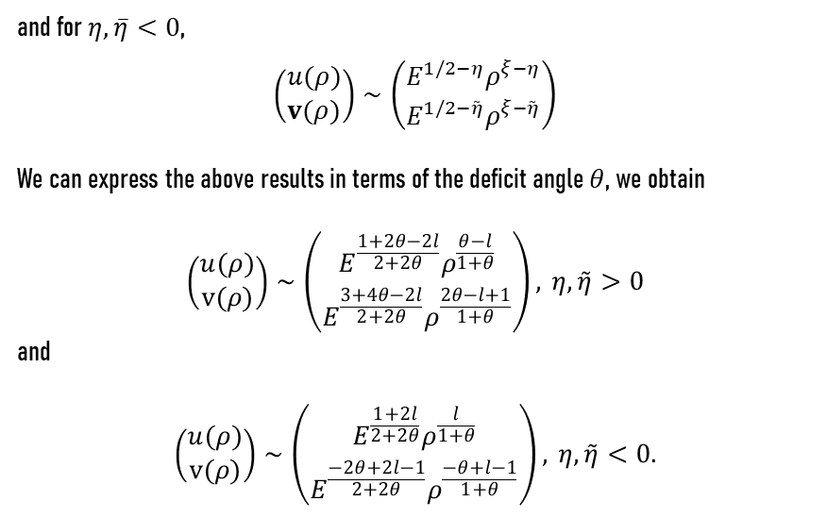
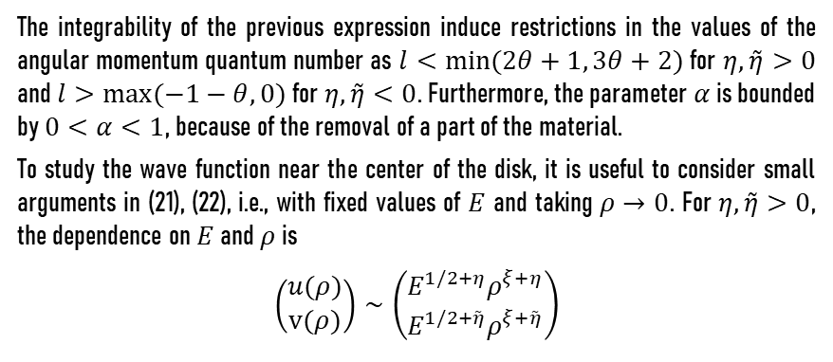
Massless fermions in disclinated planar graphene
The integrability of the previous expression induce restrictions in the values of the angular momentum quantum number as $l<min(2θ+1, 3θ+2)$ for $η,\overset{˜}{η}>0$ and $l>max(−1−θ,0)$ for $η,\overset{˜}{η}<0$. Furthermore, the parameter $α$ is bounded by $0<α<1$, because of the removal of a part of the material.
To study the wave function near the center of the disk, it is useful to consider small arguments in (21), (22), i.e., with fixed values of $E$ and taking $ρ→0$. For $η,\overset{˜}{η}>0$, the dependence on $E$ and $ρ$ is
$$\left(\begin{matrix}u(ρ) \\ v(ρ)\end{matrix}\right)∼\left(\begin{matrix}E^{1/2+η}ρ^{ξ+η} \\ E^{1/2+\overset{˜}{η}}ρ^{ξ+\overset{˜}{η}}\end{matrix}\right)$$
In particular, with the meaningful values for the angle $θ=0,−1/6,−1/3$, we get $l=0$ and, therefore, $ψ∼$ $E^{1/2},ψ∼E^{2/5}ρ^{−1/5}$, and $ψ∼E^{1/4}ρ^{−1/2}$, respectively. In the same way, for $θ=1/6,1/3,1/2$, we get $l=1$ and $ψ∼E^{2/7}ρ^{−1/7},ψ∼E^{1/8}ρ^{−1/4}$ and $ψ∼ρ^{−1/3}$, respectively.
To compute the local density of states, we notice that it diverges for $ρ→0$. This divergence can be regularized by considering the total density of states on a small disk $0<ρ≤δ$, as was done in $[12,17]$. The local density of states is defined as
$$ρ(r,E)=\sum_{i}{ }{\left|ψ_{i}(r)\right|}^{2}δ\left(E−E_{i}\right),$$
thus, we calculate the total density of states as
$$DoS={\left(\int_{0}^{\frac{δ^{γ}}{γR^{⊤}−T}}{ } u(ρ)dρ\right)}^{2}+{\left(\int_{0}^{\frac{δ^{γ}}{γR^{⊤}−T}}{ } v(ρ)dρ\right)}^{2}$$
and we find the dependence for $E$ and $δ$ as
$$DoS∝\left\{\begin{matrix}E^{\frac{4θ−2l+3}{1+θ}}δ^{γ\frac{6θ−2l+4}{1+θ}} & η,\overset{˜}{η}>0 \\ E^{\frac{−2θ+2l−1}{1+θ}}δ^{γ\frac{2l}{1+θ}} & η,\overset{˜}{η}<0\end{matrix}\right.$$
(28)
(32)
and for $η,\overset{‾}{η}<0$,
$$\left(\begin{matrix}u(ρ) \\ v(ρ)\end{matrix}\right)∼\left(\begin{matrix}E^{1/2−η}ρ^{ξ−η} \\ E^{1/2−\overset{˜}{η}}ρ^{ξ−\overset{˜}{η}}\end{matrix}\right)$$
We can express the above results in terms of the deficit angle $θ$, we obtain
$$\left(\begin{matrix}u(ρ) \\ v(ρ)\end{matrix}\right)∼\left(\begin{matrix}E^{\frac{1+2θ−2l}{2+2θ}}ρ^{\frac{θ−l}{1+θ}} \\ E^{\frac{3+4θ−2l}{2+2θ}}ρ^{\frac{2θ−l+1}{1+θ}}\end{matrix}\right), η,\overset{˜}{η}>0$$
and
$$\left(\begin{matrix}u(ρ) \\ v(ρ)\end{matrix}\right)∼\left(\begin{matrix}E^{\frac{1+2l}{2+2θ}}ρ^{\frac{l}{1+θ}} \\ E^{\frac{−2θ+2l−1}{2+2θ}}ρ^{\frac{−θ+l−1}{1+θ}}\end{matrix}\right), η,\overset{˜}{η}<0.$$
(29)
(33)
(30)
(34)
(31)
9

Slide 10
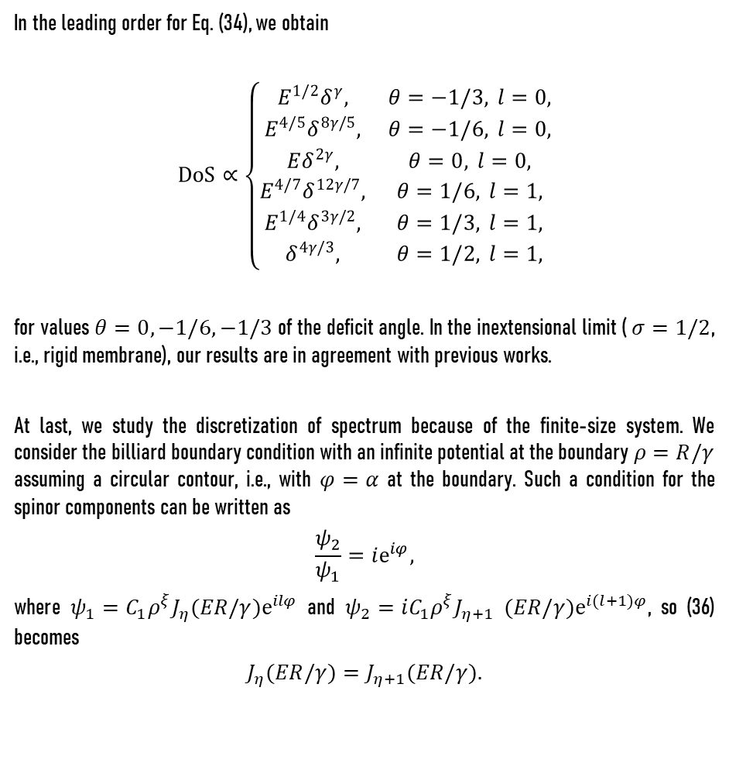
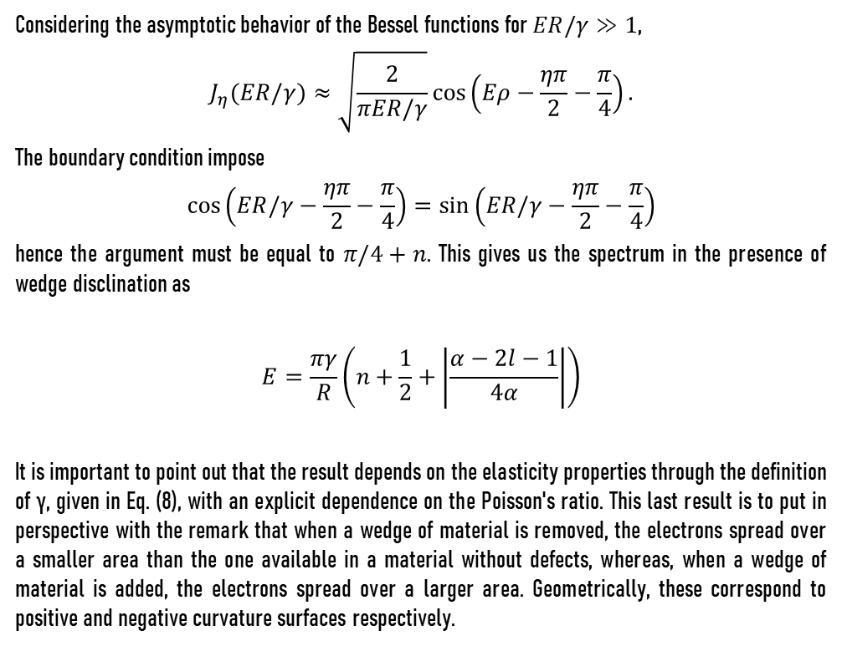
Massless fermions in disclinated planar graphene
In the leading order for Eq. (34), we obtain
$$DoS∝\left\{\begin{matrix}E^{1/2}δ^{γ}, & θ=−1/3, l=0, \\ E^{4/5}δ^{8γ/5}, & θ=−1/6, l=0, \\ Eδ^{2γ}, & θ=0, l=0, \\ E^{4/7}δ^{12γ/7}, & θ=1/6, l=1, \\ E^{1/4}δ^{3γ/2}, & θ=1/3, l=1, \\ δ^{4γ/3}, & θ=1/2, l=1,\end{matrix}\right.$$
for values $θ=0,−1/6,−1/3$ of the deficit angle. In the inextensional limit ( $σ=1/2$, i.e., rigid membrane), our results are in agreement with previous works.
At last, we study the discretization of spectrum because of the finite-size system. We consider the billiard boundary condition with an infinite potential at the boundary $ρ=R/γ$ assuming a circular contour, i.e., with $φ=α$ at the boundary. Such a condition for the spinor components can be written as
$$\frac{ψ_{2}}{ψ_{1}}=ie^{iφ},$$
where $ψ_{1}=C_{1}ρ^{ξ}J_{η}(ER/γ)e^{ilφ}$ and $ψ_{2}=iC_{1}ρ^{ξ}J_{η+1}$ $(ER/γ)e^{i(l+1)φ}$, so (36) becomes
$$J_{η}(ER/γ)=J_{η+1}(ER/γ).$$
Considering the asymptotic behavior of the Bessel functions for $ER/γ≫1$,
$$J_{η}(ER/γ)≈\sqrt{\frac{2}{πER/γ}}cos\left(Eρ−\frac{ηπ}{2}−\frac{π}{4}\right).$$
The boundary condition impose
$$cos\left(ER/γ−\frac{ηπ}{2}−\frac{π}{4}\right)=sin\left(ER/γ−\frac{ηπ}{2}−\frac{π}{4}\right)$$
hence the argument must be equal to $π/4+n$. This gives us the spectrum in the presence of wedge disclination as
$$E=\frac{πγ}{R}\left(n+\frac{1}{2}+\left|\frac{α−2l−1}{4α}\right|\right)$$
It is important to point out that the result depends on the elasticity properties through the definition of γ, given in Eq. (8), with an explicit dependence on the Poisson's ratio. This last result is to put in perspective with the remark that when a wedge of material is removed, the electrons spread over a smaller area than the one available in a material without defects, whereas, when a wedge of material is added, the electrons spread over a larger area. Geometrically, these correspond to positive and negative curvature surfaces respectively.
(38)
(35)
(39)
(40)
(36)
(37)
10

Slide 11
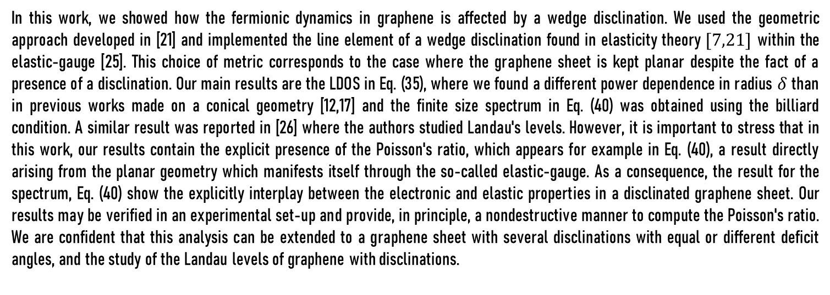
CONCLUSIONS
In this work, we showed how the fermionic dynamics in graphene is affected by a wedge disclination. We used the geometric approach developed in [21] and implemented the line element of a wedge disclination found in elasticity theory $[7,21]$ within the elastic-gauge [25]. This choice of metric corresponds to the case where the graphene sheet is kept planar despite the fact of a presence of a disclination. Our main results are the LDOS in Eq. (35), where we found a different power dependence in radius $δ$ than in previous works made on a conical geometry [12,17] and the finite size spectrum in Eq. (40) was obtained using the billiard condition. A similar result was reported in [26] where the authors studied Landau's levels. However, it is important to stress that in this work, our results contain the explicit presence of the Poisson's ratio, which appears for example in Eq. (40), a result directly arising from the planar geometry which manifests itself through the so-called elastic-gauge. As a consequence, the result for the spectrum, Eq. (40) show the explicitly interplay between the electronic and elastic properties in a disclinated graphene sheet. Our results may be verified in an experimental set-up and provide, in principle, a nondestructive manner to compute the Poisson's ratio. We are confident that this analysis can be extended to a graphene sheet with several disclinations with equal or different deficit angles, and the study of the Landau levels of graphene with disclinations.
11

Slide 12
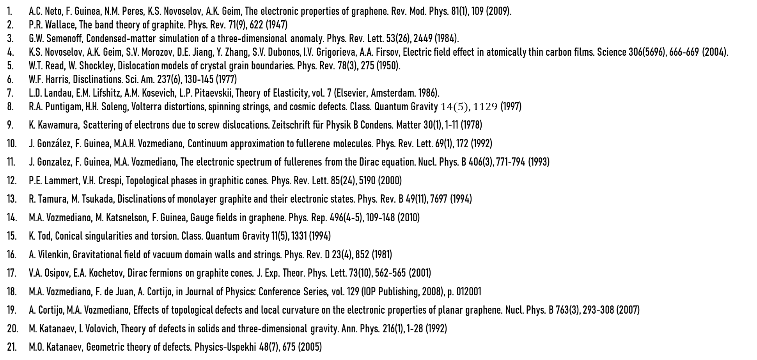
References
A.C. Neto, F. Guinea, N.M. Peres, K.S. Novoselov, A.K. Geim, The electronic properties of graphene. Rev. Mod. Phys. 81(1), 109 (2009).
P.R. Wallace, The band theory of graphite. Phys. Rev. 71(9), 622 (1947)
G.W. Semenoff, Condensed-matter simulation of a three-dimensional anomaly. Phys. Rev. Lett. 53(26), 2449 (1984).
K.S. Novoselov, A.K. Geim, S.V. Morozov, D.E. Jiang, Y. Zhang, S.V. Dubonos, I.V. Grigorieva, A.A. Firsov, Electric field effect in atomically thin carbon films. Science 306(5696), 666-669 (2004).
W.T. Read, W. Shockley, Dislocation models of crystal grain boundaries. Phys. Rev. 78(3), 275 (1950).
W.F. Harris, Disclinations. Sci. Am. 237(6), 130-145 (1977)
L.D. Landau, E.M. Lifshitz, A.M. Kosevich, L.P. Pitaevskii, Theory of Elasticity, vol. 7 (Elsevier, Amsterdam. 1986).
R.A. Puntigam, H.H. Soleng, Volterra distortions, spinning strings, and cosmic defects. Class. Quantum Gravity $14(5),1129$ (1997)
K. Kawamura, Scattering of electrons due to screw dislocations. Zeitschrift für Physik B Condens. Matter 30(1), 1-11 (1978)
J. González, F. Guinea, M.A.H. Vozmediano, Continuum approximation to fullerene molecules. Phys. Rev. Lett. 69(1), 172 (1992)
J. Gonzalez, F. Guinea, M.A. Vozmediano, The electronic spectrum of fullerenes from the Dirac equation. Nucl. Phys. B 406(3), 771-794 (1993)
P.E. Lammert, V.H. Crespi, Topological phases in graphitic cones. Phys. Rev. Lett. 85(24), 5190 (2000)
R. Tamura, M. Tsukada, Disclinations of monolayer graphite and their electronic states. Phys. Rev. B 49(11), 7697 (1994)
M.A. Vozmediano, M. Katsnelson, F. Guinea, Gauge fields in graphene. Phys. Rep. 496(4-5), 109-148 (2010)
K. Tod, Conical singularities and torsion. Class. Quantum Gravity 11(5), 1331 (1994)
A. Vilenkin, Gravitational field of vacuum domain walls and strings. Phys. Rev. D 23(4), 852 (1981)
V.A. Osipov, E.A. Kochetov, Dirac fermions on graphite cones. J. Exp. Theor. Phys. Lett. 73(10), 562-565 (2001)
M.A. Vozmediano, F. de Juan, A. Cortijo, in Journal of Physics: Conference Series, vol. 129 (IOP Publishing, 2008), p. 012001
A. Cortijo, M.A. Vozmediano, Effects of topological defects and local curvature on the electronic properties of planar graphene. Nucl. Phys. B 763(3), 293-308 (2007)
M. Katanaev, I. Volovich, Theory of defects in solids and three-dimensional gravity. Ann. Phys. 216(1), 1-28 (1992)
M.O. Katanaev, Geometric theory of defects. Physics-Uspekhi 48(7), 675 (2005)
12

Slide 13
References
K. Kondo, in Proceedings of the 2nd Japan National Congress for Applied Mechanics, vol. 2 (1952), pp. 41-47.
B.A. Bilby, R. Bullough, E. Smith, Continuous distributions of dislocations: a new application of the methods of non-Riemannian geometry. Proc. R. Soc. Lond. Ser. A Math. Phys. Sci. 231(1185), 263-273 (1955).
E. Kröner, Continuum theory of defects, in Physics of Defects (Les Houches, Session 35), ed. by R. Balian et al. (North-Holland, Amsterdam, 1980).
M.O. Katanaev, Wedge dislocation in the geometric theory of defects. Theor. Math. Phys. 135(2), 733-744 (2003).
C. Furtado, B.G. da Cunha, F. Moraes, E.B. de Mello, V. Bezzerra, Landau levels in the presence of disclinations. Phys. Lett. A 195(1), 90-94 (1994).
C. Furtado, F. Moraes, On the binding of electrons and holes to disclinations. Phys. Lett. A 188(4-6), 394-396 (1994).
H.I. Arcos, J.G. Pereira, Torsion gravity: a reappraisal. Int. J. Mod. Phys. D 13(10), 2193-2240 (2004).
S. Bahamonde, K. Dialektopoulos, C. Escamilla-Rivera, G. Farrugia, V. Gakis, M. Hendry, M. Hohmann, J. Said, J. Mifsud, E. Di Valentino, Teleparallel gravity: from theory to cosmology. Reports on Progress in Physics (2021).
13

Slide 14
¡THANK YOU!

