Slide 1
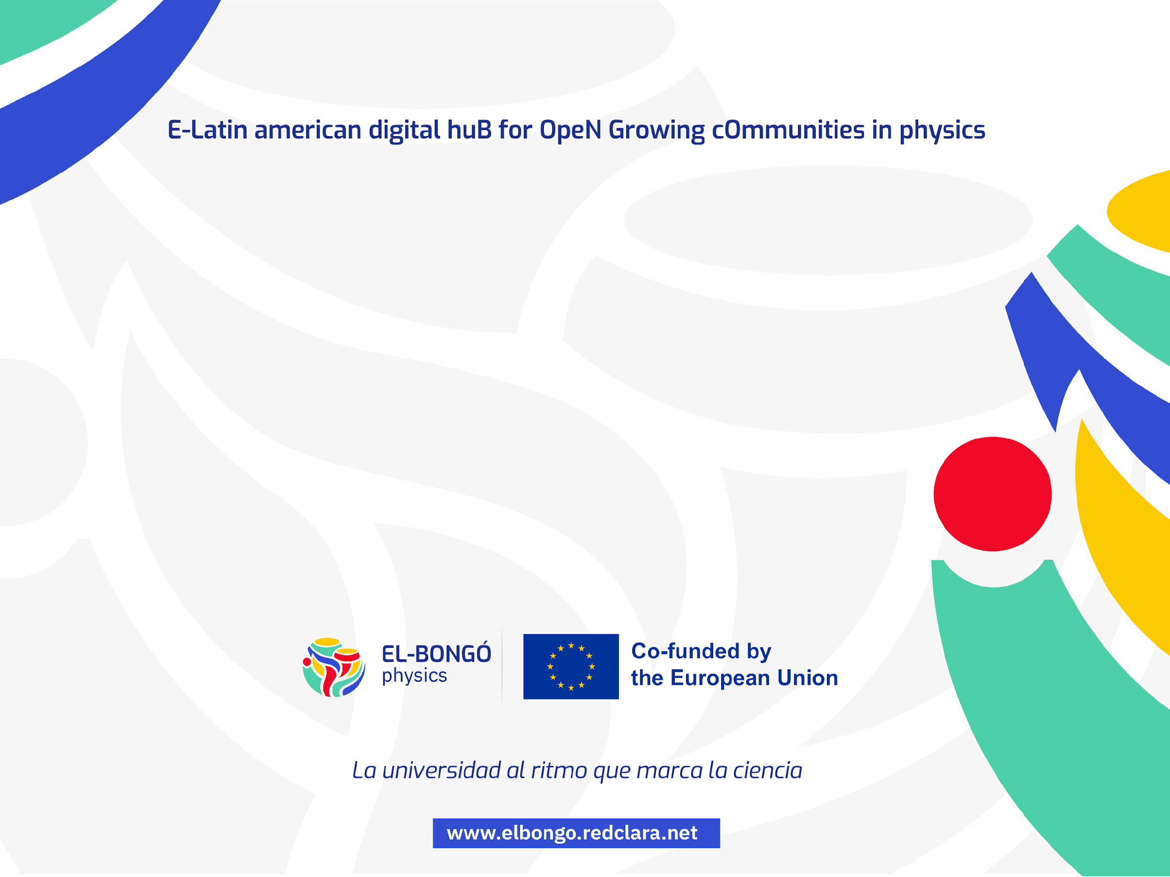
Ciencia abierta
Un compromiso entre la disciplina y la facilidad
Luis A. Núñez
Escuela de Física
Universidad Industrial de Santander

Slide 2

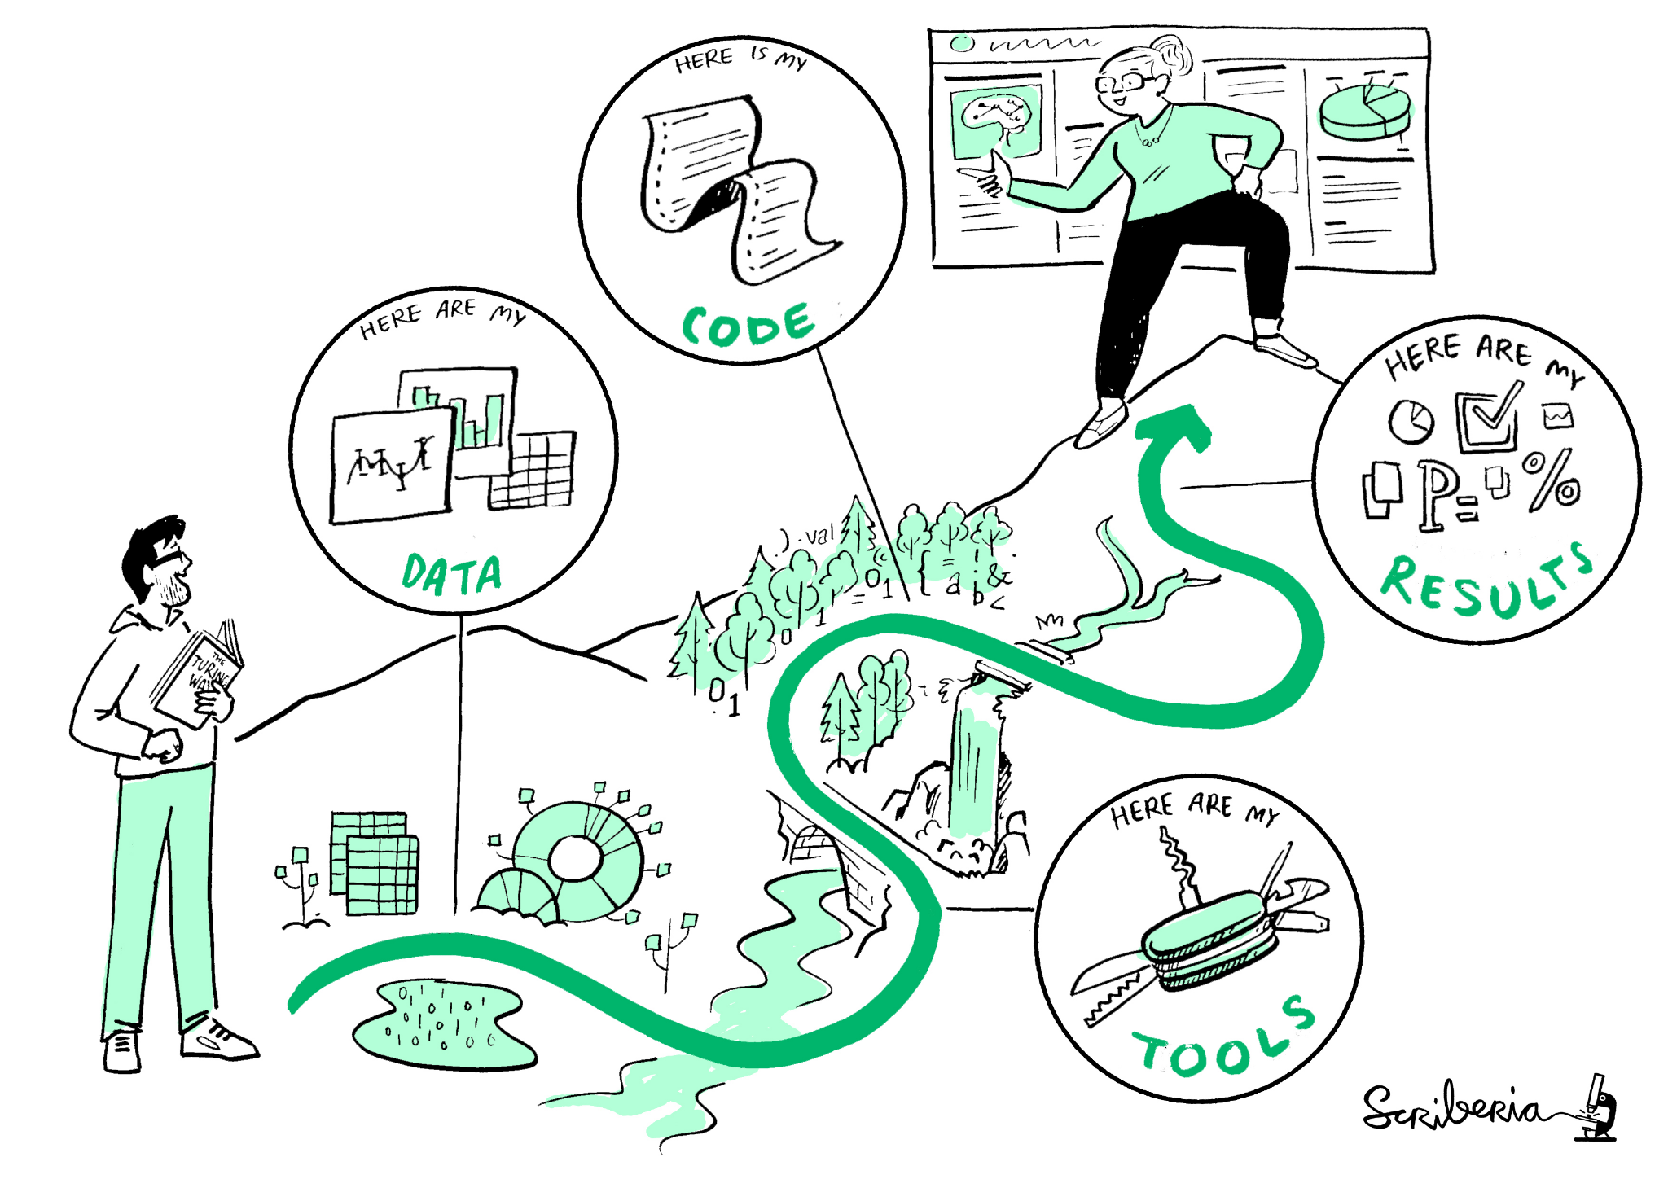
Ciencia abierta = Ciencia Reproducible
Reproducible
Replicable
Repetible
‹#›

Slide 3




The FAIR paradigm
Findability
Accessibility
Interoperability
Reusability
discoverable, identifiable and locatable by means of a standard identification mechanism
PiD, Metadata
always available and obtainable; even if the data is restricted, the metadata is open
Cloud storage
syntactically parseable and semantically understandable, allowing data exchange and reuse
Vocabulary
described and shared with the least restrictive licences, allowing the widest reuse possible
Harversters, copyleft

Slide 4
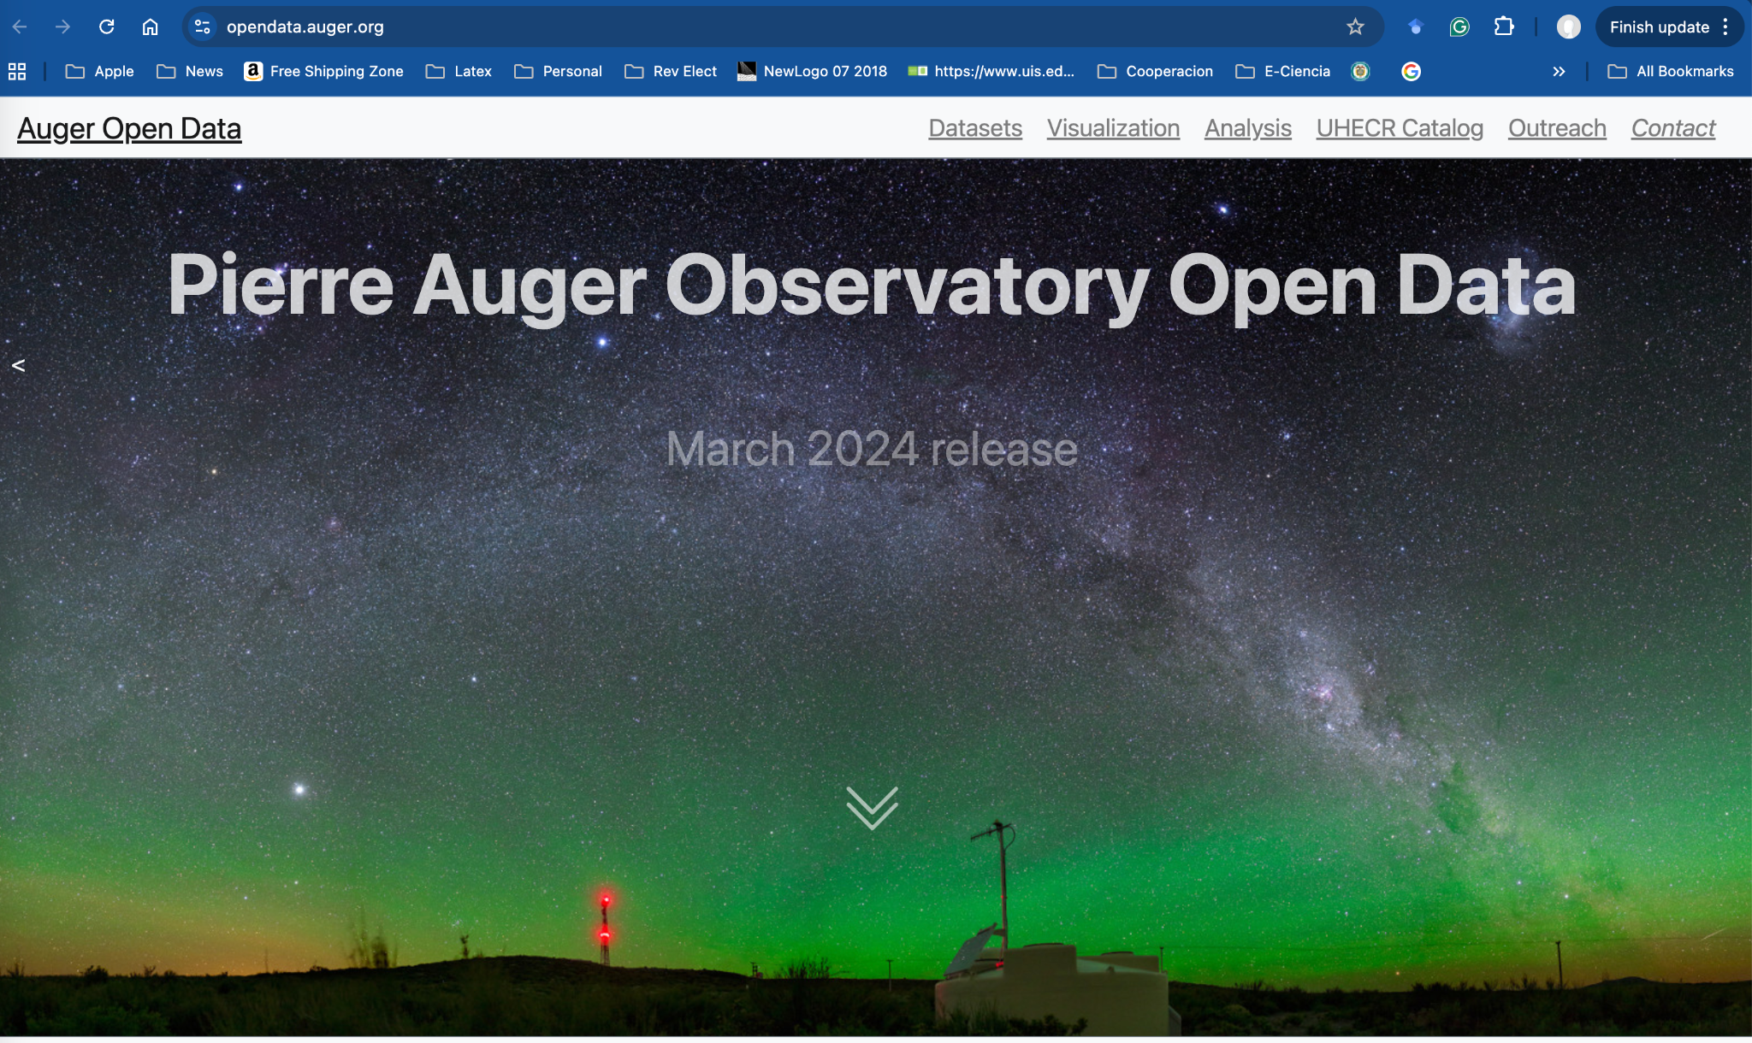
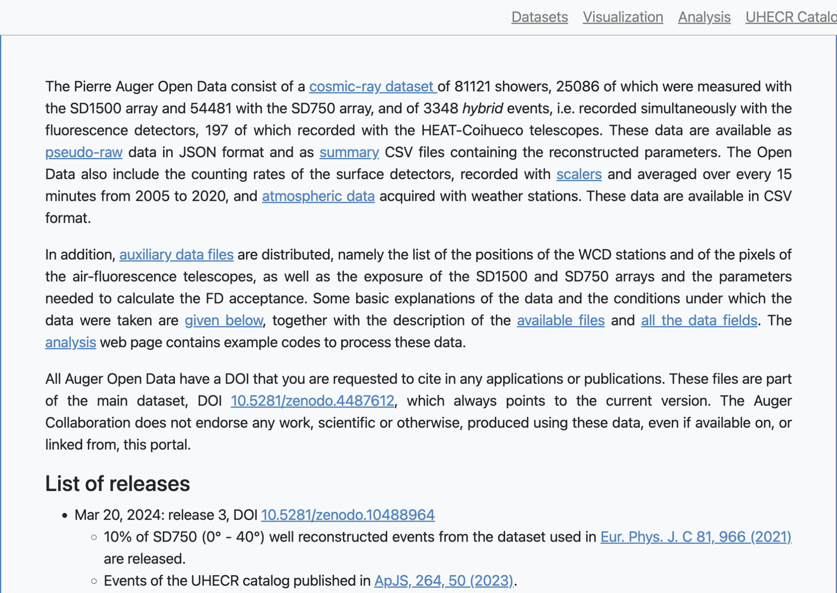
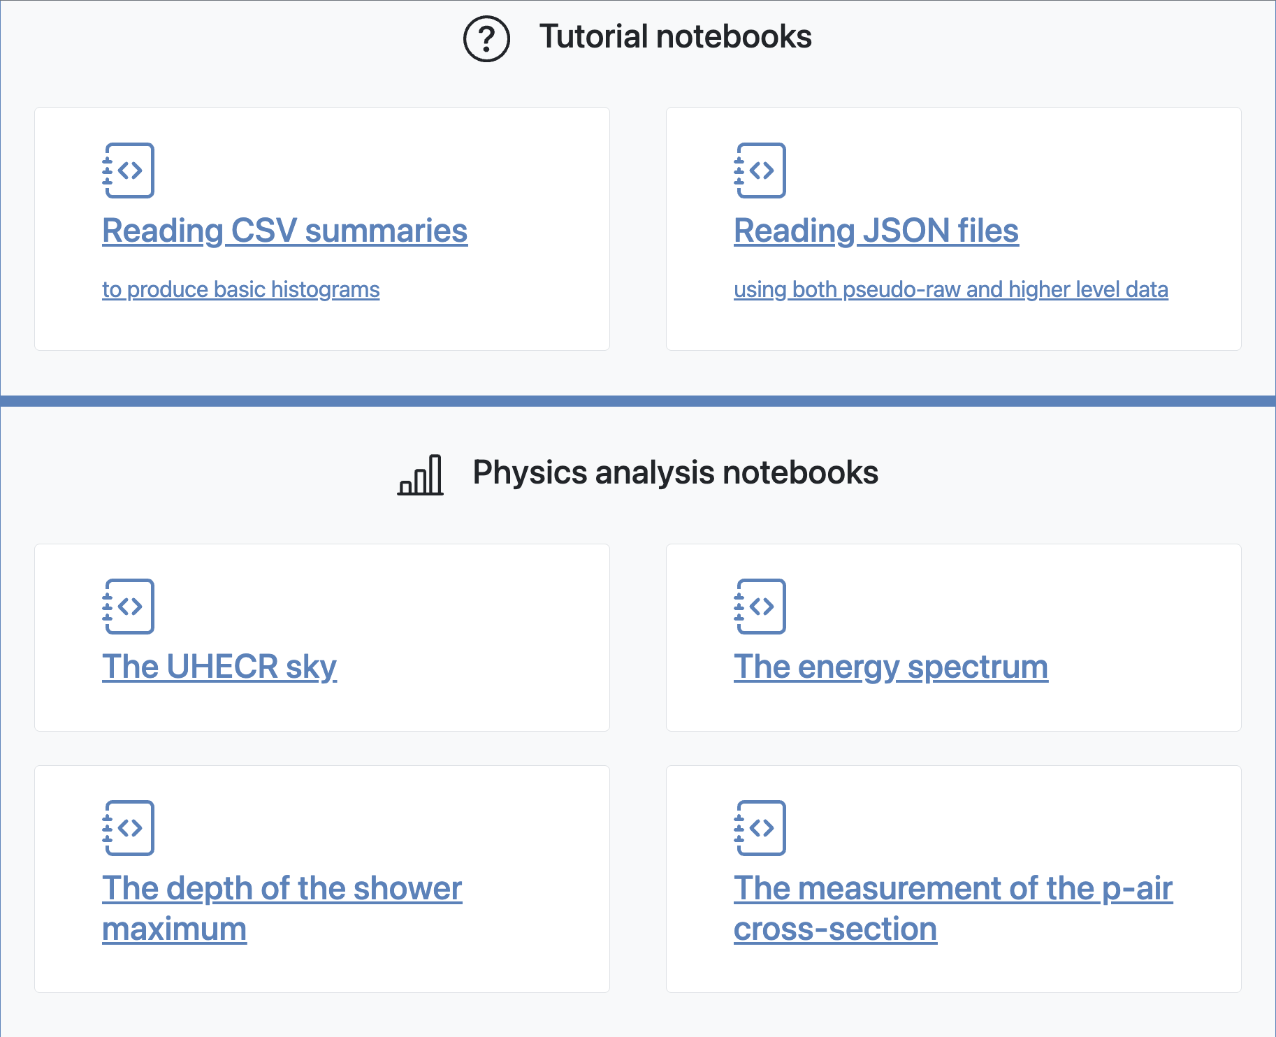
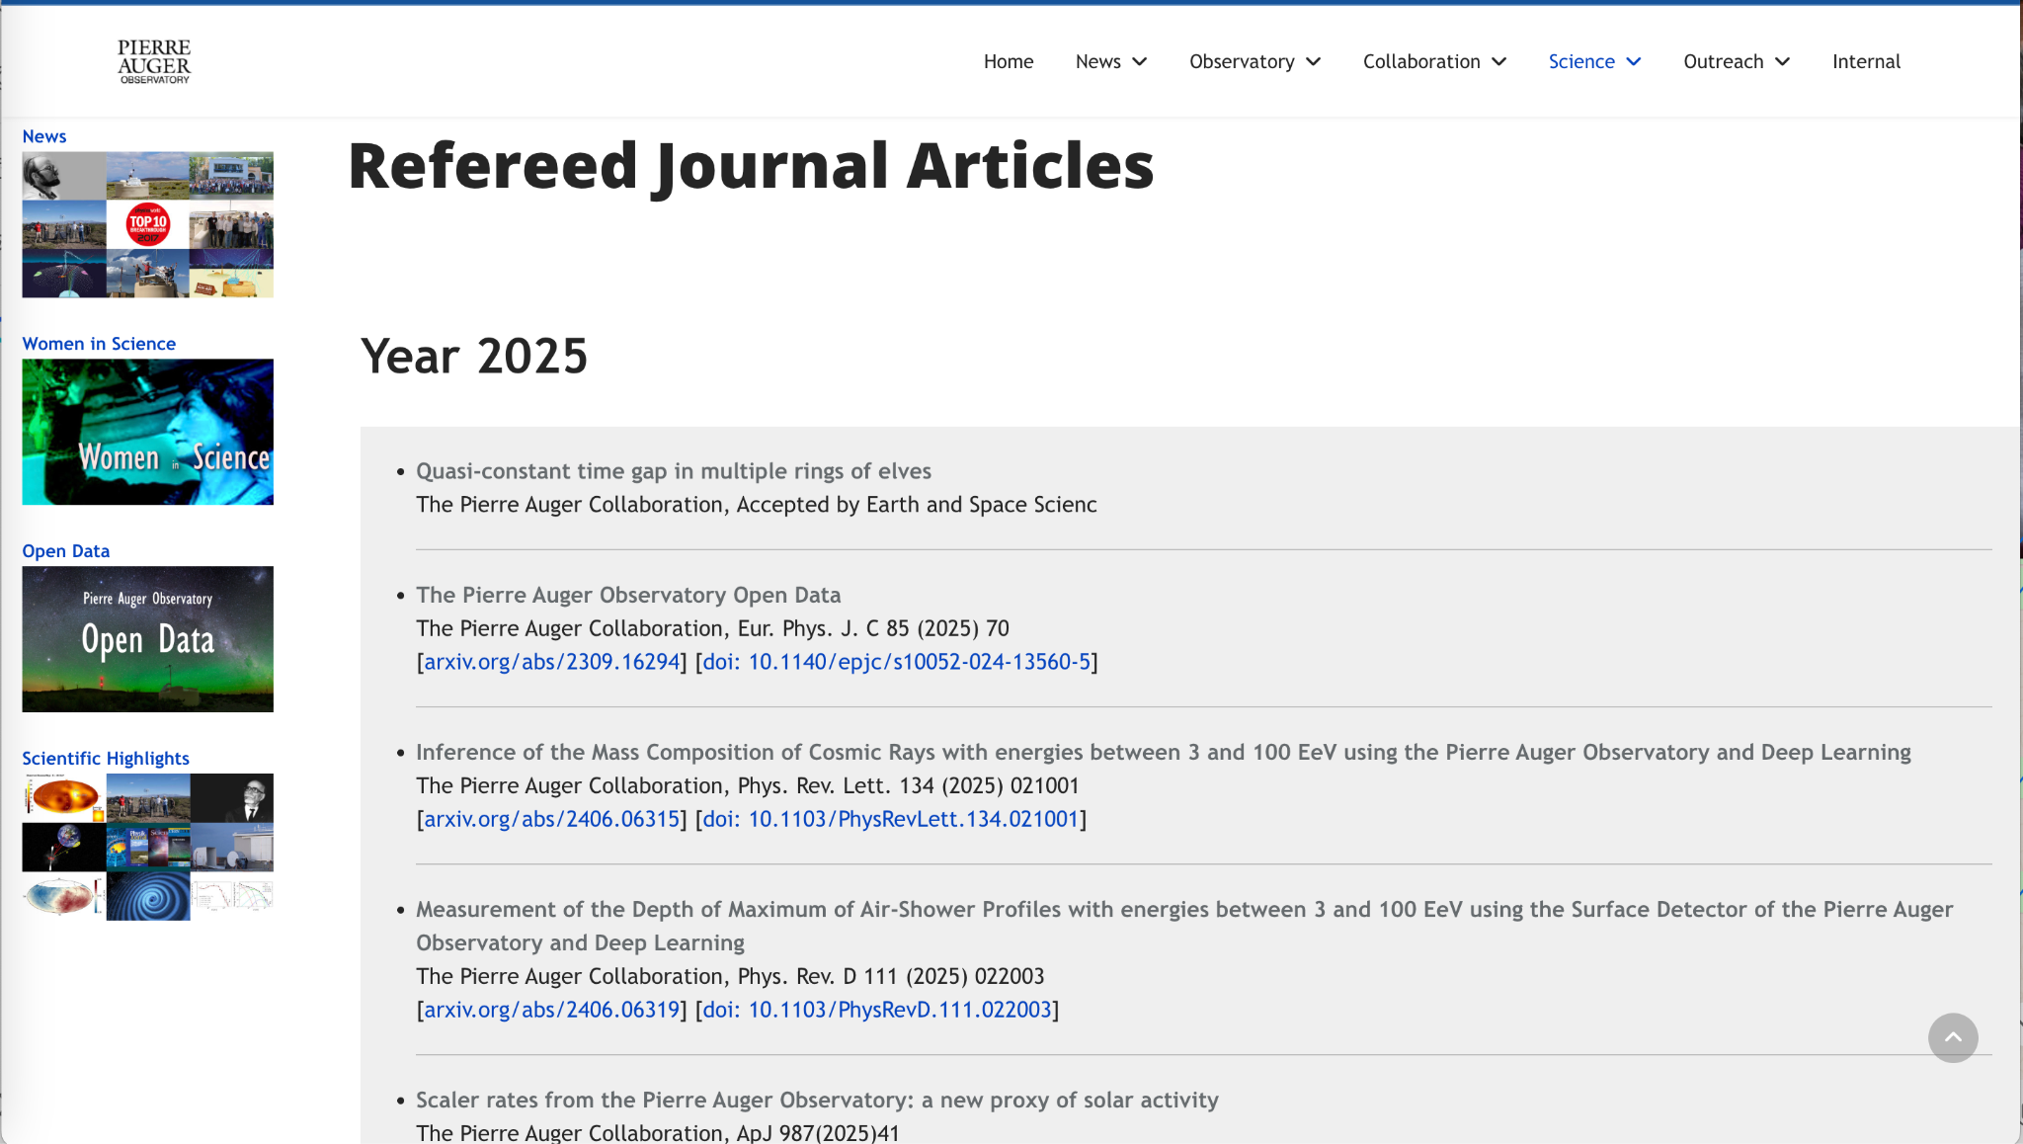

Slide 5
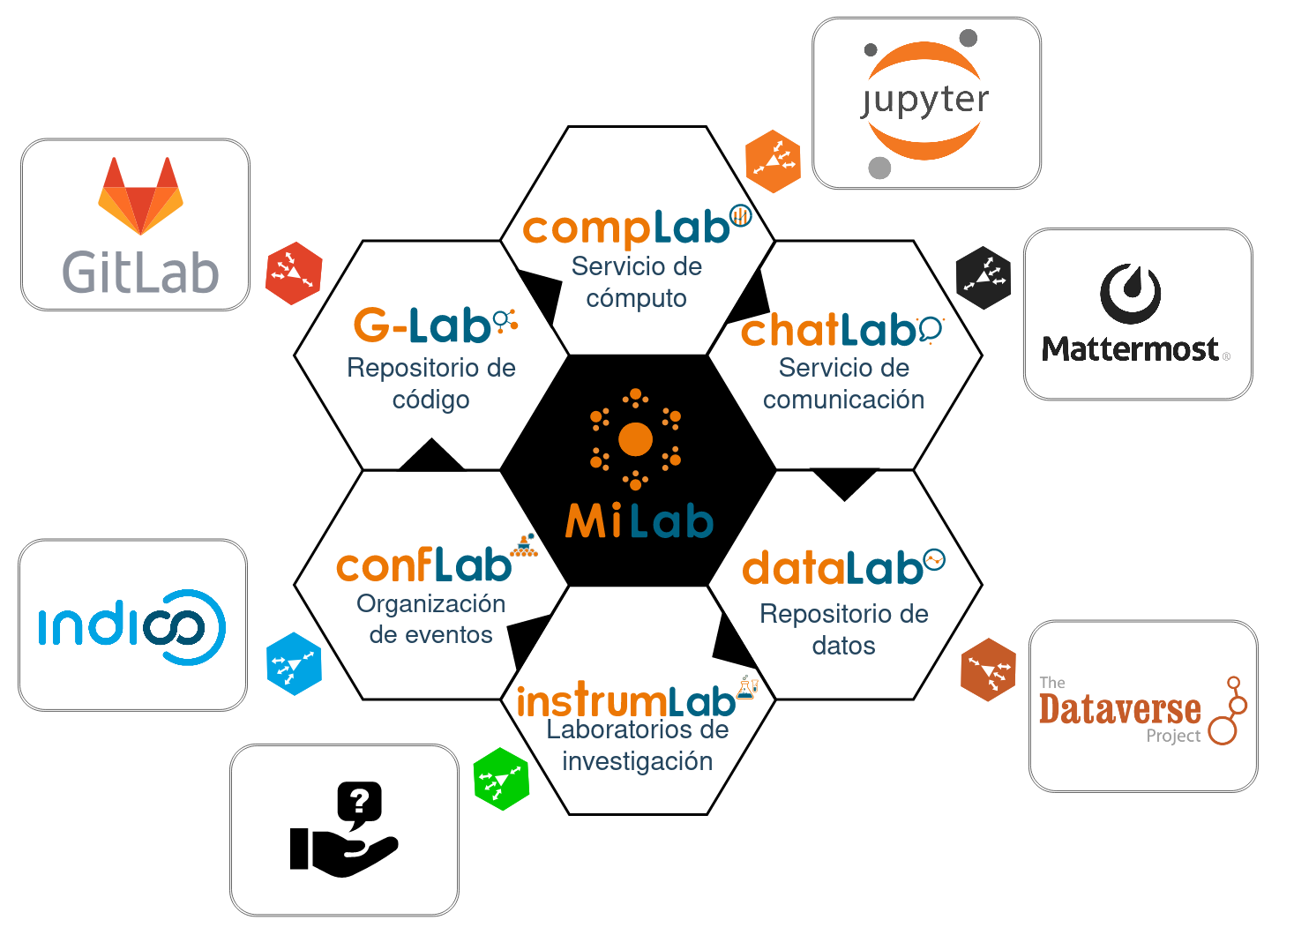
MiLab: una plataforma para la gestión de ciencia abierta
Plataforma como servicio en la nube para apoyar a pequeños/medianos grupos de investigación asociados a RedClara en la gestión de:
Datos de investigación
Códigos computacionales
Entornos de cómputo
Comunicación
Visibilidad web

Slide 6
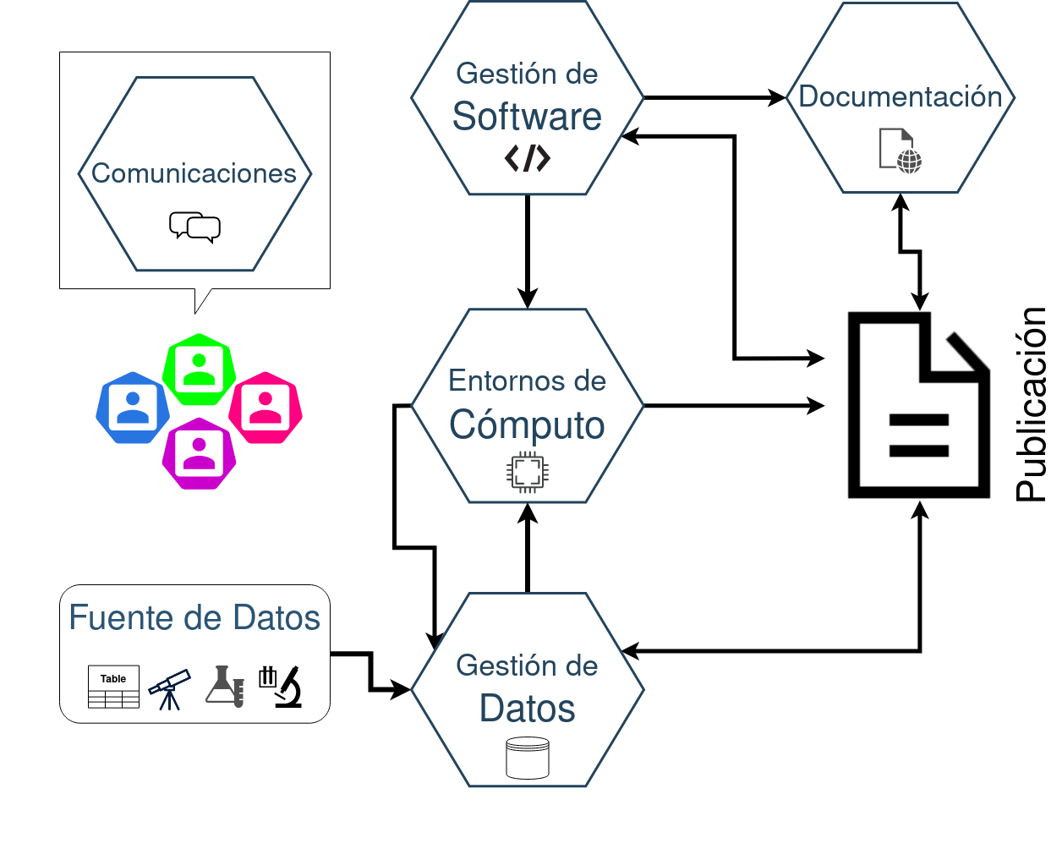

Slide 7





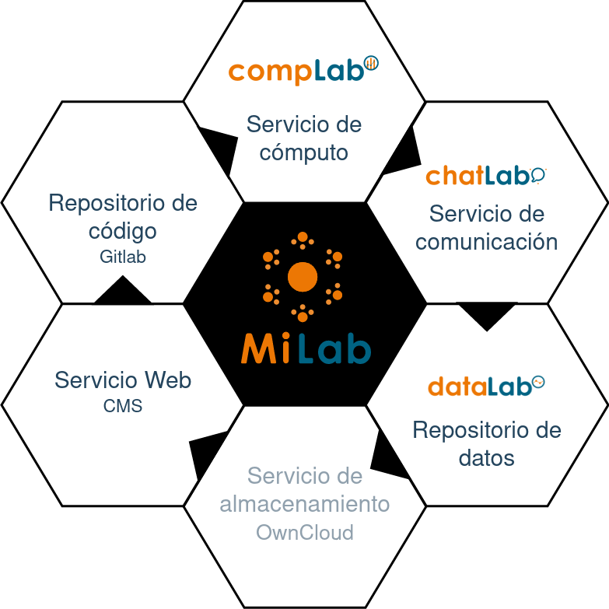


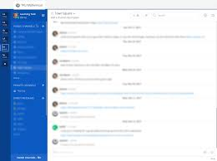





Professional platform for courses
Content y Access
Class n
Course 1
Repository Git
Admin
GitLab
Videos
carpetas
Text
Class 1
Class 2
Class 4
Class 5
Class 6
Class n
Platform LA-CoNGA
Data
Push/Pull
Push/Pull
Computations
Repository
Git Prof
Repository
Git Prof
Instruments
VideoConf
Push/Pull
Instant messaging
Repository
Git Student
Repository
Git Student
Repository
Git Student

Slide 8





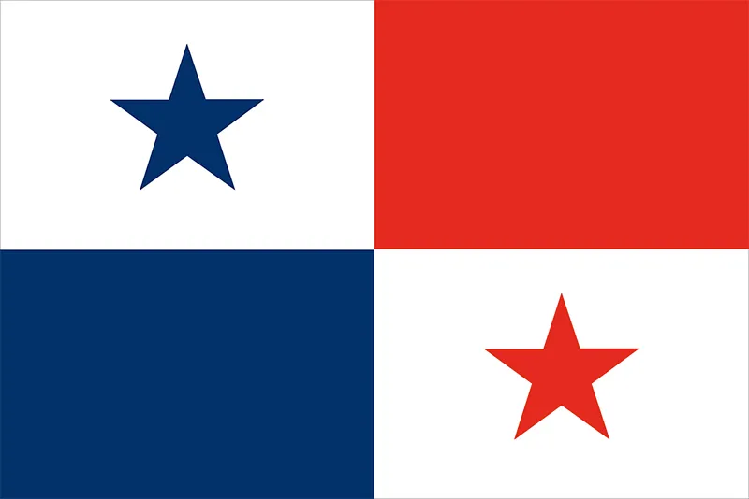










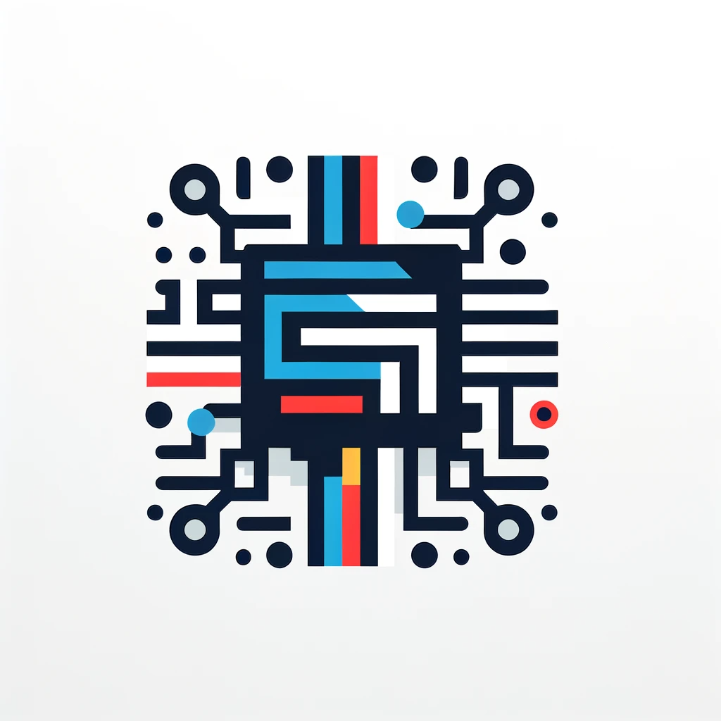


EL-BONGO Physics: E-Latin america digital huB for OpeN Growing cOmmunities in physics
Space Weather Astronomy
Courses
Workshops
Data
Codes
Publications
Chats
Visualizations
Seismology
Courses
Workshops
Data
Codes
Publications
Chats
Visualizations
Re
Re
Conf-Lab
Conf-Lab
Instrum-Lab
Instrum-Lab
USC(GT), UIS(CO), UCV(VE), UMG(GT), USFQ(EC), UPC(FR), UNMSM (PE)
Inter Community
Open Science Hub
UES(SV), UIS(CO), USB(VE), USC(GT), UNMSM(PE)
AI-HPC Tools
High Energy Physics
Courses
Workshops
Data
Codes
Publications
Chats
Visualizations
Re
Re
Courses
Workshops
Data
Codes
Publications
Chats
Visualizations
Conf-Lab
Conf-Lab
Instrum-Lab
Instrum-Lab
USal(ES), UIS, ULyon, UFG(SV), UNMSM(PE), UP(PA)
UNAH (HN), USC(GT), UPC(FR), UPS(FR), USFQ(EC), UNI(PE), UAN(CO)

Slide 9
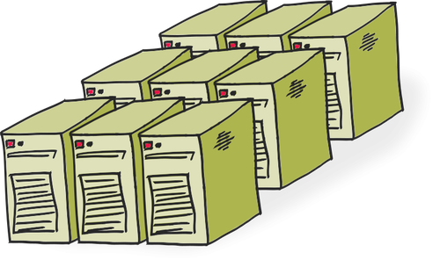






MiLAB
Science Gateway
Research
Group
Researcher

Slide 10

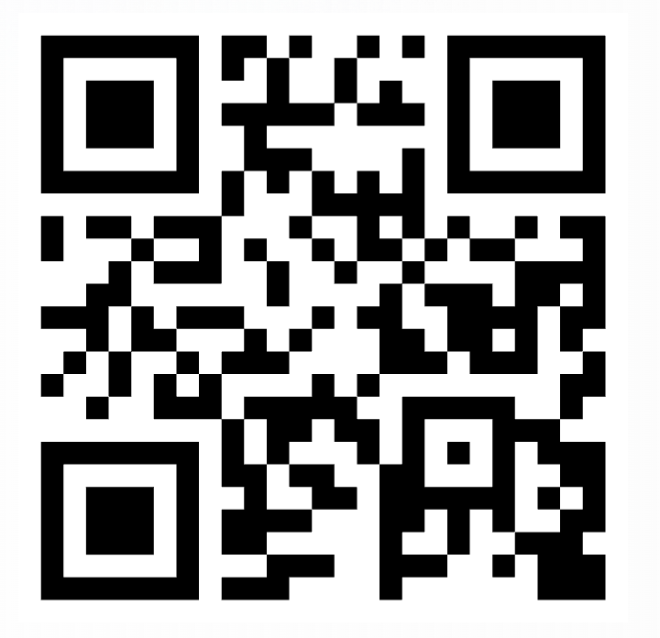
Gracias

